Slide 1


ASSOCIATION BETWEEN TYPE-2 DIABETES AND CANCER RISK: AN UMBRELLA ANALYSIS OF OBSERVATIONAL STUDIES
PRESENTED BY: MUHAMMAD FAHEEM
EVENT: Datafest 2025
DATE: NOVEMBER 2025
DEPARTMENT OF MATHEMATICS & STATISTICS
THE UNIVERSITY OF HARIPUR, KHYBER PAKHTUNKHWA,
PAKISTAN.

Slide 2
Presentation Outline
Introduction
Problem Statement
Significance of Research
Objectives
Research Methodology
Results and Discussion
Conclusion
References

Slide 3
Introduction
Cancer
Cancer is a disease in which some cells in the body grow uncontrollably and spread to other parts of the body.
In 2022, there were an estimated 20 million new cancer cases diagnosed globally.
Approximately 9.7 million cancer-related deaths occurred in 2022.
Type-2 Diabetes
A condition where the body can't use insulin properly, causing high blood sugar.
Type-2 diabetes (T2D) affects 462 million people worldwide, or 6.28 percent of the world's population.
According to the International Diabetes Federation (IDF), by 2045, 783 millions people will have diabetes.

Slide 4
Problem Statement
Despite the growing body of research, there is still a lack of comprehensive
reviews that assess the global association between Type-2 Diabetes and cancer.
This gap in synthesized evidence limits our ability to fully understand the
magnitude and nature of this relationship.
Significance of Research
This research seeks to fill a critical gap by providing an umbrella review of
existing meta-analyses on T2D and cancer. The findings will help inform public
health policies, guide cancer prevention efforts, and improve disease
management strategies in diabetic populations.

Slide 5
Objectives
To examine the global prevalence of T2D and cancer risk.
Finding underlying cancer risk factors in individuals with T2D.
To investigate the trend over period between T2D and cancer.

Slide 6
Research Methodology
Umbrella-Analysis
Umbrella analysis is a review approach that combines findings from multiple meta-analyses on one topic to give a broader, high-level summary of the available evidence.
It is commonly used in medical research to find stronger, clearer conclusions.
Random effect model
A random effects model is a statistical technique used in meta-analysis to estimate the impact size of a treatment or intervention across multiple studies due to significant heterogeneity.
Heterogeneity
Heterogeneity in meta-analyses refers to the variation in study results, influenced by factors like research designs, population characteristics, and measures.
Subgroup Analysis
Subgroup analysis is a vital component of meta-analyses, examining the significant differences in pooled effect sizes between subgroups of studies.
Meta-regression
The graph provides a quick summary of the data from the several studies that made up the meta-analysis, along with an estimate of the final findings.
Forest Plot
The graph summarizes data from multiple studies in the meta-analysis and estimates the final findings.
Funnel plot
The relationship between a study's precision and effect size is displayed using a funnel plot.

Slide 7
Inclusion and Exclusion Criteria
Inclusion
Meta-analyses or systematic reviews of epidemiological human studies only.
Those which performed a systematic search for relevant research.
Those in which T2D was the main exposure of interest.
Those which examined the association between T2D and cancer incidence.
Written in English.
Exclusion
Randomized controlled trials (RCTs) were excluded.
Studies in which T2D was not the primary exposure (e.g., T1D, gestational diabetes, diabetic complications).
Studies in which cancer incidence or mortality was not the primary outcome.
Meta-analyses of prognostic studies of T2D and mortality in cancer patients.

Slide 8
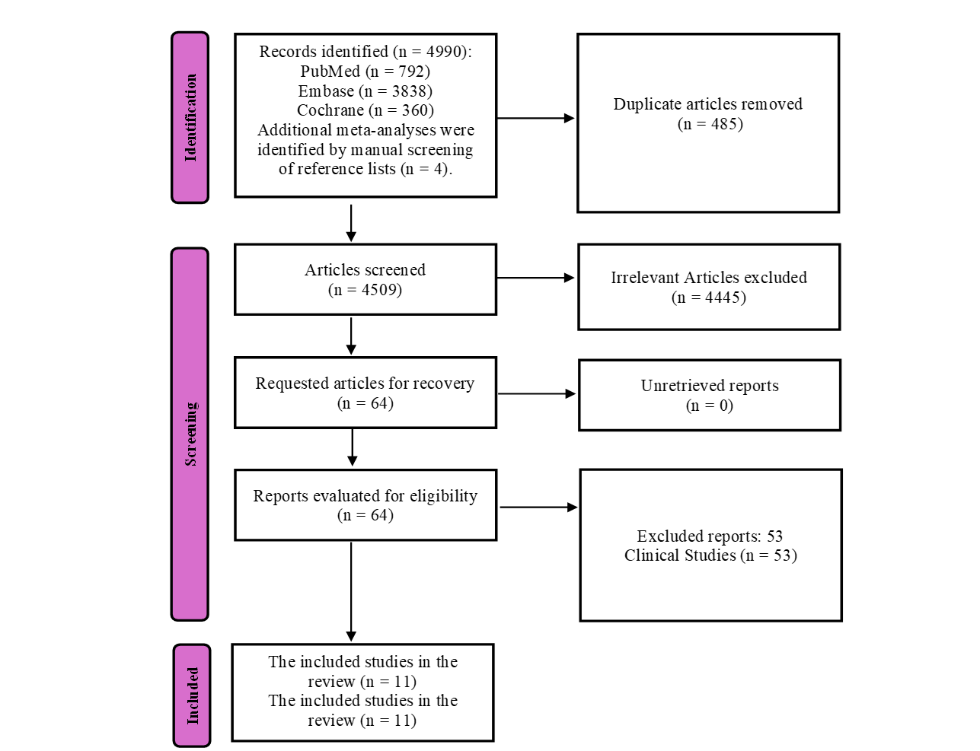

Results & Discussion:
A total of 4994 records were identified through databases and manual search. After removing duplicates and ineligible studies, 11 meta-analysis papers were finally included in this umbrella analysis. The analysis was performed using R software (4.4.2).
Prisma Flow Chart for Inclusion and Exclusion of Studies

Slide 9
General Characteristics of Studies Selected in the Umbrella Analysis (n=11).
S.no | Author | Association Diabeteswith | Year | Studies | Cancer Events | Total Population | I-square | Random Effects | Gender | p-value | Study Design
1 | Kramer et al. [37] | Colorectal cancer | 2011 | 29 | 107089 | 4144874 | NA | RR = 1.31 (95% CI = 1.23-1.39) | Both | p < 0.05 | case-control and cohort
2 | Boyle et al. [38] | Breast cancer | 2012 | 39 | 56138 | NA | 0.74 | RR = 1.27 (95% CI = 1.16-1.39) | Both | p < 0.01 | case-control and cohort
3 | Yang et al. [39] | Gallbladder cancer | 2013 | 23 | 6413 | 5463339 | 0.94 | RR = 1.68 (95% CI = 1.32-2.13) | Both | p < 0.01 | case-control and cohort
4 | Xu et al. [40] | Prostate cancer | 2013 | 45 | 157407 | 1505878 | 0.78 | RR = 0.84 (95% CI = 0.78-0.91) | Both | p < 0.01 | case-control and cohort
5 | Gu et al. [41] | Gallbladder cancer | 2015 | 20 | 4106 | 4100000 | 0.435 | RR = 1.56 (95% CI = 1.36-1.79) | Both | p < 0.010 | case-control and cohort
6 | Guraya [42] | Colorectal cancer | 2015 | 8 | 5229 | 114252 | 0.92 | RR = 1.21 (95% CI = 1.02-1.42) | Both | p < 0.00001 | cohort studies
7 | Wu et al. [43] | Overall nut consumption | 2015 | 36 | 30708 | 2119718 | 0.742 | RR = 0.98 (95% CI = 0.84-1.14) | Both | p < 0.004 | case-control and cohort
8 | Yan et al. [70] | Head and Neck cancer | 2021 | 27 | 51496 | 1456902 | 0.832 | RR = 1.04 (95% CI = 0.88-1.23) | Both | NA | case-control and cohort
9 | Zhang et al. [71] | Breast cancer | 2021 | 17 | 6115 | 73816 | 0.643 | OR = 1.19 (95% CI = 1.04-1.36) | Women | p < 0.012 | case-control study
10 | Zeng et al. [72] | Colorectal cancer | 2022 | 4 | 3402 | 271024 | 0.579 | HR = 1.21 (95% CI = 1.11-1.31) | Women | NA | cohort studies
11 | Jordt et al. [73] | Breast cancer | 2023 | 15 | 1769 | 95743 | 0.97 | EE = 1.23 (95% CI = 1.13-1.33) | Both | NA | case-control, cohort, case-cohort

Slide 10
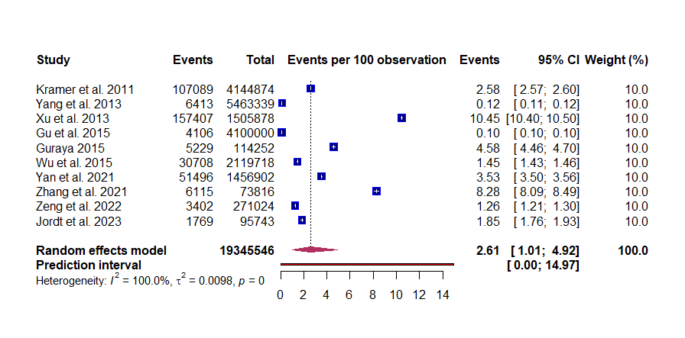
A forest plot displaying the global prevalence of T2D and Cancer.
Umbrella analysis included 10 studies with 19.3 million people.
Global prevalence was 2.61% (95% CI: 1.01–4.92).
Prevalence ranged from 0.10% to 10.45% → very high heterogeneity (I² = 100%).
Random-effects model was applied, prediction interval 0.00–14.97%.

Slide 11
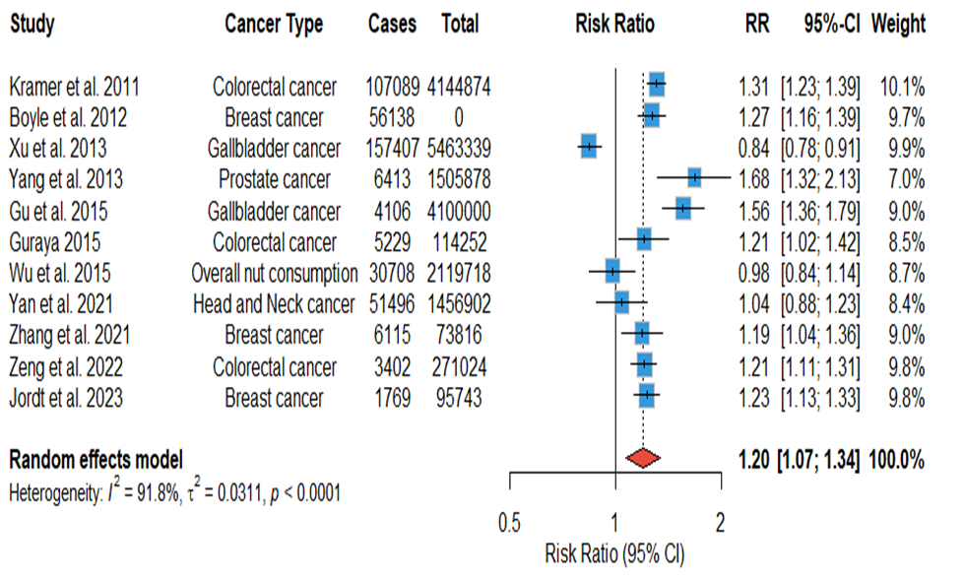
A forest plot displaying the Pooled Risk ratios estimates of T2D and Cancer Risk factors.
Forest plot of 11 meta-analyses showed 20% higher cancer risk in people with T2D (RR = 1.20, 95% CI: 1.07–1.34, p < 0.01).
Indicates a positive association between Type 2 Diabetes and cancer.
High heterogeneity (I² = 91.8%) shows variation between studies due to population, methods, or cancer type.

Slide 12
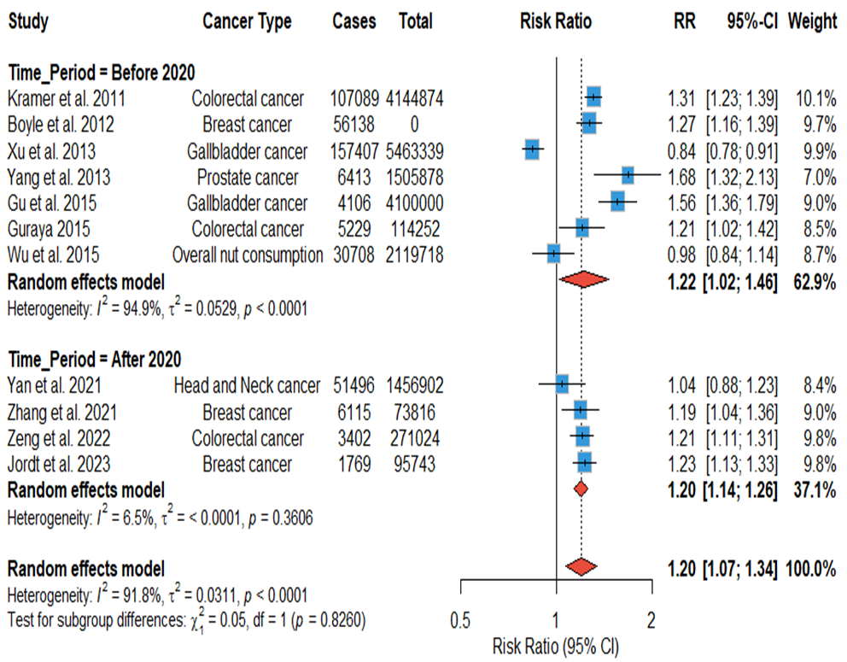
Subgroup forest plot showing Year-wise Risk Estimates of T2D and Cancer (Before and After 2020).

Slide 13
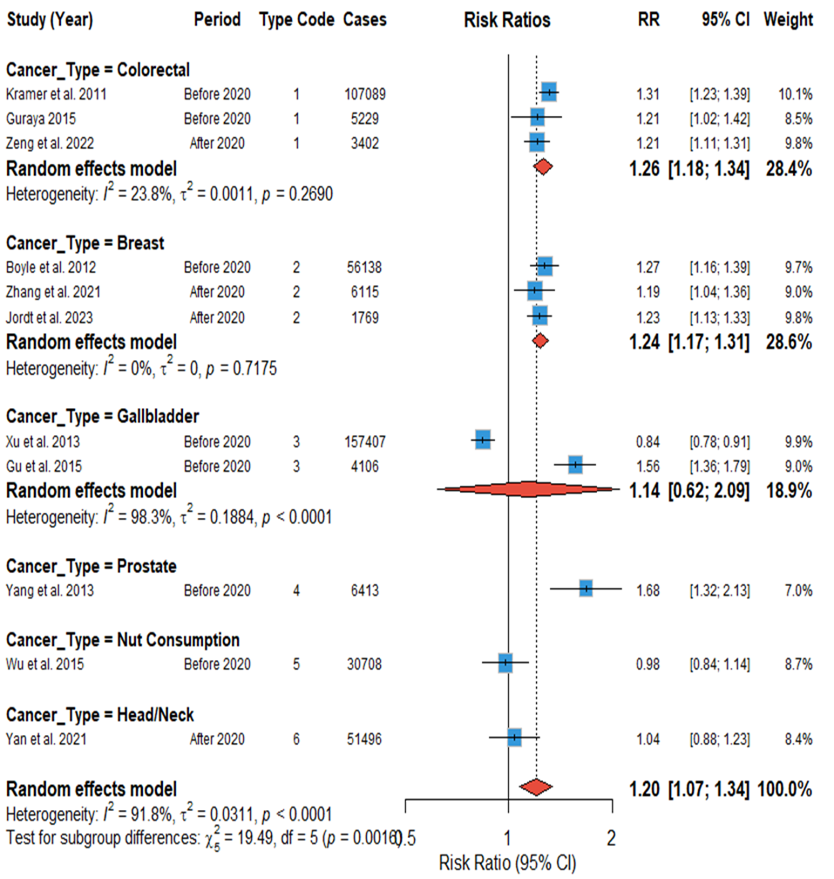
Subgroup Analysis of T2D and Cancer Types.

Slide 14
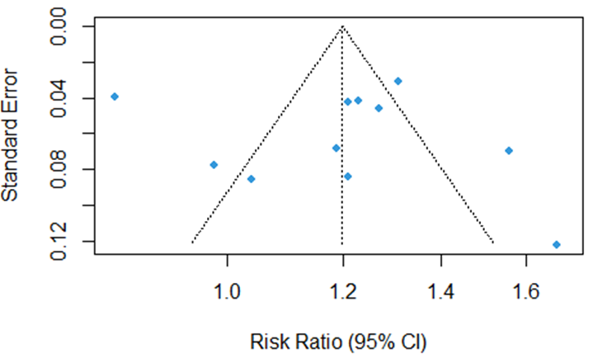
Funnel Plot Assessing Publication Bias in the Umbrella-Analysis

Slide 15
Uni-variate Meta Regression
Meta-regression analysis found
that year of publication, cancer
type, and gender had no
significant effect on T2D and
cancer risk. Only the effect of
sample size was significant
(p = 0.0367), meaning
that the risk ratio was slightly
lower with larger
sample sizes.
Uni-variate Meta Regression
Co-variate | Co-efficient (β) | p-value | 95% confidence interval | R-square
Year of publication | -0.0045 | 0.747 | (-0.0321 to 0.0230) | 0.00%
Sample size | -0.0000 | 0.0367 | (-0.0000 to -0.0000) | 28.34%
Breast cancer | 0.2074 | 0.0691 | –0.1162 to 0.4309 | 0.00%
Colorectal cancer | 0.0113 | 0.9445 | –0.3055 to 0.3281 | 0.00%
Gallbladder cancer | -0.0854 | 0.6368 | –0.4398 to 0.2691 | 0.00%
Head and Neck cancer | -0.1681 | 0.4795 | –0.6342 to 0.2979 | 0.00%
Nut Consumption (Overall) | -0.2276 | 0.3333 | –0.6885 to 0.2334 | 0.00%
Prostate cancer | 0.3114 | 0.2188 | –0.1849 to 0.8078 | 0.00%
Gender | 0.0321 | 0.625 | –0.1606 to 0.0965 | 67.14%

Slide 16
Conclusion
10 studies (19.3 million people) → global prevalence 2.61% (95% CI: 1.01–4.92).
Prevalence range was wide (0.10% to 10.45%).
Forest plot showed pooled RR = 1.20 (95% CI: 1.07–1.34) → T2D patients have 20% higher cancer risk (p < 0.01).
Strong association seen especially with colorectal, breast and prostate cancer.
Subgroup analysis showed similar results before and after 2020 (RR 1.22 vs 1.20).
Meta-regression showed year, cancer type and gender did not change the cancer risk; only sample size had a small effect (p = 0.0367).
Funnel plot showed no major publication bias, making the results more reliable.

Slide 17
References
[1] World Health Organization, “Diabetes,” WHO. [Online]. Available: https://www.who.int/health-topics/diabetes#tab=tab_1. [Accessed: Dec. 23, 2024].
[2] K. K. Tsilidis, J. C. Kasimis, D. S. Lopez, E. E. Ntzani, and J. P. A. Ioannidis, “Type 2 diabetes and cancer: umbrella review of meta-analyses of observational studies,” BMJ, vol. 350, no. jan02 1, p. g7607, Jan. 2015.
[3] T. Ohkuma, S. A. Peters, and M. Woodward, “Association of type 2 diabetes with cancer: A meta-analysis with bias analysis for unmeasured confounding in 151 cohorts comprising 32 million people,” Diabetes Care, vol. 43, no. 9, pp. 2313–2322, Sep. 2020.
[4] Y. Zheng, M. He, and N. Congdon, “The Worldwide Epidemic of Diabetic Retinopathy,” Indian Journal of Ophthalmology, vol. 60, no. 5, p. 428, Jan. 2012.
[5] Y. Gang, W. Qing, Q. Bin, S. Yan, W. Chuanxin, L. Xiaoyong, and H. Dalin, “Collaborative meta-analysis of individual participant data from observational studies of type 2 diabetes mellitus and risk of prostate cancer,” Ann. Oncol., vol. 24, no. 2, pp. 452–460, Feb. 2013.
[6] S. Y. Guraya, “Association of type 2 diabetes mellitus and the risk of colorectal cancer: A meta-analysis and systematic review,” World J. Gastroenterol., vol. 21, no. 19, pp. 6026–6031, May 2015.
[7 ] S. C. Larsson, C. S. Mantzoros, and A. Wolk, “Diabetes mellitus and risk of breast cancer: A meta‐analysis,” Int. J. Cancer, vol. 121, no. 4, pp. 856–862, Mar. 2007.

