Slide 1




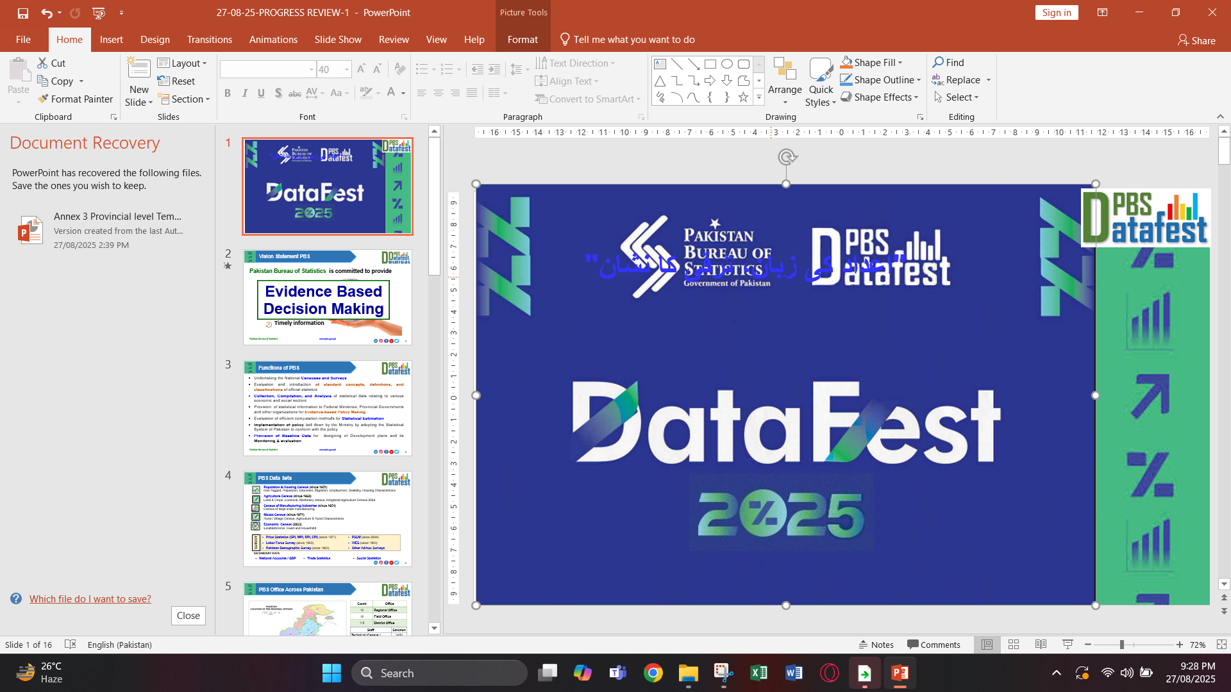
"اعداد کی زبان، ترقی کا نشان"
Empowering Marginalized Female Communities: An Equitable Road Map to Enhancing Inclusivity in Sindh Rural Communities.
Dr. Qurratulain Sardar
DELL, Assistant Professor
Government College University Hyderabad.

Slide 2
Topic & Key Points
Topic:
Empowering Marginalized Female Communities: An Equitable Road Map to Enhancing Inclusivity in Sindh Rural Communities.
Agenda: Gender Equity, Inclusivity, and Sustainable Development in Rural Sindh.
Aligned SDGs: 4, 5, 8, 10, 16.
Opening by establishing a link between gender equity and sustainable development, citing the United Nations 2030 Agenda that underscores inclusive, equitable quality learning and gender equality as prerequisites for sustainable societies. (United Nations, 2015).

Slide 3
Opening thought
“When a woman learns, her family and her village learn with her.” — Sindhi Proverb (Adapted)

Slide 4
Context and Rationale
Women in rural Sindh undergo multi-faceted marginalization including economic, social, and educational aspects (Pakistan Bureau of Statistics, 2022).
The analysis of the combination of gender inequality, poverty, and dominant social norms can be explained by the concept of intersectionality as described by Crenshaw (1989).
Rural women empowerment contributes to global sustainability through Sustainable Development Goal objectives of gender equality and resilient community development (UN Women, 2022)

Slide 5
Workshop Goals (SDG-Aligned)
At the conclusion, the participants will able to :
learn about gender inequity that are common in rural communities,
which is discussed by SDG 5 and SDG 10.
determine the obstacles to women participation, as required by SDG 8.
understand that education is a force behind empowerment, as SDG 4.
community equity Co-establish a community equity system, as per
SDG 16.
These objectives embody the United Nations Development Programme’s framework, linking local
empowerment to verifiable global progress towards the Sustainable Development Goals (UNDP, 2023).

Slide 6
Theoretical Framework for Sustainable Empowerment
Key Models:
Maslow’s Hierarchy of Needs : empowerment as self-actualization (Maslow, 1943).
Sen’s Capability Approach : freedom as development (Sen, 1999).
Gender and Development (GAD) Framework : gendered analysis in development (Moser, 1993).
Sustainability Lens : social equity as the foundation of community resilience (UNESCO, 2023).
This is a synthesized theoretical framework that incorporates the views of psychological development, social justice and sustainable development.

Slide 7
Key Concepts of Gender and Equity
Concepts:
Empowerment transforms dependency into agency (Kabeer, 1999).
Equity vs. Equality: equality gives the same resources; equity addresses contextual disadvantages.
Inclusivity ensures all voices are represented.
Sustainability requires justice, not just growth (UNDP, 2022).

Slide 8
The Sindh Rural Context
• The rural Sindh female literacy is less than 40 percent, which is lower than the national rates (World Bank, 2021).
• The cultural practices restrict the movement and decision-making process of women.
Education and microenterprises can change these social constraints to economic empowerment.
• The inclusion of female leadership enhances sustainability of the community (SDG 5 and 8).

Slide 9
Obstacles to Gender Inclusiveness
Barriers:
• Patriarchal rules on the limited roles in the society (Khan, 2020).
• Disparity in access to digital technologies and gender.
• Poor institutional representation.
There are environmental burdens that disproportionately affect women (UN Women, 2021).

Slide 10
Case Study :Grassroots Empowerment and SDG Impact.
Case study:
Women Literacy Circles in rural Sindh (Aurat Foundation, 2020).
• Informal literacy schools are community-based institutions that are used to encourage education and microfinance.
• Positive results: higher level of literacy, self-esteem and well-being of family.
• Impact impacts SDGs 4, 5, 8 and 10 - a local sustainability model.

Slide 11
Empowerment (SDG Integration) Strategies.
Strategies:
• Foster female education and training of teachers (SDG 4). Build entrepreneurship and microcredit programmes (SDG 8).
• Promote political engagement of women (SDG 5, 16).
• Introduce digital and eco-conscious campaigns (SDG 13).
The United Nations Educational Programme (UNESCO, 2023) focuses on education and engagement as one of the ways to achieve sustainable development in a fair and balanced manner.

Slide 12
ACTIVITY ZONE
Identify one local challenge for rural women.
Match it with an SDG.
Design a short-term, realistic action plan.
Purpose: Connecting local efforts to global sustainability.
Reference: (UNESCO, 2023)

Slide 13
Sustainable Road Map for Equity and Inclusion
Stage | Focus Area | SDG Link
Awareness | Education & Literacy | 4, 5
Capacity | Skills & Vocational Training | 8
Inclusion | Policy & Governance | 16
Sustainability | Local Leadership & Partnerships | 10, 17
Sustainable Road Map for Equity and Inclusion
This roadmap builds empowerment in phases , rom awareness to sustainable governance ,
mirroring UNDP’s Gender and Inclusion Framework (UNDP, 2022).

Slide 14
Anticipated Results and SDG Goals..
Outcomes
• Increased gender sensitivity and action (SDG 5).
• Greater educational and leadership ability (SDG 4).
The improved livelihood and inclusion opportunities (SDG 8).
• Increased citizenship and political representation (SDG 16).
All SDGs are multiplied with gender equality because it promotes equitable and sustainable growth (UN Women & UNDP, 2022). development and not passive receivers.

Slide 15
Implications to Policy and Community.
Recommendations:
• Incorporate gender responsive indicators into local policy.
• Create collaborations between universities, NGOs and local councils.
• Make budgets gender responsive (OECD, 2021).
• Turn women into agents of sustainable

Slide 16
Closing Reflection
True empowerment begins when women are free to shape their own stories. — Dr. Qurratulain Sardar
Let’s reinforce, empowerment is not charity, it is Justice.

Slide 17
References
Aurat Foundation. (2020). Women empowerment through literacy programs: Sindh region report. Karachi: Aurat Foundation.
Crenshaw, K. (1989). Demarginalizing the intersection of race and sex: A Black feminist critique of antidiscrimination doctrine. University of Chicago Legal Forum, 1989(1), 139–167.
Kabeer, N. (1999). Resources, agency, achievements: Reflections on the measurement of women's empowerment. Development and Change, 30(3), 435–464.
Khan, S. (2020). Gender, culture, and education in Pakistan’s rural areas. Asian Journal of Women’s Studies, 26(2), 189–205.
Maslow, A. H. (1943). A theory of human motivation. Psychological Review, 50(4), 370–396.
Moser, C. O. N. (1993). Gender planning and development: Theory, practice and training. Routledge.
Nussbaum, M. (2000). Women and human development: The capabilities approach. Cambridge University Press.
OECD. (2021). Gender equality and public policy: Measuring progress. OECD Publishing.
Pakistan Bureau of Statistics. (2022). Pakistan social and living standards measurement survey 2022. Government of Pakistan.
Sen, A. (1999). Development as freedom. Oxford University Press.
UN Women. (2021). Gender equality and climate change: Global perspectives. UN Women.
UN Women. (2022). Progress on the Sustainable Development Goals: Gender snapshot 2022. United Nations.
UN Women & UNDP. (2022). Gender equality as an accelerator for the SDGs. United Nations Development Programme.
UNDP. (2022). Gender equality and social inclusion framework. UNDP Pakistan.
UNDP. (2023). Sustainable Development Goals progress report – Pakistan. United Nations Development Programme.
UNESCO. (2023). Education for sustainable development: Empowering learners for a sustainable future. UNESCO.
United Nations. (2015). Transforming our world: The 2030 agenda for sustainable development. United Nations.
World Bank. (2021). Pakistan country gender assessment. World Bank Grou

