Slide 1
Blockchain, Crypto & Web3
Data Insights for Pakistan’s Digital Future
Dr. M. Shakeel
Assistant Professor of Economics, VU

Slide 2
Pakistan Snapshot (2023 Census)
• Population: 241.49 million
• Rural: 61.18%, Urban: 38.82%
(Source: PBS, Census 2023)

Slide 3
Pakistan’s Payments / Fintech Landscape
• Raast P2P transfers Q1 FY25: PKR 4.69 trillion
• Visa targets 10× growth in Pakistan’s digital acceptance
• Digital transactions rising fast in retail & business sectors

Slide 4
Remittances: Size & Opportunity
• Overseas Pakistanis sent > USD 31 billion in 2023–24
• 2023 remittances: USD 29.87 billion
Financial Inclusion Potential
1.7B unbanked worldwide (World Bank 2022).
In Pakistan: ~100M+ adults lack formal bank accounts.
Crypto wallets & mobile money → bridges inclusion gap.
Case study: Easypaisa + potential stablecoin integration.
• Blockchain could lower cost & improve efficiency by removing intermediaries (Banks etc)

Slide 5
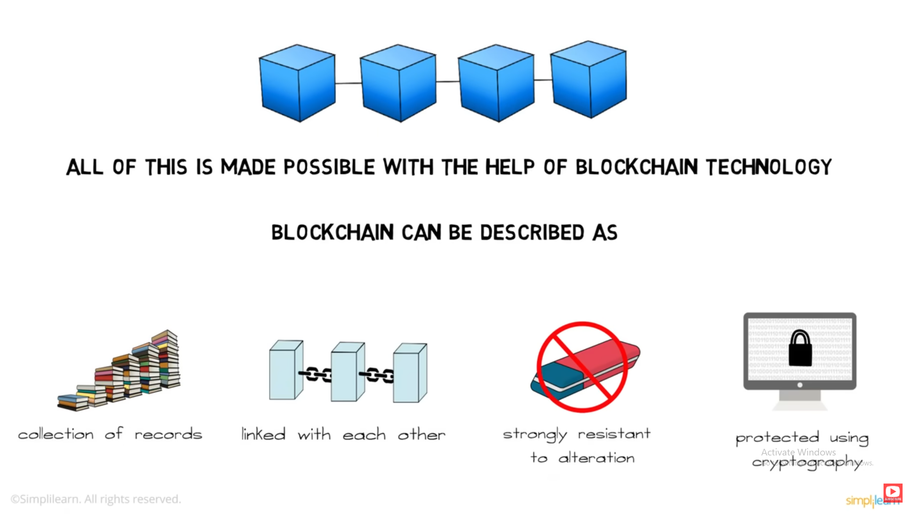
Crypto / Blockchain Adoption in Pakistan
• 15–20M Pakistanis estimated to own crypto
• Annual trading volume ~$25B (2023)
• Some claims: 40M+ users, $300B volume (unverified)
• Ranked among top global adopters

Slide 6
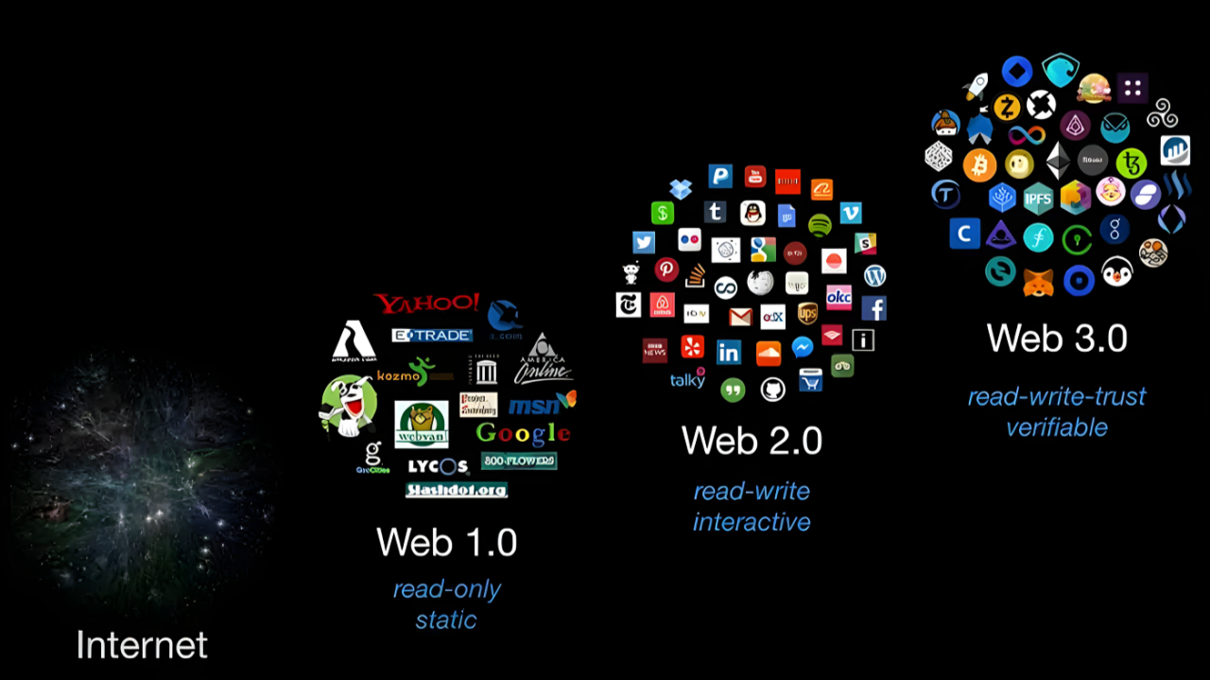
Global Crypto / Remittance Trends
• 562M people worldwide own crypto (~6.8% of population, 2024)
• APAC crypto on-chain activity +69% YoY (to June 2025)
• Crypto remittances rising (~23% of global flows)

Slide 7
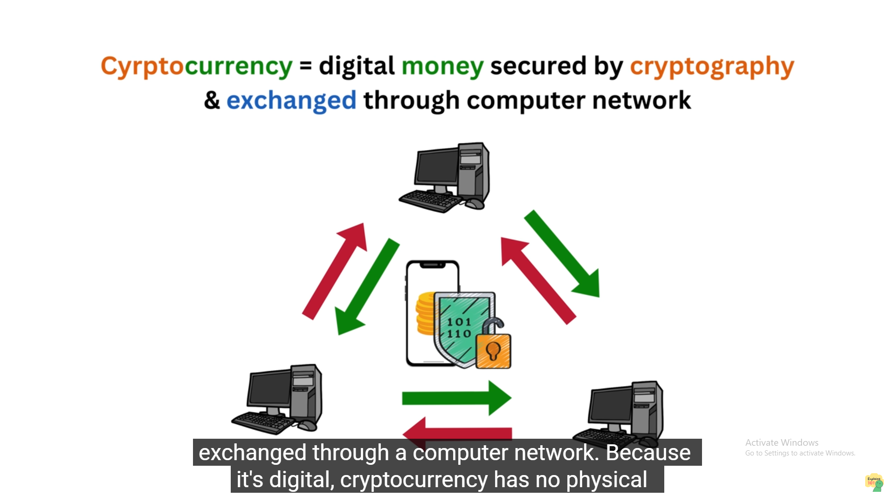
📊 Cryptocurrency as Money & Supply Dynamics
Functions of Money
Medium of exchange, store of value, unit of account.
Bitcoin: partly fulfills roles (strong as store of value, weak as unit of account).
Compared with fiat & central bank money → limited acceptance, high volatility.
Supply & Scarcity
Bitcoin’s fixed cap: 21 million coins.
Economic implications:
  Inflation resistance (cannot be printed like fiat).
  Deflationary bias (scarcity may discourage spending).
Contrast: Central banks can expand fiat supply → monetary flexibility.

Slide 8
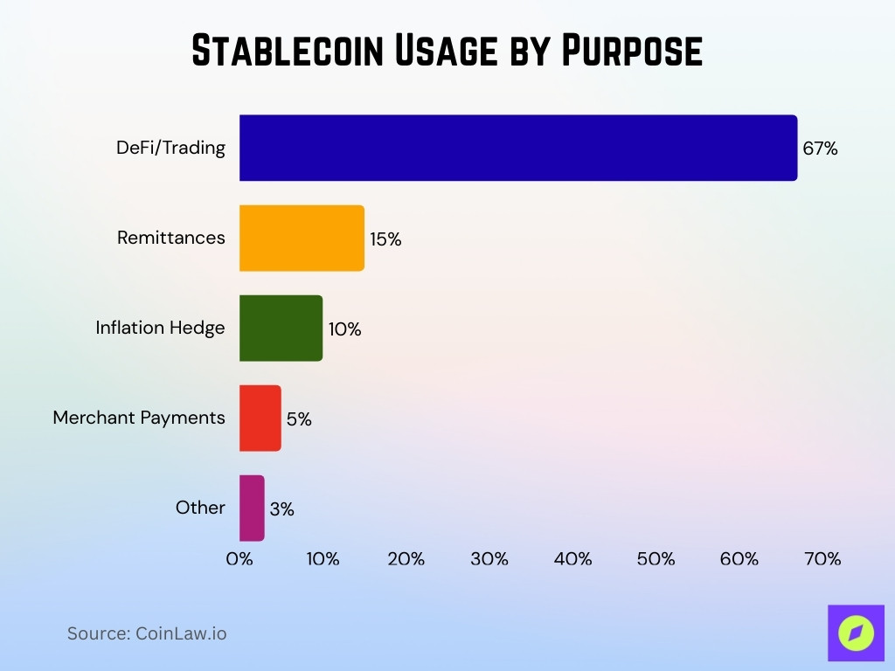
Stablecoins & Cross-Border Flow
• Global remittance avg. cost ~6.2% (World Bank, 2023)
• Stablecoins = cheaper, faster transfers
• Pakistan exploring blockchain remittance corridors (PVARA+Crypto Council)

Slide 9
Behavioral & Market Dynamics
• Trading volumes spike in bull cycles
• FOMO, Herd Behavior, Loss Aversion drive swings
• Media & influencers amplify volatility
Marker Caps : Crypto 4.13 trillion, Gold 23.6 trillion, Stock 127 trillions (October 2025)
Data driven analysis will guide to take profits in economic cycles of crypto market (Web 3.0 based system)

Slide 10
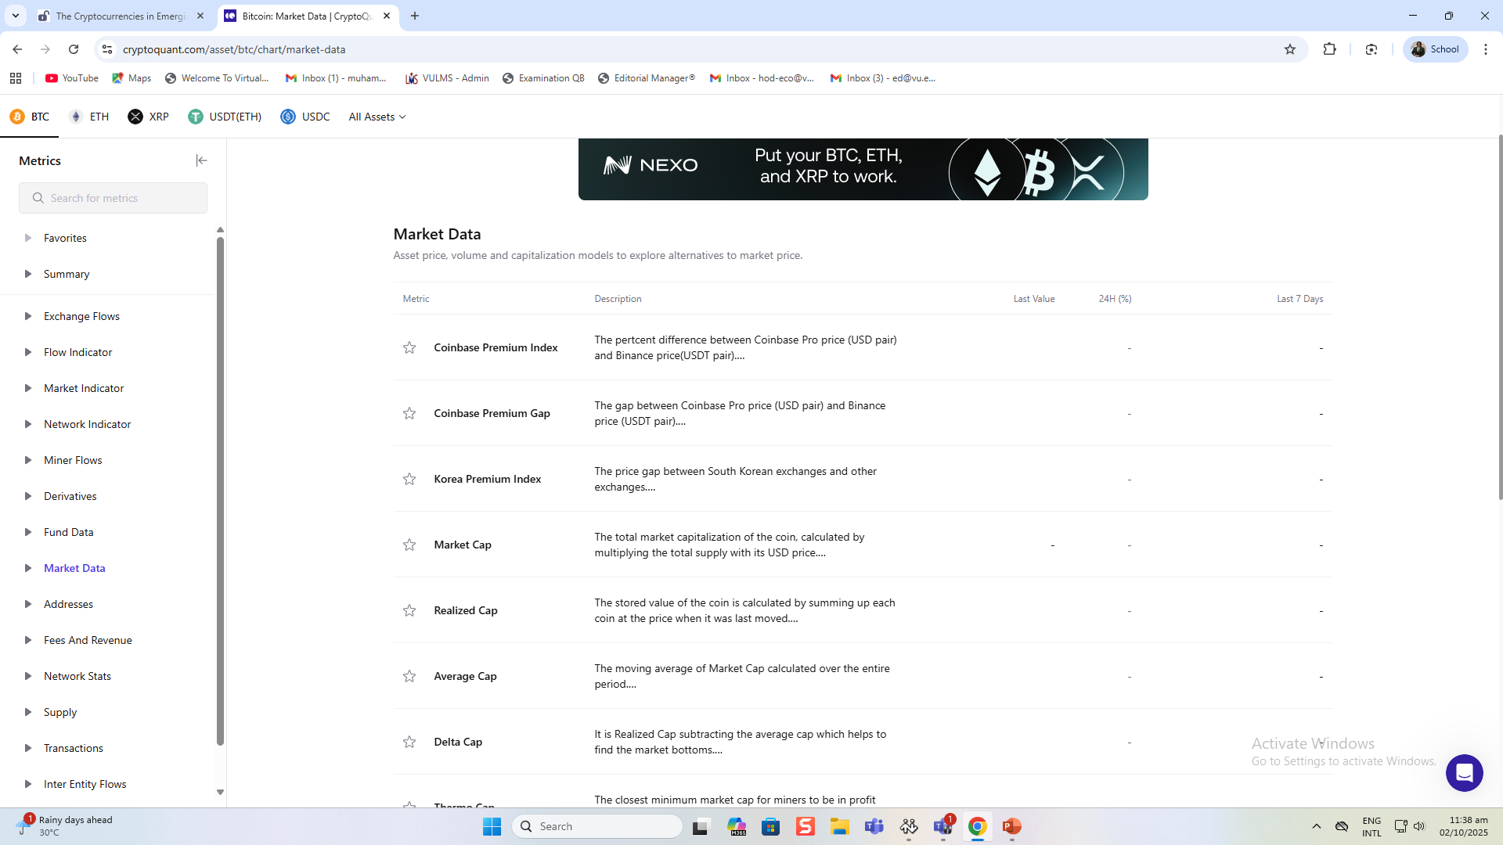
Pakistan Case Studies / Potential Paths
• Remittances: If 10% of $31B shifts to blockchain → major cost savings (Dis intermediation)
• PBS Big Data Portal can inform digital economy policy
Bitcoin can be used a digital gold (inflation Hedge)

Slide 11
The Unified Theory of Acceptance and Use of Technology
(UTAUT) is a widely recognized model that explains user acceptance of technology based on four key factors:
UTAUT Applied to Cryptocurrency
Performance Expectancy → Economic gains, security, faster remittances.
Effort Expectancy → Simplicity of wallet apps, local-language interfaces.
Social Influence → Peer pressure, influencers, media hype.
Facilitating Conditions → Internet penetration, regulatory clarity, mobile money access.
Implications for Developing Countries (Pakistan Focus)
High remittance inflows → Performance Expectancy strong driver.
Low financial literacy → Effort Expectancy a barrier.
Strong peer & diaspora networks → Social Influence accelerates adoption.
Unequal internet & banking access → Facilitating Conditions critical gap.

Slide 12
🎯 Why It Matters for Economics/Finance
Understand decentralization as market disintermediation.
Analyze crypto as alternative money in monetary economics.
Apply bubble & speculation theory to crypto markets.
Apply Employment theories to smart contract-based markets (Ecommerce, Freelancing etc)
Case Studies: Blockchain in supply chains; RWA tokenization in finance.
Projects: Compare Bitcoin remittances vs. banks; analyze crypto & inflation.

Slide 13
Risks & Enablers
• Regulatory uncertainty (Hacking, scams, incorrect transfers)
• Data quality & scalability issues (PBS can provided insights)
• Financial inclusion challenges (Policy clarity+Adoption)
Need for governance & transparency

Slide 14
Key Insights & Recommendations
• Blockchain = Tech + Economics
• Data-driven policymaking is essential
• Pilot blockchain-based remittance corridors
• Build regulatory capacity & public trust

