Slide 1
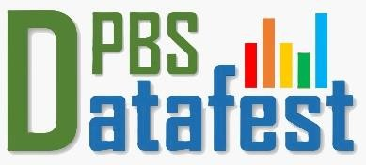


Enhancing Privacy in Large Language Models
Protecting Data Confidentiality in the Age of AI
Ms. Nabeela Bibi
Lecturer | Bahria University
PhD Scholar | NUST
nabeelabb786@gmail.com

Slide 2

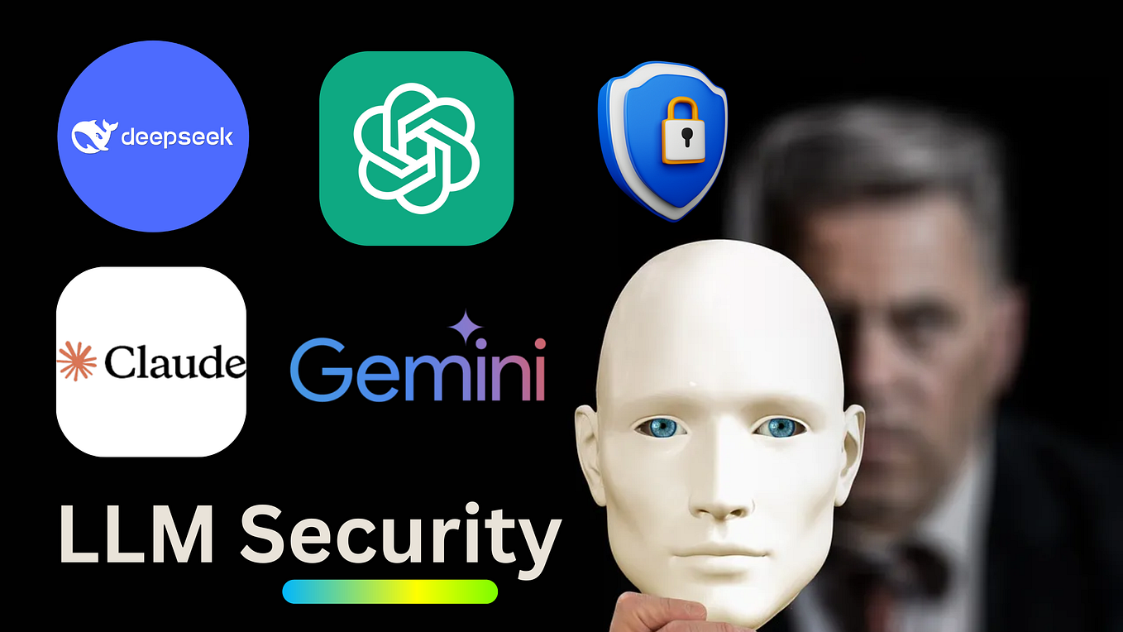

The LLM Revolution: A New Tool for Insight
LLMs are transforming every sector. They are powerful tools for extracting insights from vast, unstructured text data.
►
Automating data classification
►
Analyzing unstructured survey responses
►
Improving public-facing services

Slide 3
The Privacy Paradox: The Problem of Memorization
81%
The "Learning" vs. "Memorizing" Dilemma
LLMs are trained on vast, often user-generated, data. The critical problem: they don't just *learn* general concepts, they *memorize* specific, raw data points.
of the public say risks from data collection outweigh benefits.
71%
This creates a massive risk of leaking sensitive, personally identifiable information (PII) through simple queries.
are worried about government use of their data.

Slide 4
The Stakes for Public Trust: A Message for PBS
"We have a legal obligation to protect personal information. It is a criminal offence to improperly disclose information... Your mandate is built on the promise of confidentiality."
"
"
— Adapted from ONS / U.S. Census Bureau Privacy Mandates
A single data leak from an LLM trained on census or survey data could be catastrophic for public trust. We must apply the same rigor of Statistical Disclosure Limitation (SDL) to this new technology.

Slide 5

Our Research Goal
How can we train effective Large Language Models...
while rigorously protecting the confidentiality of the underlying data?

Slide 6

Investigating the Risks: How Do Leaks Happen?
Membership Inference
Data Extraction
This attack allows an adversary to determine if a specific person's data (e.g., a unique medical record or financial statement) was part of the model's training set. This alone is a breach of confidentiality.
A more severe attack. An attacker "tricks" the model, often through clever prompt engineering, into spitting out raw, memorized training data, including names, addresses, phone numbers, or private correspondence.

Slide 7






Proposed Solution: A Multi-Layered Defense
1. Pre-Processing
2. In-Training
3. Post-Processing
Privacy-Preserving Training. Implement techniques like Differential Privacy (DP) & Federated Learning (FL) during the training process itself.
Data Anonymization. Rigorous PII scrubbing, data cleaning, and aggregation *before* any data is shown to the model.
Secure Deployment. Use prompt-based techniques (masking, rewriting) and "unlearning" to remove data *after* a model is trained.

Slide 8
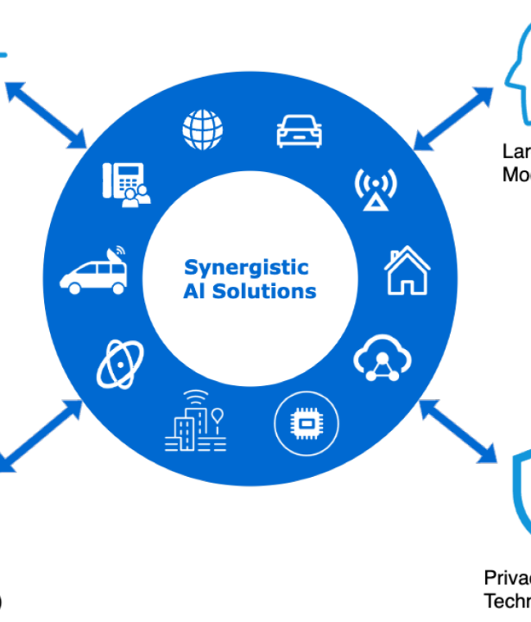
Deep Dive 1: Differential Privacy (DP)
The 'gold standard' for statistical privacy, now adapted for LLMs.
It adds mathematical 'noise' during training, making the model's output statistically indistinguishable whether any single person's data was included or not.
This provides a formal, mathematical guarantee of privacy.

Slide 9
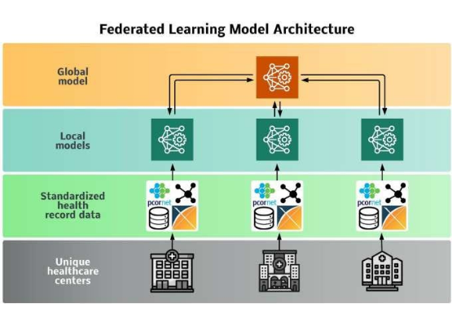
Deep Dive 2: Federated Learning (FL)
A fundamental paradigm shift: Why move the data, when you can move the model?
The AI model is sent to local devices (e.g., hospitals, local servers).
The raw, sensitive data *never* leaves its secure environment.
Only the anonymous, aggregated model *updates* are sent back.

Slide 10
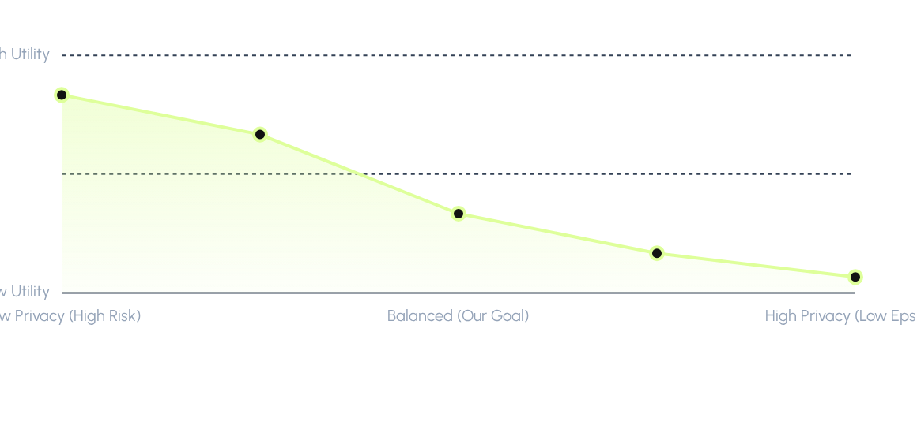
The Core Challenge: The Privacy-Utility Trade-Off
Our research identifies optimal parameters in this trade-off, finding the 'sweet spot' that provides strong, provable privacy with minimal impact on model performance.

Slide 11
Conclusion & Future Directions
LLMs can be used safely for public data, but only with explicit privacy-by-design. Key takeaways:
Defense-in-Depth is Essential: A layered approach (pre, in, and post-processing) is the only way to ensure robust protection.
The Trade-Off is Real: We must actively measure and manage the balance between data privacy and model utility, just as in traditional statistics.
Future Work for PBS: Our next step is applying these models to real-world PBS datasets (e.g., unstructured survey text) in a secure "data enclave" to build a trusted, private AI tool for public good.

Slide 12
References
Extracting Training Data from Large Language Models. Proceedings of the 38th International Conference on Machine Learning (ICML).
Communication-Efficient Learning of Deep Networks from Decentralized Data. Proceedings of the 20th International Conference on Artificial Intelligence and Statistics (AISTATS).
Membership Inference Attacks Against Machine Learning Models. Proceedings of the 37th IEEE Symposium on Security and Privacy (S&P).
Privacy Protection in Large Language Models: A Survey. arXiv preprint arXiv:2308.11874.

Slide 13
Thank You. Questions?
Your partners in building a secure, private, and insightful data future.
Nabeela Bibi | Bahria University
nabeelabb786@gmail.com

