Slide 1


Wafaqi Mohtasib (Ombudsman)’s Secretariat

Slide 2



Data Management and Operations for Dispensation of Justice Eradication of Mal-administration

Slide 3

INTRODUCTION
The Office of Wafaqi Mohtasib (Ombudsman) was established through P.O.No.1 of 1983 on 24 January 1983 with the following objectives:
Diagnose, investigate, redress, and rectify any injustice done to a person through maladministration.
Undertake investigations into allegations of maladministration by agencies or their officers/employees
Provide speedy relief to citizens by addressing grievances and promoting good governance, dispose of the cases within 60 days
Arrange studies, assessments and research to identify root causes of corrupt practices and injustice, and recommend steps for their eradication.

Slide 4
What is Maladministration?
Definition of Maladministration as per (President’s Order No.1 of 1983)
Decisions or actions that violate laws, rules, or established procedures without valid reasons
Perverse, arbitrary, unreasonable, unjust, biased, oppressive, or discriminatory
Actions based on irrelevant grounds
Abuse or neglect of power for corrupt motives (bribery, favoritism, nepotism)
Neglect, inattention, delay, incompetence, inefficiency, and ineptitude in discharge of duties
Addressing maladministration is essential for protecting human rights and achieving good governance and the rule of law.
Maladministration and bad governance are interconnected issues that flourish in environment of nepotism, favoritism, discrimination, and corruption, ultimately undermining the merit and fair play.

Slide 5




















Agency
Agency” means a Ministry, Division, Department, Commission or office of the Federal Government or statutory body, corporation or other not included the Supreme Court, the Supreme Judicial Council, the Federal Shariat Court or a High Court
More than 250 federal government agencies fall under jurisdiction of WMS
Federal Government Agencies:

Slide 6

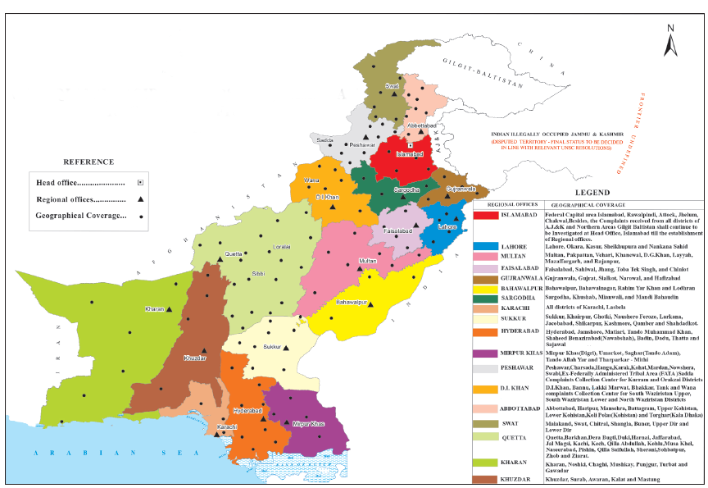
Geographical Representation of Wafaqi Mohtasib

Slide 7


Complaint Processing Mechanism
Registration of Complaint: The complaint is registered. Unique complaint No is allotted and forwarded for Investigation
Investigation: Investigation officer investigate the complaint and prepare draft findings.
Appraisement: The draft findings are appraised to keep the uniformity and standard of the findings as per law
Approval: The Appraised findings are submitted to the HWM for approval.
Implementation: After the approval, The findings are issued to the parties. The rejected/closed cases consigned to record, Recommendations are sent to Implementation wing for Implementation process
To carryout this process WMS established CMIS

Slide 8
Complaint Management Information System
A central IT-enabled tool at the Wafaqi Mohtasib Secretariat, facilitating streamlined and integrated complaint management through data-driven processes. This multi-language software allows users worldwide to lodge complaints and track their status online, ensuring data accessibility and transparency. CMIS enhances communication between the Head Office and Regional Offices, monitors the investigation and implementation process, and identify delays on the part of defaulters, improving overall efficiency in handling complaint data ,receive online complaints from general public and reports from the agencies, integrating their complaint system.
Notes:
Take slide 26 from cmis presentation

Slide 9
CMIS DATA
Complaints Received And Disposed
Aug 1983 – till Oct-2025
Receipt | Disposal
2,524,261 | 2,504,933
Disposal Percentage = 99.2%

Slide 10

Grievance Redressal through Integrated Complaint Resolution Mechanism (ICRM)
Automated digital platform connecting the Ombudsman Office with 213 Federal Government agencies
Integrated Complaint Resolution (ICR) Mechanism
Linking interface using CMIS between WMS and Agency for complaints registration.
Complaint resolution for overseas Pakistanis, Children complaints
Interface linked with President’s Secretariat for Representations
Automated transfer of unresolved complaints beyond 30 days to WMS-CMIS via ICR mechanism

Slide 11
24 X 7 Online Centralized Complaint Management Information System (CMIS)
Online Complaint Registration, Online Status, Mobile App
WMS Regional Offices
President Secretariat
All Federal and Provincial Ombudsman Offices
Overseas Pakistani Complaint
Integrated Complaint Resolution (ICR)
213 agencies,
CMIS LINKAGE

Slide 12

Mode of Receipt of Complaints (JAN –Oct 2024 Vs 2025)
Mode of Receipt | 2024 | 2025 | (+/-)
Matter pertaining Child protection | 486 | 535 | 10 %
ICR | 14,825 | 17,263 | 16.45 %
 | 10% | 8%
Mobile App | 21,453 | 24,996 | 14.19 %
 | 12% | 12%
Normal | 93,706 | 108,134 | 15 %
 | 53% | 51%
Online/Website | 50,894 | 60,340 | 19 %
 | 25% | 28%
Total | 181,364 | 211,268 | 16 %

Slide 13
TIMELINE DECISION MAKING PROCESS
TOTAL CASES UNDER PROCESS TILL OCTOBER 2025: 211,268
Percentage of timely disposal: 99.2%
Notes:
Graph depicts how timely decision making (under 45 days) is taking place in the WMS as the 95% under process cases lie within provided timeframe.

Slide 14

Percentage% Year-2024: 86% Year-2025: 91%
Notes:
From the above data obtained through CMIS it was identified that there was a lapse in implementation of the cases, which WMS is trying to improve in year 2025 as the percentage of implemented cases has improved from 86% to 91% this year.

Slide 15
Outreach & Monitoring
OCR
Khuli Kutcheries
Inspection Visits
IRD
Steps taken by WMS on the basis of existing data received from CMIS

Slide 16

Outreach Complaint Resolution (OCR)
Launch Date: January 27, 2016
Objective: Speedy resolution of complaints, Maximum coverage
Coverage:
  Initial phase: 36 districts
  Current phase: Extended to 138 districts and 435 sub-divisions.
Time Limit: 40 days for case disposal
Implementation: Focused on 23 districts, including remote areas like Hub and Lasbela.
Till date WMS has received and disposed 5226 complaints in OCR
Mechanism:
Complaints are received and scrutinized by the Registrar, forwarded to I.Os.
Tour schedule (venue & date of Hearing) of I.Os are advertised in advance.
Hearing within 18 days of Registration.
Preparation and uploading of Findings within 48 hours of Hearing.
Findings are appraised and approved within 5 days of uploading.
Notes:
Outreach Complaint Resolution (OCR) mechanism was launched to provide speedy redressal of complaints at the doorsteps of the citizens. During 2023, Regional Offices at Bahawalpur, D.I. Khan, Gujranwala, Hyderabad, Lahore, Multan and Sukkur undertook OCR visits to various remote areas

Slide 17
Informal Resolution of Disputes
The Informal Resolution of Disputes (IRD) mirrors traditional Jirga/Panchayat systems to resolve complaints.
Procedure for Handling IRD Cases
Contact respondents to discuss informal resolution willingness.
Upon refusal, complainant must persuade; otherwise, case is archived.
Write to agency representatives for action, if the respondent is an agency.
Schedule hearings to facilitate settlement between agency and complainant.
Note resolved terms with signatures from all parties.
Establish timelines for case management without fixed deadlines.
Notes:
In March 2022, the Wafaqi Mohtasib expanded the office's activities under Article 33, following the advice of the Honorable President of Pakistan, to further benefit the common citizens of the country.
IRD is often preferred by lower-income individuals over the formal judicial system, which is expensive and lengthy.

Slide 18
Special Initiatives taken by WMS to Improve Governance
International Linkages (AOA/IOI/OICOA)
  Wafaqi Mohtasib is presently President of Asian Ombudsman’s Association (AOA).
  Wafaqi Mohtasib actively participates in International Ombudsman Institute (IOI) and OIC Ombudsmen Association (OICOA)
  Highlight Pakistan's commitment to promoting good governance, the rule of law, and human rights.
Promotion and Protection of Child Rights :
  Zainab Alert Response & Recovery Act (ZARA) ,
  Prevention of Cybercrimes Act, 2016 and Prevention of Electronic Crimes (Amendment) Act, 2023.
  Implementation of WMS recommendations of the WMS Study Report on Street Children in ICT.
Overseas Pakistanis:
  Grievance Commissioner collaborates with Agencies and oversees. One Window Facilitation Desks at International airports, support for the diaspora.

Slide 19
CONCLUSION
Working in line with Goal 16 of United Nations’ SDGS to promote peaceful and inclusive societies for sustainable development, provide access to justice for all and build effective, accountable and inclusive institutions at all levels.
Data leverage is essential to improve service delivery, accountability, good governance, access to justice and effective redressal of grievances to meet the needs of justice for everyone as required under the principles of policy as enshrined in the Constitution.
Wafaqi Mohtasib helps the judicial system by addressing administrative accountability issues to reduce the burden of cases.

Slide 20
Cont’d
Identifying Issues:
Data helps pinpoint recurring complaints and systemic problems, enabling targeted interventions.
Measuring Impact: Analyzing outcomes allows for the evaluation and improvement of service effectiveness.
Resource Allocation: Data-driven insights helps focus on underserved populations.
Enhancing Accessibility: Understanding demographics ensures targeted services for marginalized groups i.e. Children, women and prisoners
Promoting Accountability: Transparency in data fosters trust and allows stakeholders to monitor performance.
Facilitating Feedback: Public feedback analysis refines services and enhances responsiveness.
Building Partnerships: Data sharing fosters collaboration with other agencies for comprehensive solutions.

Slide 21

Significance of WMS Data Management
WMS data can help Government for statistical data analysis, to measure the magnitude of governance and identify the systemic issues
Use data insights to advocate policy changes, address identified gaps and improve service delivery.
Develop structured channels for continuous public feedback to refine services and adapt to changing needs.
Implement advanced analytics tools and technologies to enhance data processing, predictive analysis, and reporting capabilities.

Slide 22




Thank you
mohtasib.registrar@gmail.com
Wafaqi Mohtasib's Secretariat, 36 Constitution Avenue G-5/2, Islamabad)
General Inquiry: 1055 / for children contact us 1056
https://mohtasib.gov.pk

