Slide 1
Introduction to Spatial Data Analysis and Mapping Using ArcGIS
By Farah Naz
Lecturer, PIDE school of economics, pide, islamabad

Slide 2
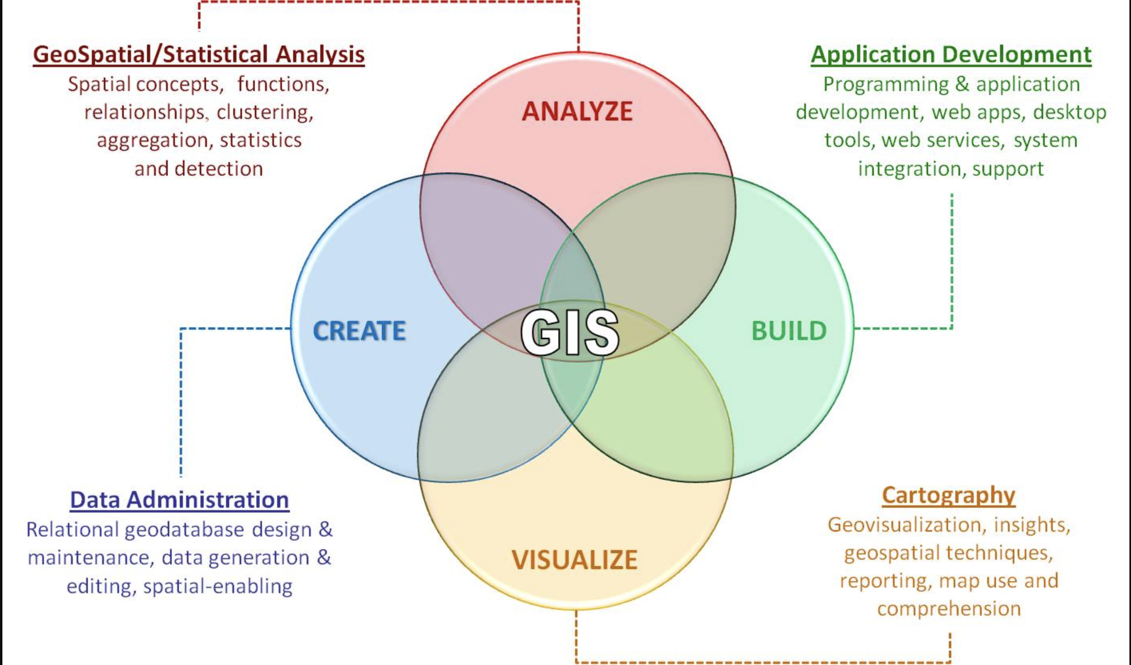
Introduction

Slide 3
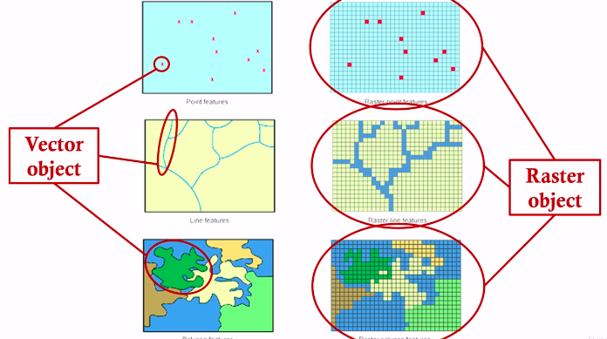
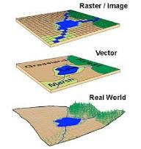
Understanding Spatial Data
Spatial data = data linked to a location or geographic coordinate

Slide 4
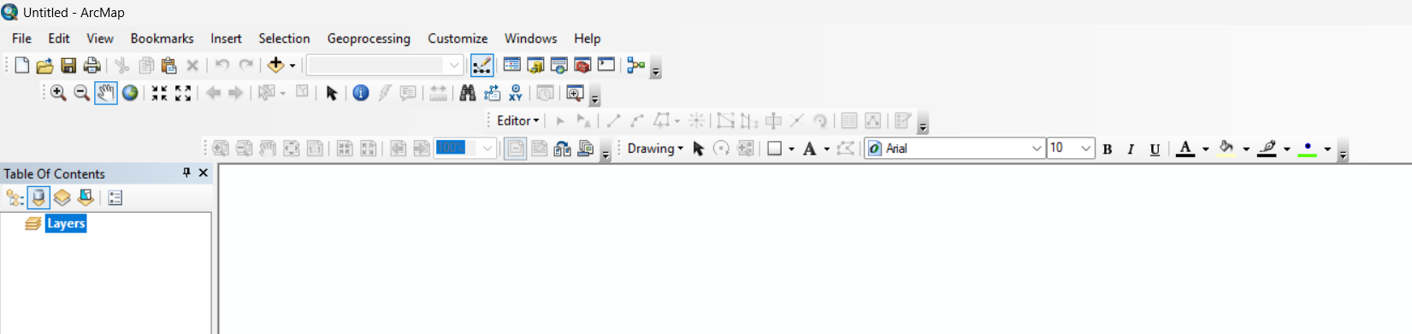
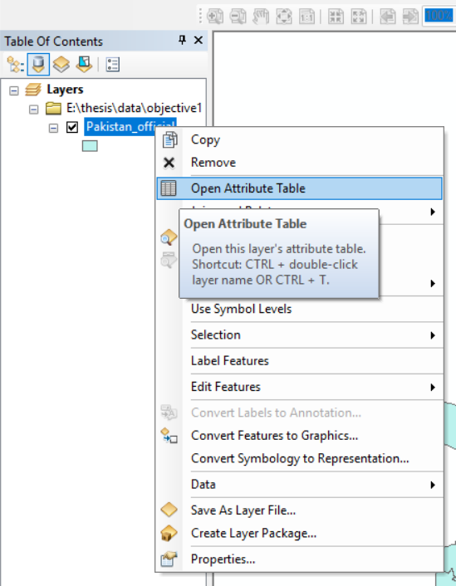
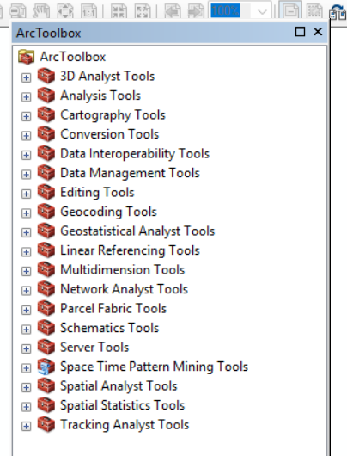
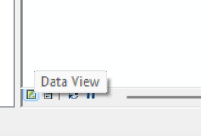
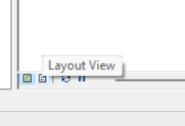

Slide 5
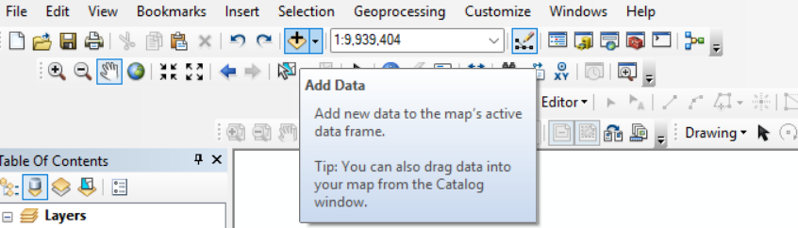
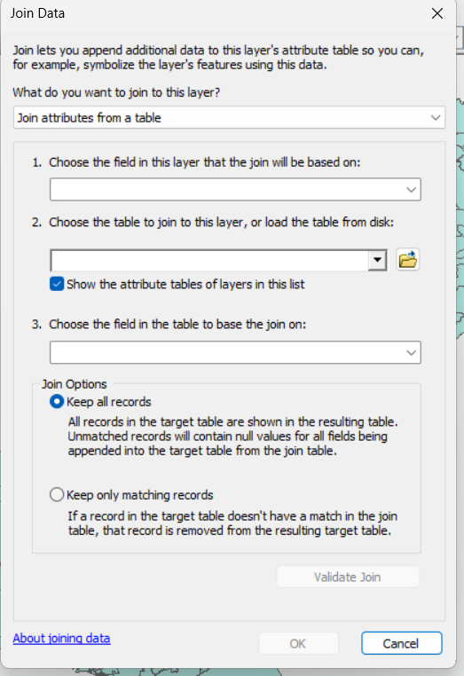
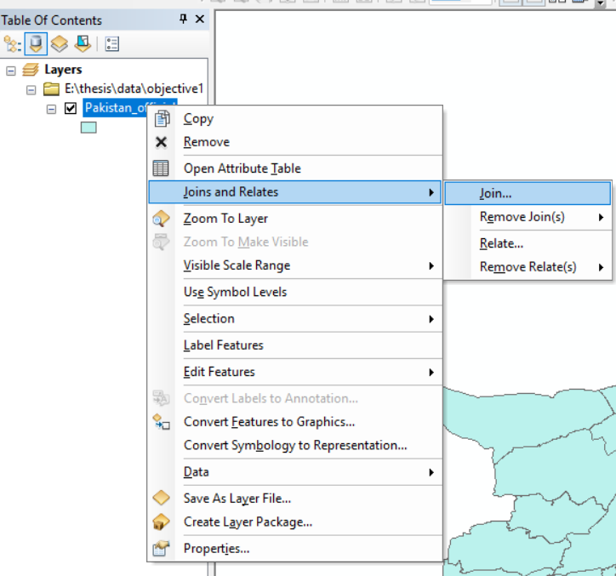
Data Handling in ArcGIS

Slide 6
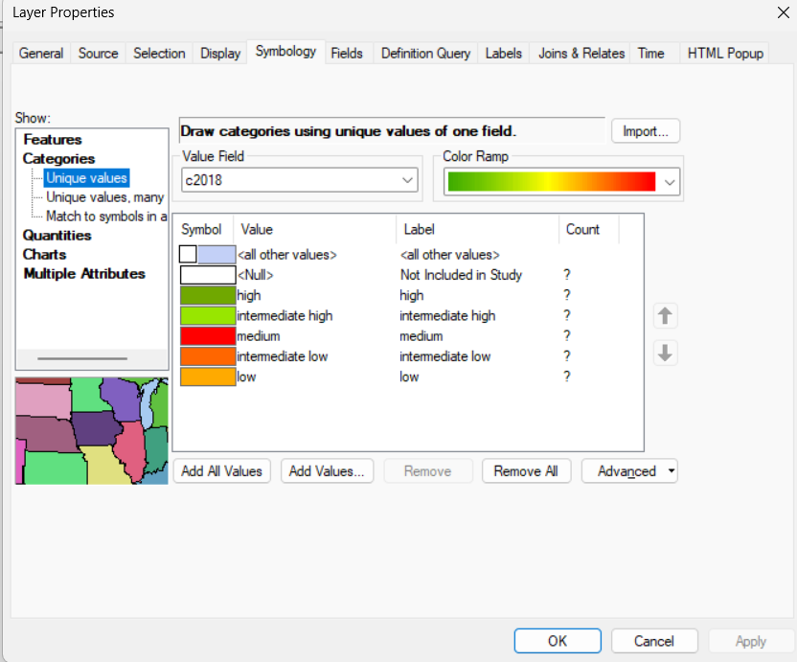
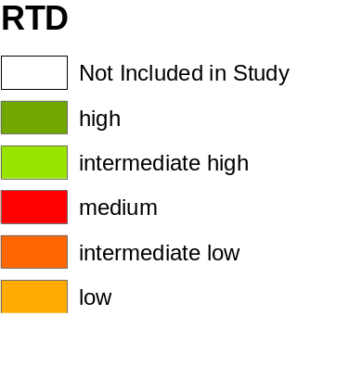

Legend
North Arrow
Scale Bar

Slide 7
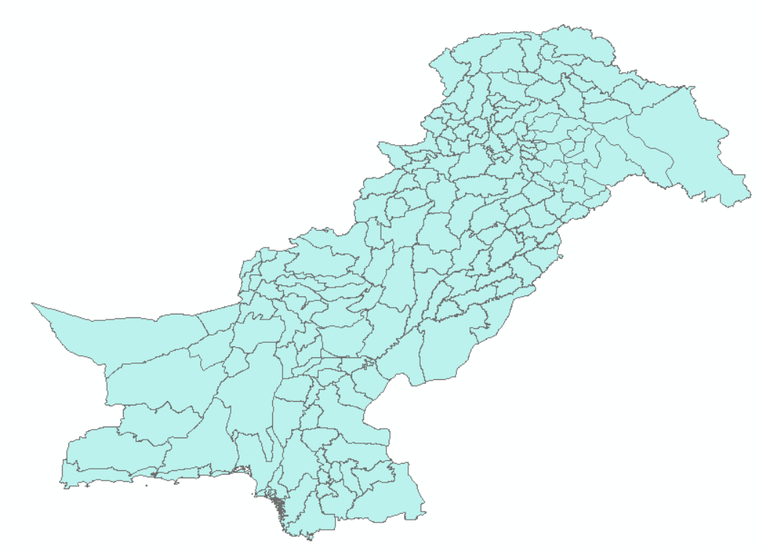
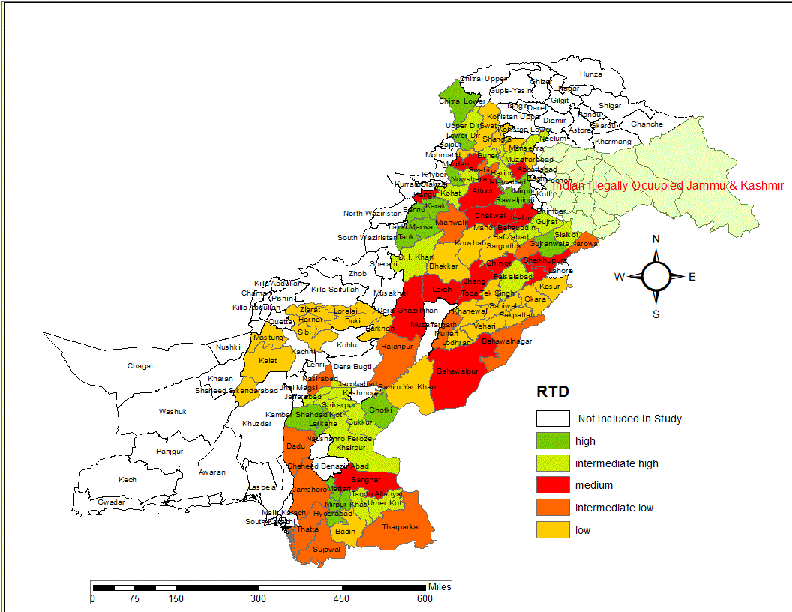
Choropleth Map

Slide 8
Quick View and Live Practice: Working with Spatial Data in ArcGIS

Slide 9
Thank you
Email: farah@pide.org.pk

