Slide 1
From Data to Discovery: The Power of Visualization
“In God we trust, all others bring data.”
W. Edwards Deming

Slide 7
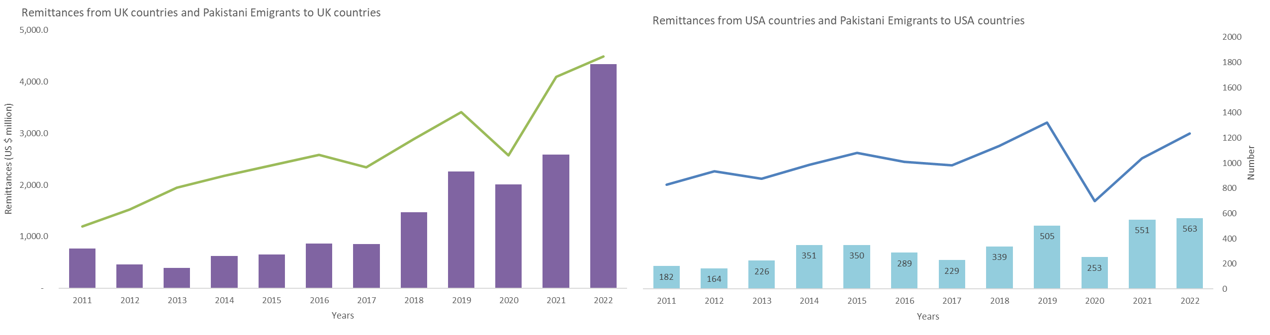

Slide 11
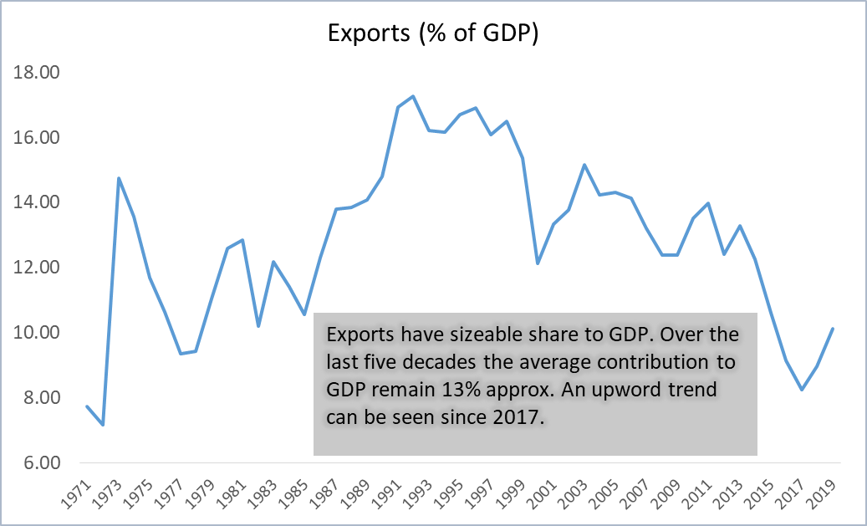

Slide 12
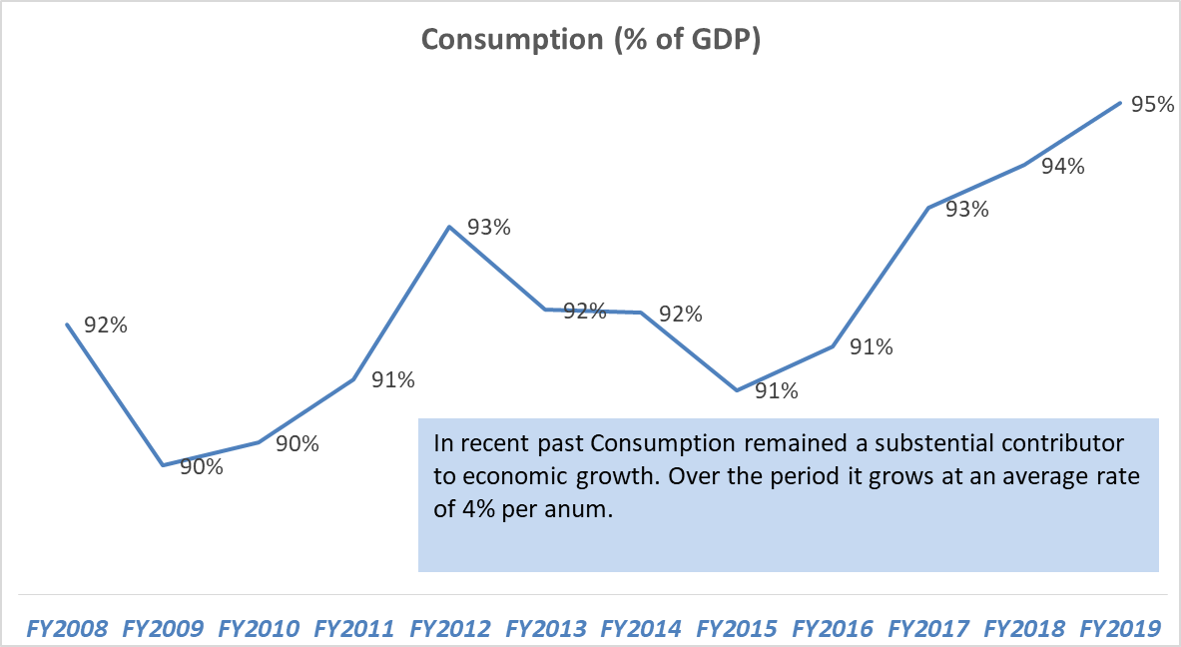

Slide 13
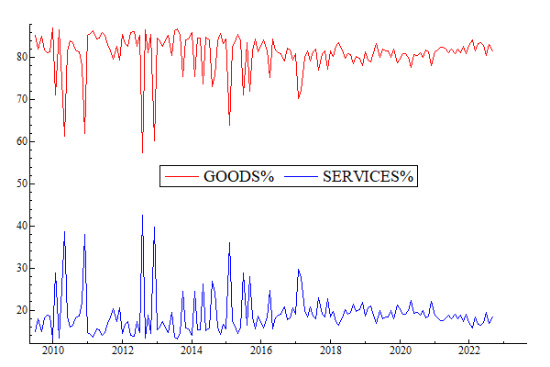

Slide 14
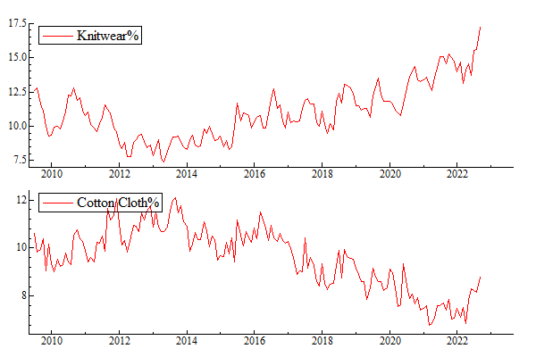

Slide 15
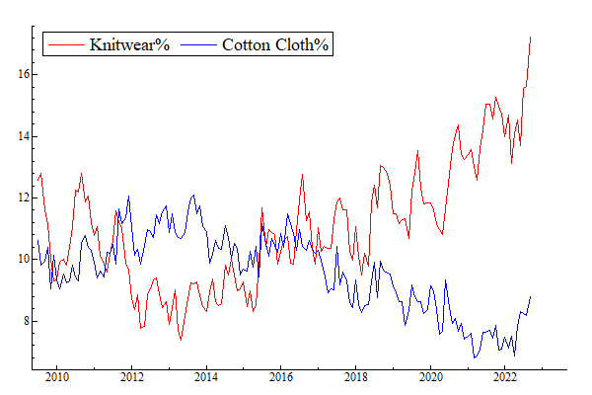

Slide 16
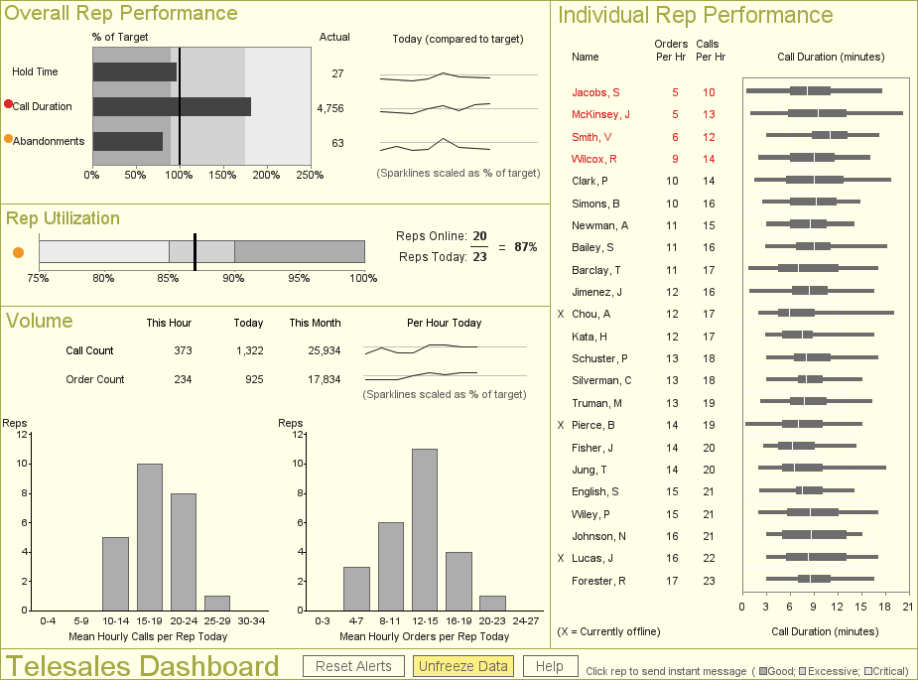
Most people agree that this is data visualization…
Source: Information Dashboard Design (2 Ed.) by Stephen Few
Notes:
This is a call center dashboard featured in Stephen Few’s book, Information Dashboard Design. This would certainly be considered data visualization.

Slide 17
The Building Blocks of Data Visualization

Slide 18
Putting it all together
We live in a world that is rich with data
Tools let us look at the past, present, and “try out” future scenarios
Ultimately, we want to understand our world and make better choices, change behavior, grow wealth, improve quality of life, etc.
We discover how to do these things by asking questions through data…

Slide 19
Putting it all together
The understanding and interpretation of data is an activity of
human cognition
  Asking questions, discovering patterns, drawing meaning from the data
  Creative, visually-driven process; also requires empirical and mathematical skills
  Requires subject matter knowledge
  Built-in rules (or at least, guidelines) affect the way we process
  information

Slide 20
Easy, right? Not so fast…
Software promises to reveal the answers…but…
  Computers can’t figure out what our data means, how it connects to the business or problem, and what to do
  Data needs are changing (e.g., big data)
  Users expect “iPhone easy”
We don’t train for visual intelligence
Data + tools + brains >>> DATA ANALYTICS

Slide 21
Concluding Thoughts
Ultimately, we’re trying to understand our world and make better choices, change behavior, enhance wealth, or improve quality of life.
Learning more about the way our brains work, how we perceive and process data, and improving how we practice visualization
is essential to achieving these goals.

Slide 22
Data Visualization Tool Comparison Chart
Software | Key Features | Pricing | Best for | Core Uses
Visme | Customizable charts and infographics, AI tools, animation and interactivity, analytics tools, robust template library | Free; Paid plans from $12.25/month | Non-designers, marketers | Presentation-ready charts, maps, infographics, interactive visuals, social media graphics with animations
Tableau | Advanced and interactive dashboards, real-time data analysis, AI-powered insights, real-time collaboration, geospatial visualization | From $15/user/month | Data analysts, enterprises | Complex data visualization, real-time analytics, storytelling dashboards
HubSpot | CRM reporting and data visualization, integration with BI tools | From $15/mo/seat | Marketing and sales teams | Visualizing customer trends, marketing funnels, and sales performance
Microsoft Power BI | Interactive dashboards, data modeling, AI insights, drill-downs, strong Microsoft integration | Free; Paid plans from $10/user/month | Business analysts, enterprises | Connecting multiple data sources, advanced analytics, real-time dashboards
RawGraphs | Open-source, unique chart types (alluvial, chord, sunburst), direct data import via CSV/TSV/JSON/API, SVG export | Free | Designers, researchers | Creating highly customized data visualizations for research or design workflows
Flourish | 50+ templates, interactive maps and charts, animations, live data updates, no coding required | Free plan; Paid plans (custom pricing) | Storytellers, marketers, educators | Interactive data stories, dashboards, presentation, and embeddable visuals
Sisense | Embedded interactive visualizations, AI-driven insights, data modeling and connectivity, cloud deployment | Get quote | Enterprises | Creating BI dashboards with advanced drill-down capabilities
Databox | Centralized metrics and visual dashboards, AI performance summaries, dashboard templates, TV and mobile dashboards, white-labeling | Free; Paid starts at $47/month | SMEs, marketing agencies | Tracking KPIs from multiple data sources in visual dashboards
Datawrapper | Easy-to-use responsive charts, data import and integration, customization options, team collaboration | Free; Paid starts at $599/month | Journalists, researchers | Visualizing survey data, news insights, and academic research
Google Charts | Free and customizable charts, multiple chart types, customization tools, real-time data update, team collaboration | Free | Developers | Creating embeddable charts for websites and applications

Slide 23
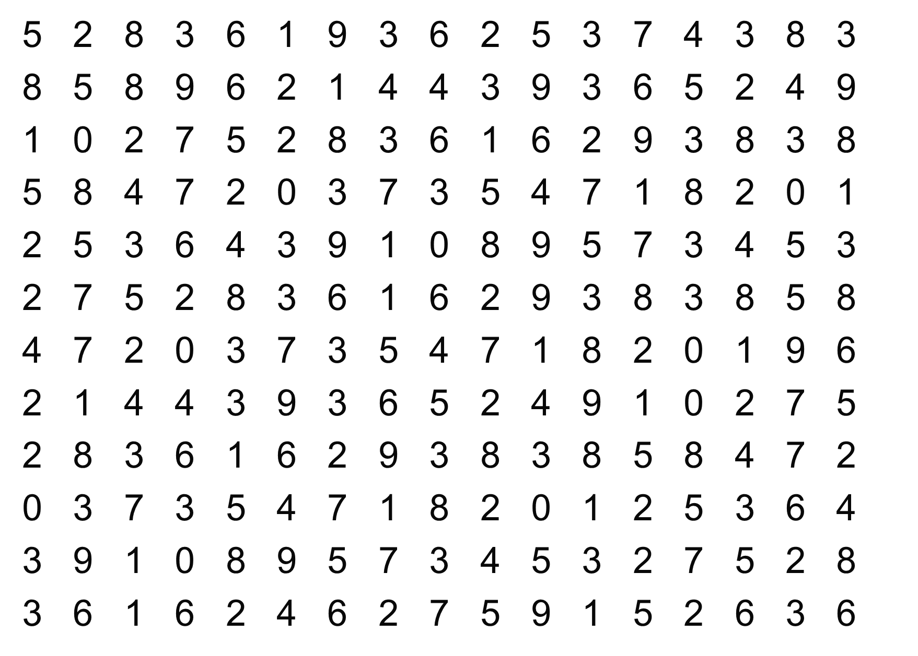
How many times does the digit 7 appear?
Notes:
Try to count the number of times the digit 7 appears in this data set. [give the students about 30 seconds to come up with a number, but don’t let them shout it out. After the exercise, as how many had 15, then 16, 17, 18, 19]. “Notice two things about this exercise. One, it takes a good bit of time to find them. Two, notice the error. Not everyone will come up with the same number.” [we will give the answer in a few slides]

Slide 24
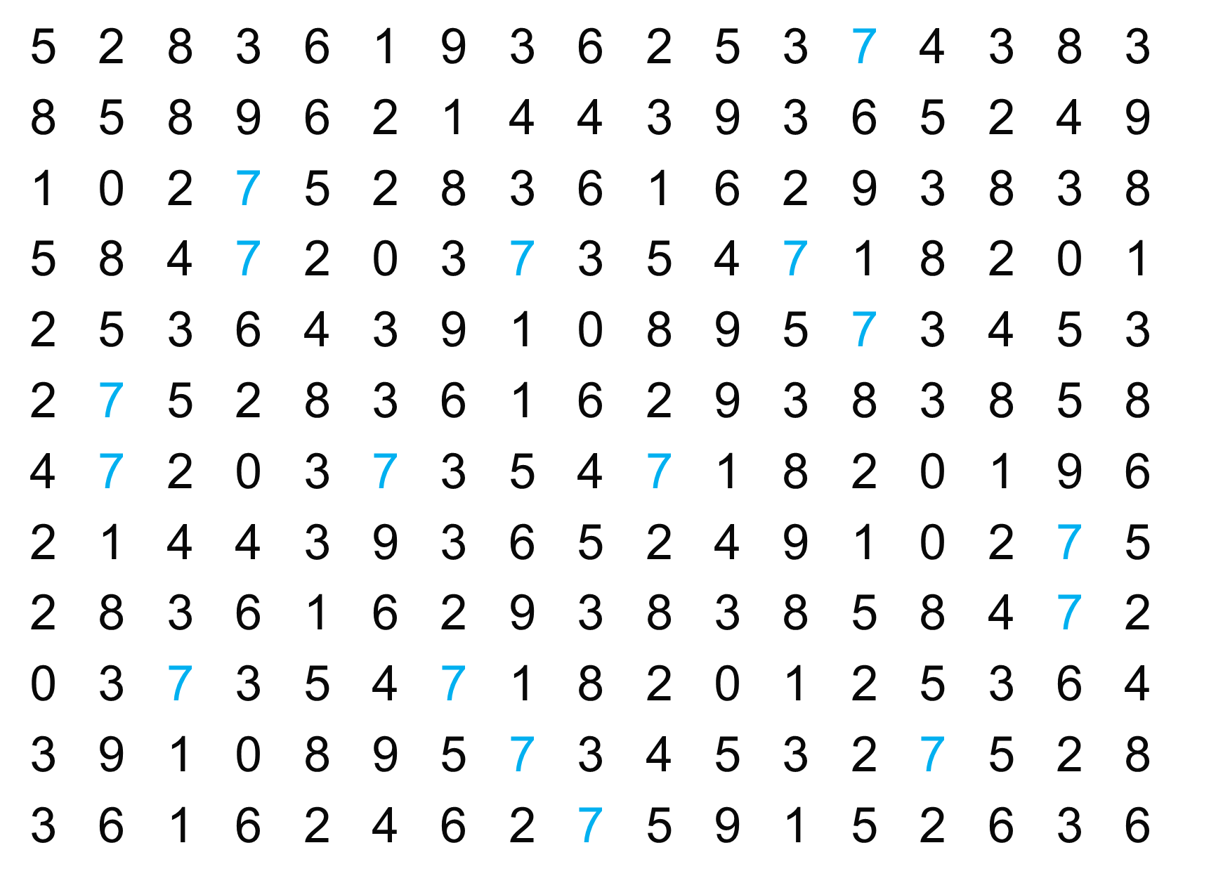
Notes:
“Is it easier now? We simply changed the color of the sevens and now it is easier to find them.”

Slide 25
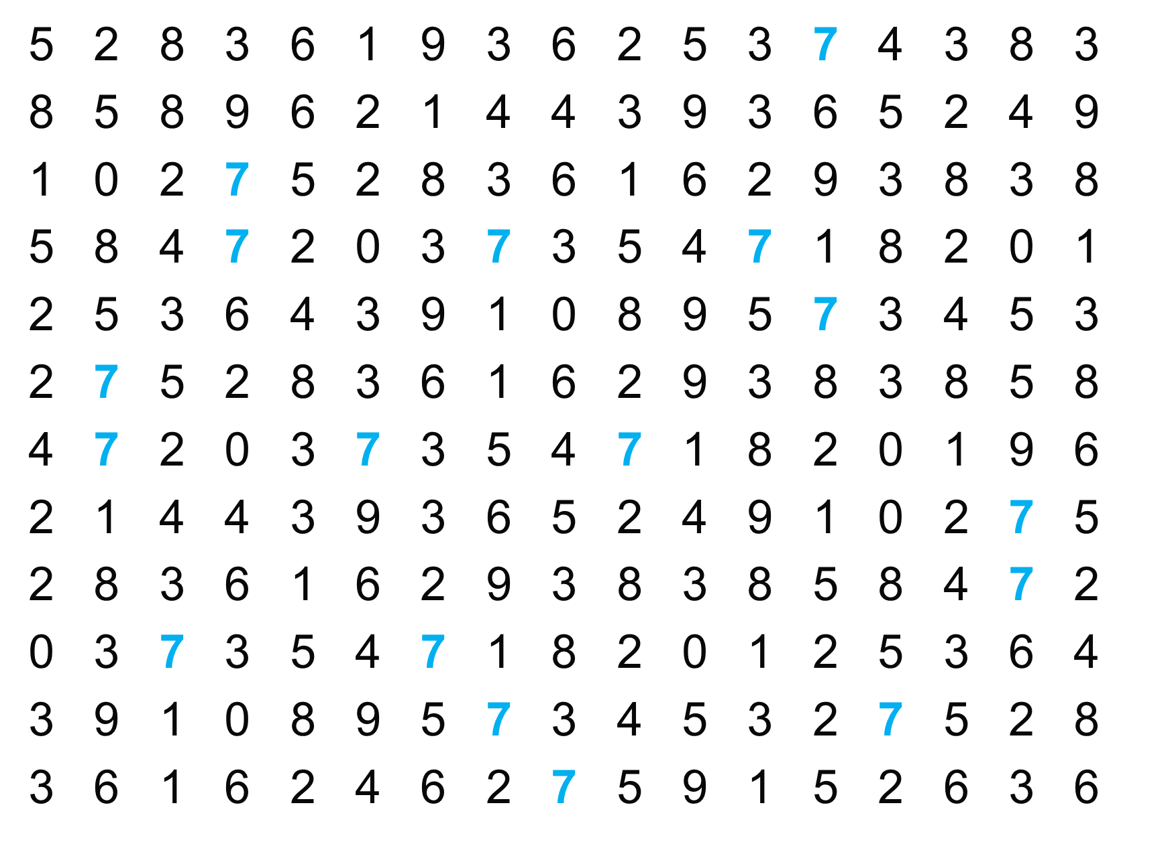
Notes:
“And now? Making it bold is easier.”

Slide 26
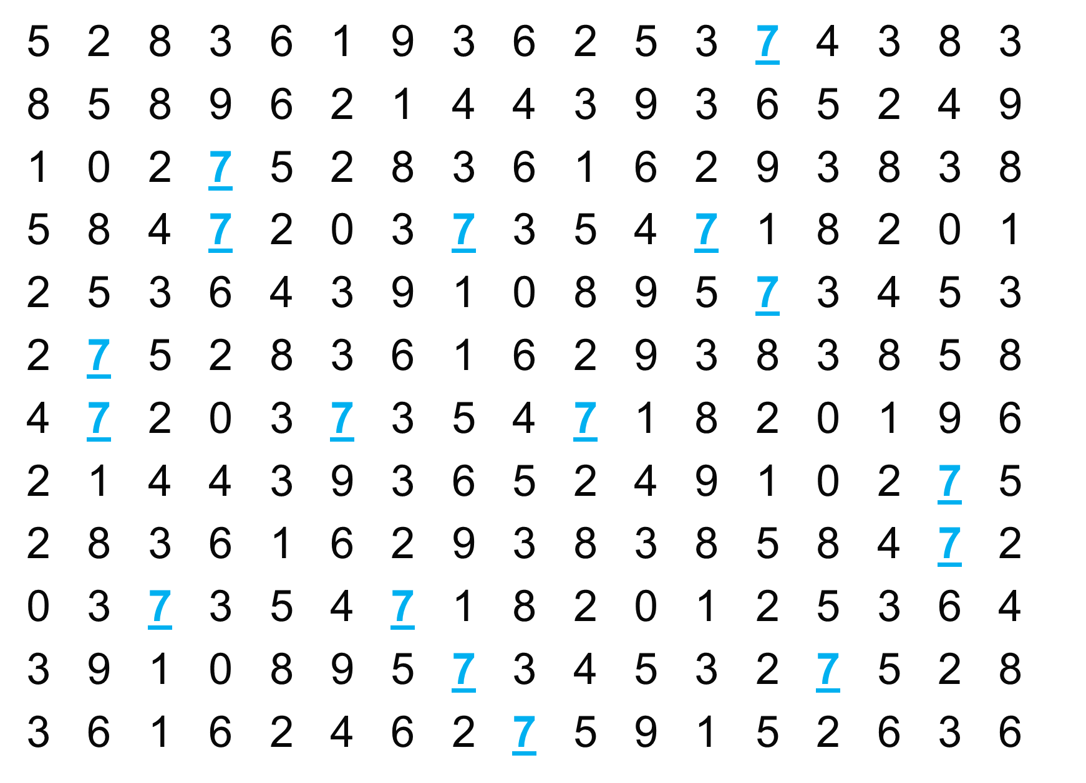
Notes:
“And underlining them.”

Slide 27
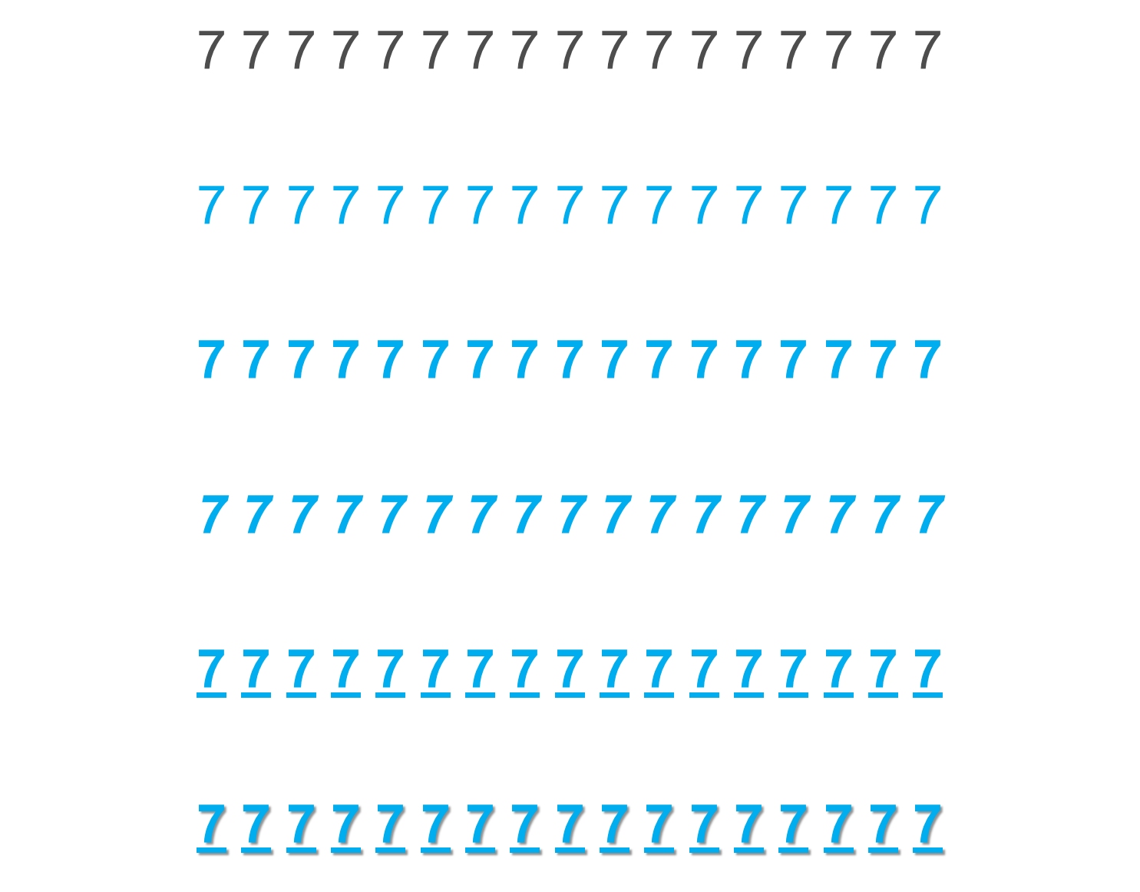
Notes:
“We can do all sort of things to make the sevens easier to see. What we are doing is using the preattentive attributes.”

Slide 28
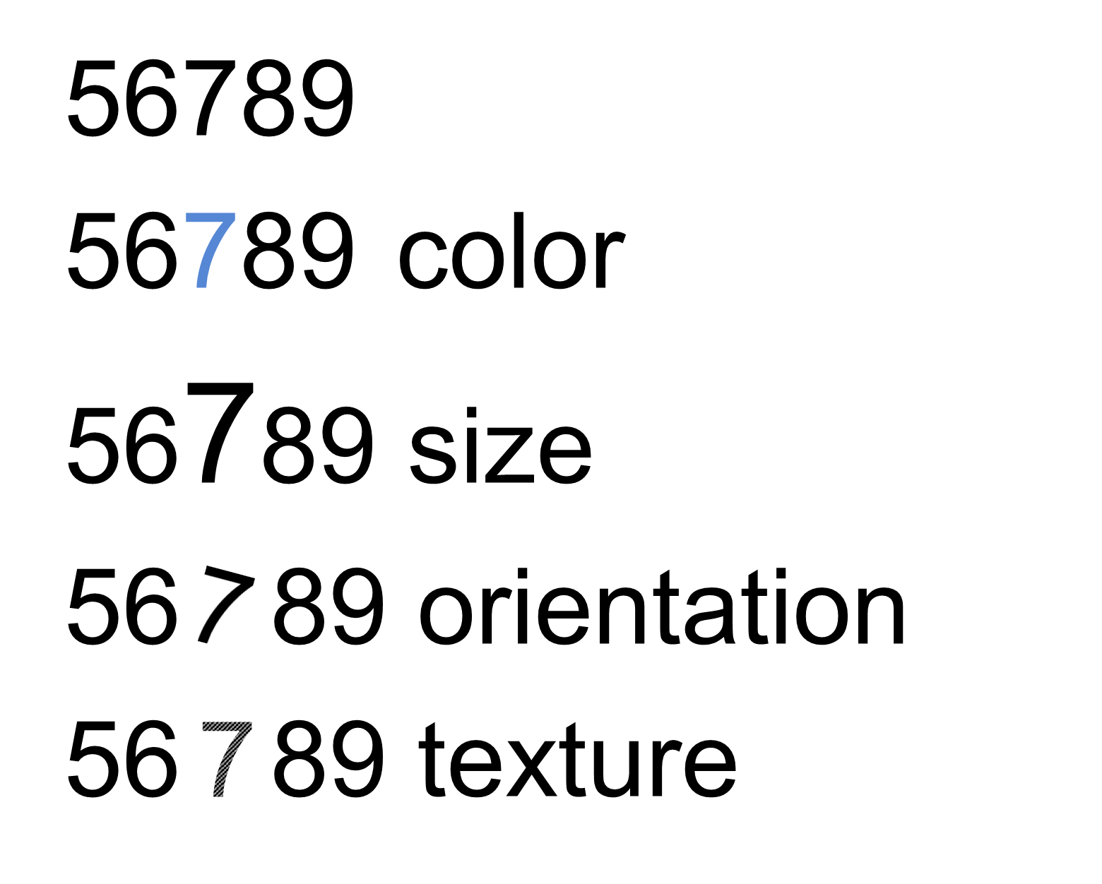
PRE-ATTENTIVE ATTRIBUTE
color, size, orientation and texture are pre-attentive (brain processes the information prior to focusing attention on anything)
Notes:
“Things like color, size, orientation and texture are preattentive. It means the brain processes the information prior to focusing attention on anything. This happens in about 250 milliseconds.”

Slide 29
We are born with an enhanced visual path to cognition
  Approximately 70% of sense receptors are in our eyes
  40% of the cerebral cortex is involved in processing visual information
  The visual connection to the brain has more bandwidth than other paths
  Visual perception is intimately connected to understanding
  This is reflected in language
    - “I see what you’re talking about…”
    - “Sketch out the idea…”
    - “Seeing is believing…”

Slide 30
Our brain is powerful… but working memory is limited
  Long-term memory is very important
  Working memory limited to a small number of “chunks”
  Visualization allows us to consolidate complex statistics so we can process more data simultaneously.
  The picture is not the end goal – It’s what we do with it that is important

Slide 31
Making sense of our visual world…
our perception of data on a typical printed page is associated
with the following visual variables:
  Shape
  Orientation
  Color
  Texture
  Value
  Size
  …and the two planar dimensions (x and y)
  which are encoded in Position and Order.
Based on the contemporary preponderance of digital technology, these factors have also become critical:
  Motion – animated presentation of frames of data
  Medium – the physical strata on which data is displayed
  Context – the sensory and emotional environment
Notes:
According to Bertin,

Slide 32
Shape
Notes:
Shape is a preattentive attribute. Notice in these examples we also see the Hermann Effect with the scintillating grid.

Slide 33
Shape
Notes:
It’s easy to see the different shapes. This could be useful for categorical comparisons, but would not be useful for a quantitative comparison.

Slide 34
Orientation
Notes:
Orientation is another preattentive attribute.

Slide 35
Orientation
Notes:
Similar to shape, this could be useful to show a categorical comparison or as a directional icon. For example, an arrow pointing up could mean something has increased and an arrow pointing down could mean something decreased.

Slide 36
Color (Hue)
Notes:
When people think about color, they typically mean color hue. The color blue versus the color red. This is a very powerful preattentive attribute. In data visualization.

Slide 37
Color (Hue)
Notes:
We can draw the reader’s attention or alert them to something important.

Slide 38
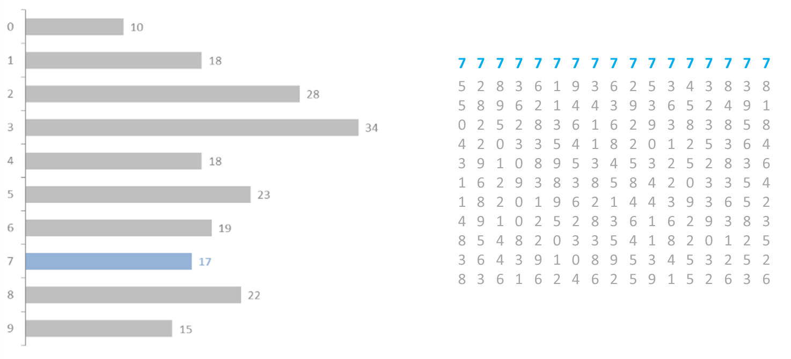
# of times digit 7 appears: 17
Notes:
“We can use charts to visualize our data and now we have more information about the data set. But just as we ordered the numbers in the grid on the right, we can do the same thing with a graph.”

Slide 39
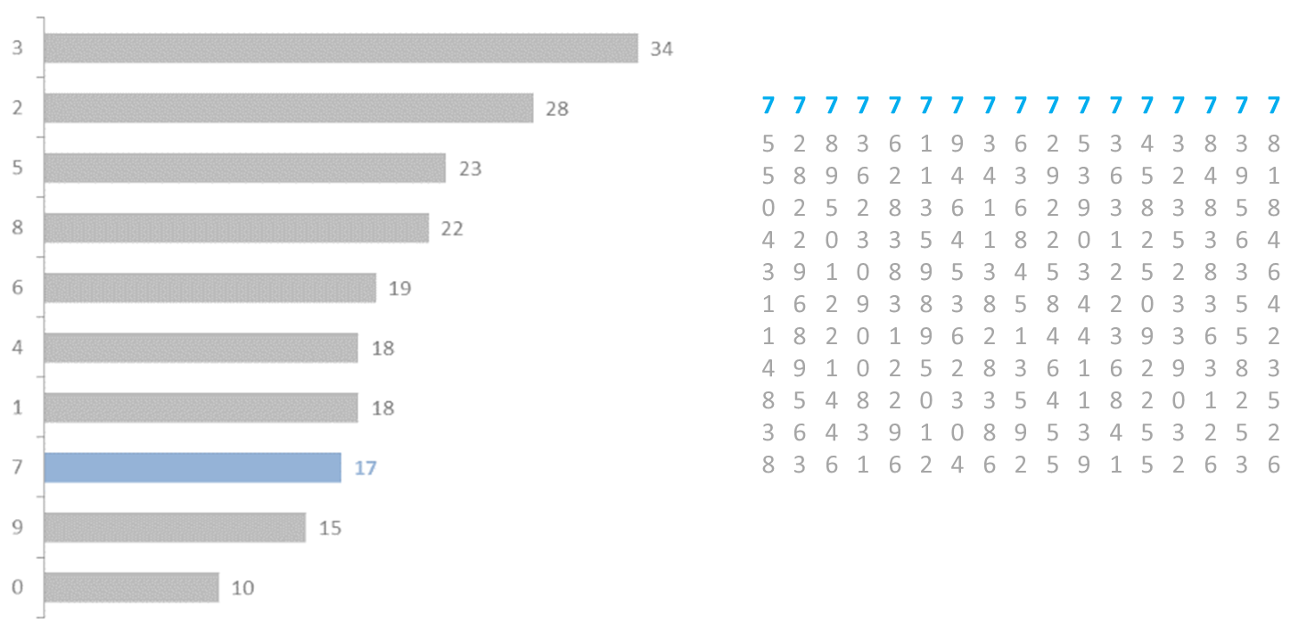
By ordering our graph, information is more readily available
# of times digit 7 appears: 17
Notes:
“By ordering our graph, we have even more information that is readily available. For example, we now know that the sevens are the third from the bottom. We can answer questions like ‘what are the top three?’ or ‘what are the bottom three?’ or ‘what’s the second most?’ These are all very easy to see and answer quickly and accurately from the graph. Also notice how easy it is to see the sixes show up just one more time than the fours. Even very small difference are easy to see from bar charts.”

Slide 40
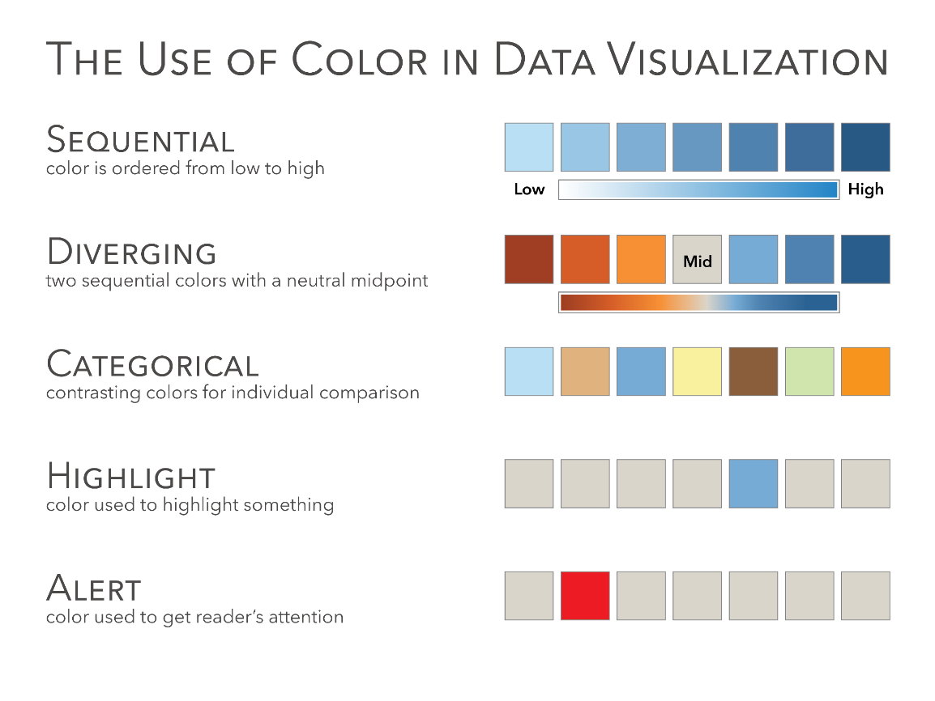
Source: The Big Book of Dashboards (page 15)
Notes:
“One of the most frequent mistakes in data visualization is the use of color. This is one of the most important slides we will cover in the entire course. It will be very important for you to know this slide, not only for the test questions, but also for your work through the course and in your future data visualization work.
The three primary ways you will use color in data visualization is Sequential, Diverging and Categorical.
Sequential color encodes a quantitative value from low to high. A great example of this is Sales, which goes from zero to infinity.
Diverging color encodes a quantitative value but has a midpoint. The midpoint could be zero, for example, displaying Profit. Profit can be positive, encoded in blue with darker blue higher profit. Profit could also be negative, encoded in orange with the darker orange showing a bigger loss. The midpoints does not have to zero. It could be the average, where it shows the average unemployment rate in the country and then one color showing the states below the average and the other color above the average. It could also be a target value, such as last year’s sales or this years projections and the two colors would encode values above and below that target.
Categorical colors encode categories. Apples, bananas, oranges, pears, or shoes, socks, shirts and ties. It would be very difficult to use a sequential color scheme for categories and trying to figure out which shade of blue means shirst or pants.
A Highlight color is used to highlight one data point or category. For example, if you have 50 lines, each representing one state, then you might highlight one state. This allows the reader to see for example California versus all of the other states.
Alerting colors are used to draw the readers attention, similar to Highlight, but in this case it’s done with an alarming or alerting color to tell the reader that something is wrong. It needs the readers attention. Note that in Western culture that red is often associated with bad. This may not be the case in other countries (ex. China). Bright alerting colors could be red, orange or yellow.

Slide 41
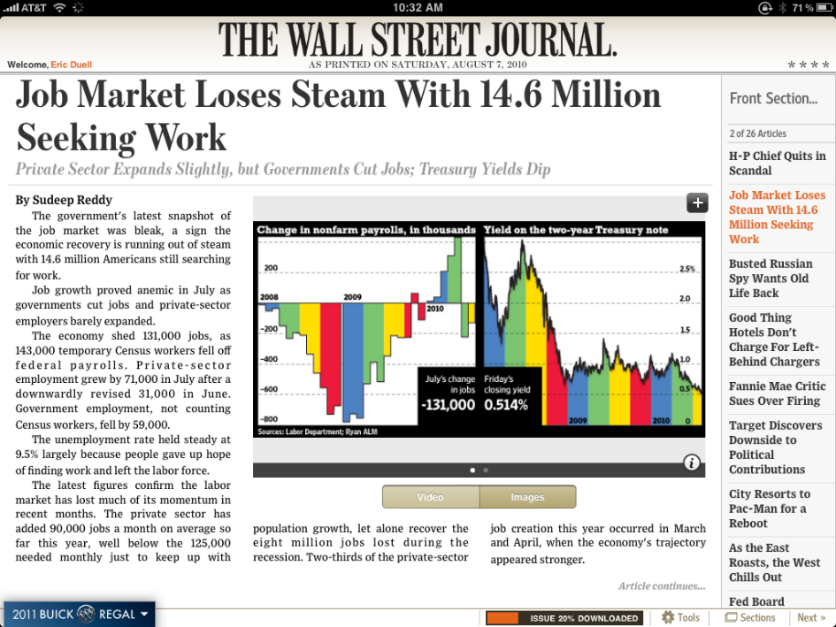
Does this color use enhance or detract?

Slide 42
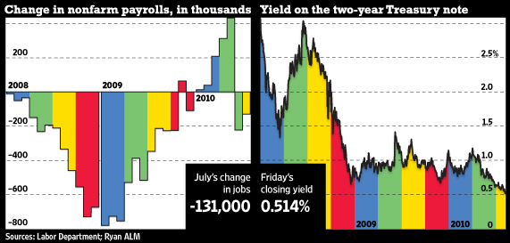
What does color even mean here?
From http://online.wsj.com - The Wall Street Journal Online, originally published August 7, 2010
Notes:
[ask the class what does color represent. It represents quarters]
Is this the best way to encode color in the data?

Slide 43
Color (Value)

Slide 44
Color (Value)
Notes:
Color value can be very useful to encode quantitative value, for example in a sequential or diverging color scheme.

Slide 45
Color (Value)

Slide 46
Texture
Notes:
Texture is another preattentive attributes. It was common to use texture in data visualization when printers only printed in black and white. Some tools offer texture (Excel and PowerPoint), but other tools don’t (ex. Tableau).

Slide 47
Texture
Notes:
This might be one to just keep in the back of your mind. It could be useful to encode categorical data, but not quantitative data.

Slide 48
Size
Notes:
Size can be used to encode both categorical or quantitative data. Note that size is not a good for making precise quantitative comparisons.

Slide 49
Size
Notes:
Notice that it’s easy to see that the one square is smaller than the others, but it’s hard to quantify that amount. Is it one third the size? Or one fourth? [it’s neither]

Slide 50
Position
Notes:
On the other hand, length/height from a common baseline and position are much better for showing precise quantitative comparisons.

Slide 51
Position
Notes:
Notice when using position that we can see even the smallest differences between the squares. Which square is positioned further to the right?

Slide 52
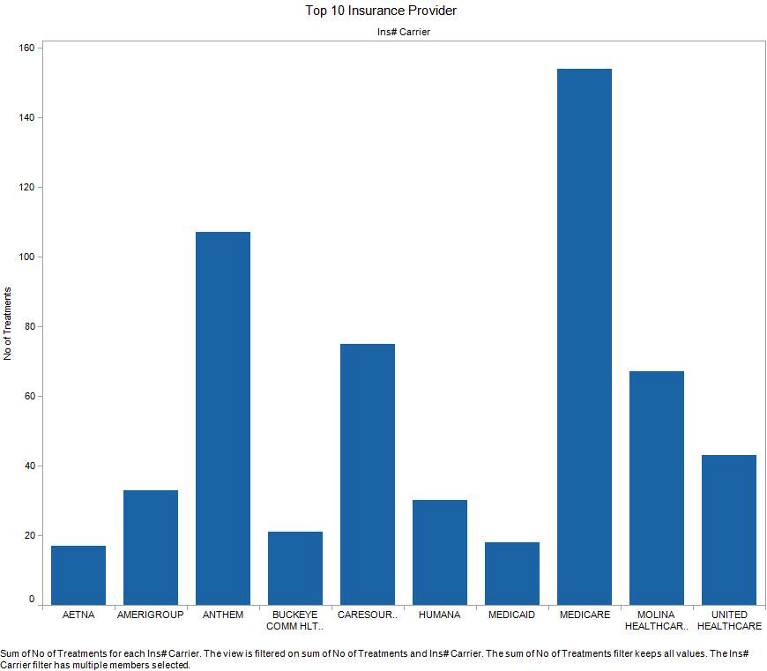
Order
Notes:
This chart is ordered alphabetically. Notice how hard it is to answer these questions quickly and accurately.
What is the top provider?
What is the bottom provider?
What are the top three providers?
What are the bottom three providers?
What rank is Humana?

Slide 53
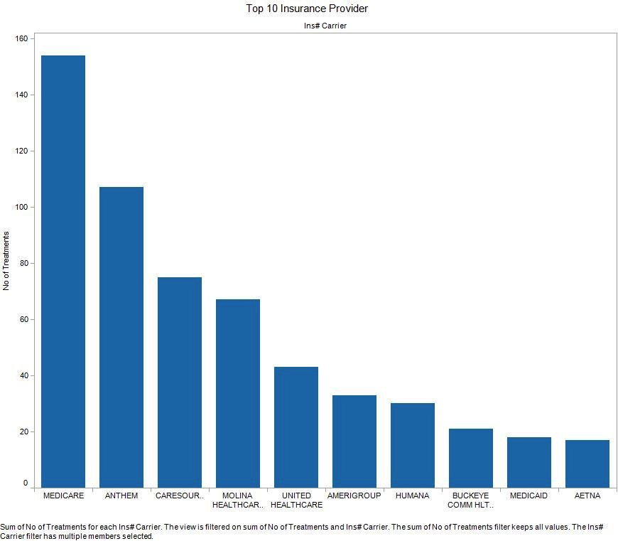
Order
Notes:
Now we order the chart based on the data and ask the same questions.
What is the top provider?
What is the bottom provider?
What are the top three providers?
What are the bottom three providers?
What rank is Humana?
We can answer all of these questions much more quickly and more accurately.

Slide 54
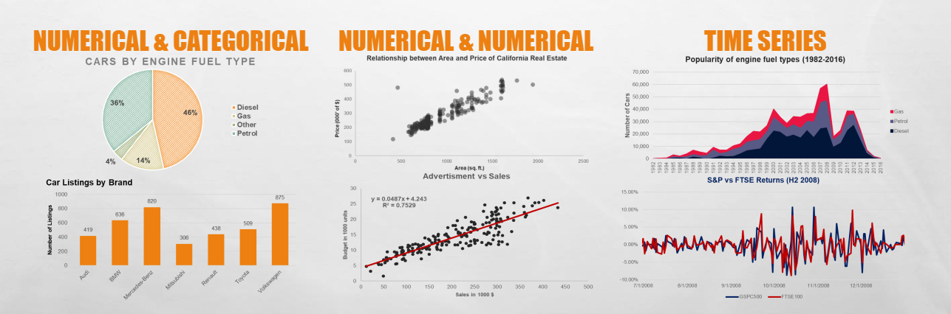
CHARTS AND DATA TYPES
THERE IS NEVER ONLY ONE RIGHT VISUALIZATION

Slide 55
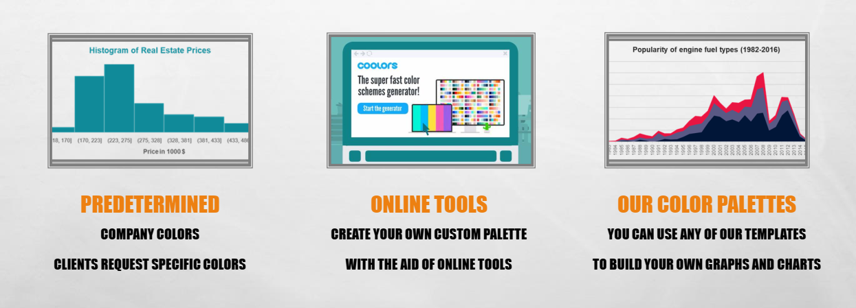
COLORS
CHOOSE 2-3 COLORS FOR YOUR CHART

Slide 56

Four Important Shapes

Slide 57
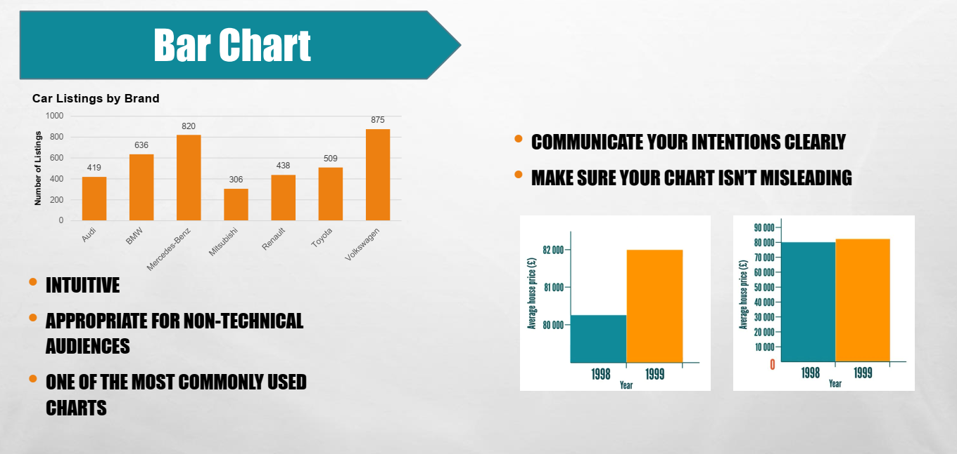

Slide 58
Shape One: Bars

Slide 59
Bar Basics
Bar chart must start at zero.
Failing to do so will make small differences in the data appear large.

Slide 60
Bar Basics
Bars may be oriented vertically or horizontally. Consider your audience’s knowledge of the metrics and layout on the page.

Slide 61
Population Pyramid (Paired Bar Chart)
Designed to show the age and sex composition/distribution, or other sociodemographic information of specific populations.
Often used by healthcare planners and public health experts to understand demographic transitions.

Slide 62
Ranking
Rank values by order to show What you want viewers to consider first?
Ordinal and Interval data should not be displayed in rank order.

Slide 63
Bars for Date Trends
Lines are usually the way that trends over time are displayed.
However, if seeing the actual values in direct comparison to each other is important, a vertical bar chart may be a good choice.
Confer with end users to determine the best way to display time series data using bars oriented horizontally.

Slide 64
Using Bars to Compare Multiple Data Points
Use small multiples.
Direct comparisons
Requires one label and color.

Slide 65
Bars to Display Part-to-Whole Relationships
Stacked bars charts should be limited to two, and on rare occasion three parts.

Slide 66
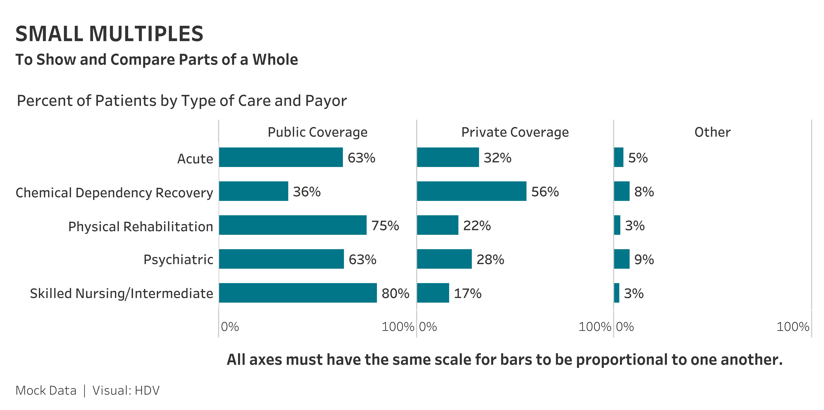
Bars to Display Part-to-Whole Relationships
Small multiples are a great technique to display three or more parts of the whole.

Slide 67
Deviation Bar Charts
Show relative differences from a target, goal, or budget, where the absolute values are all very different and would be difficult to display.
A solution that solves the temptation to start a bar chart at some value other than zero.
May also be used to show absolute difference from a goal or target value and the actual value (end of bar).

Slide 68
Using Bars to Display Ranges and Comparative Values
Floating bars may be used to show a range of values or confidence intervals (CIs).
Easy to add a point or line to show mean, median, or a specific group’s results.
Bullet graphs allow for encoding lots of comparative values and are perfectly designed to get a lot of information in a limited amount of space. Perfect for dashboards.
A key is always required to be placed close to these types of graphs, so the end viewer understands the display.

Slide 69
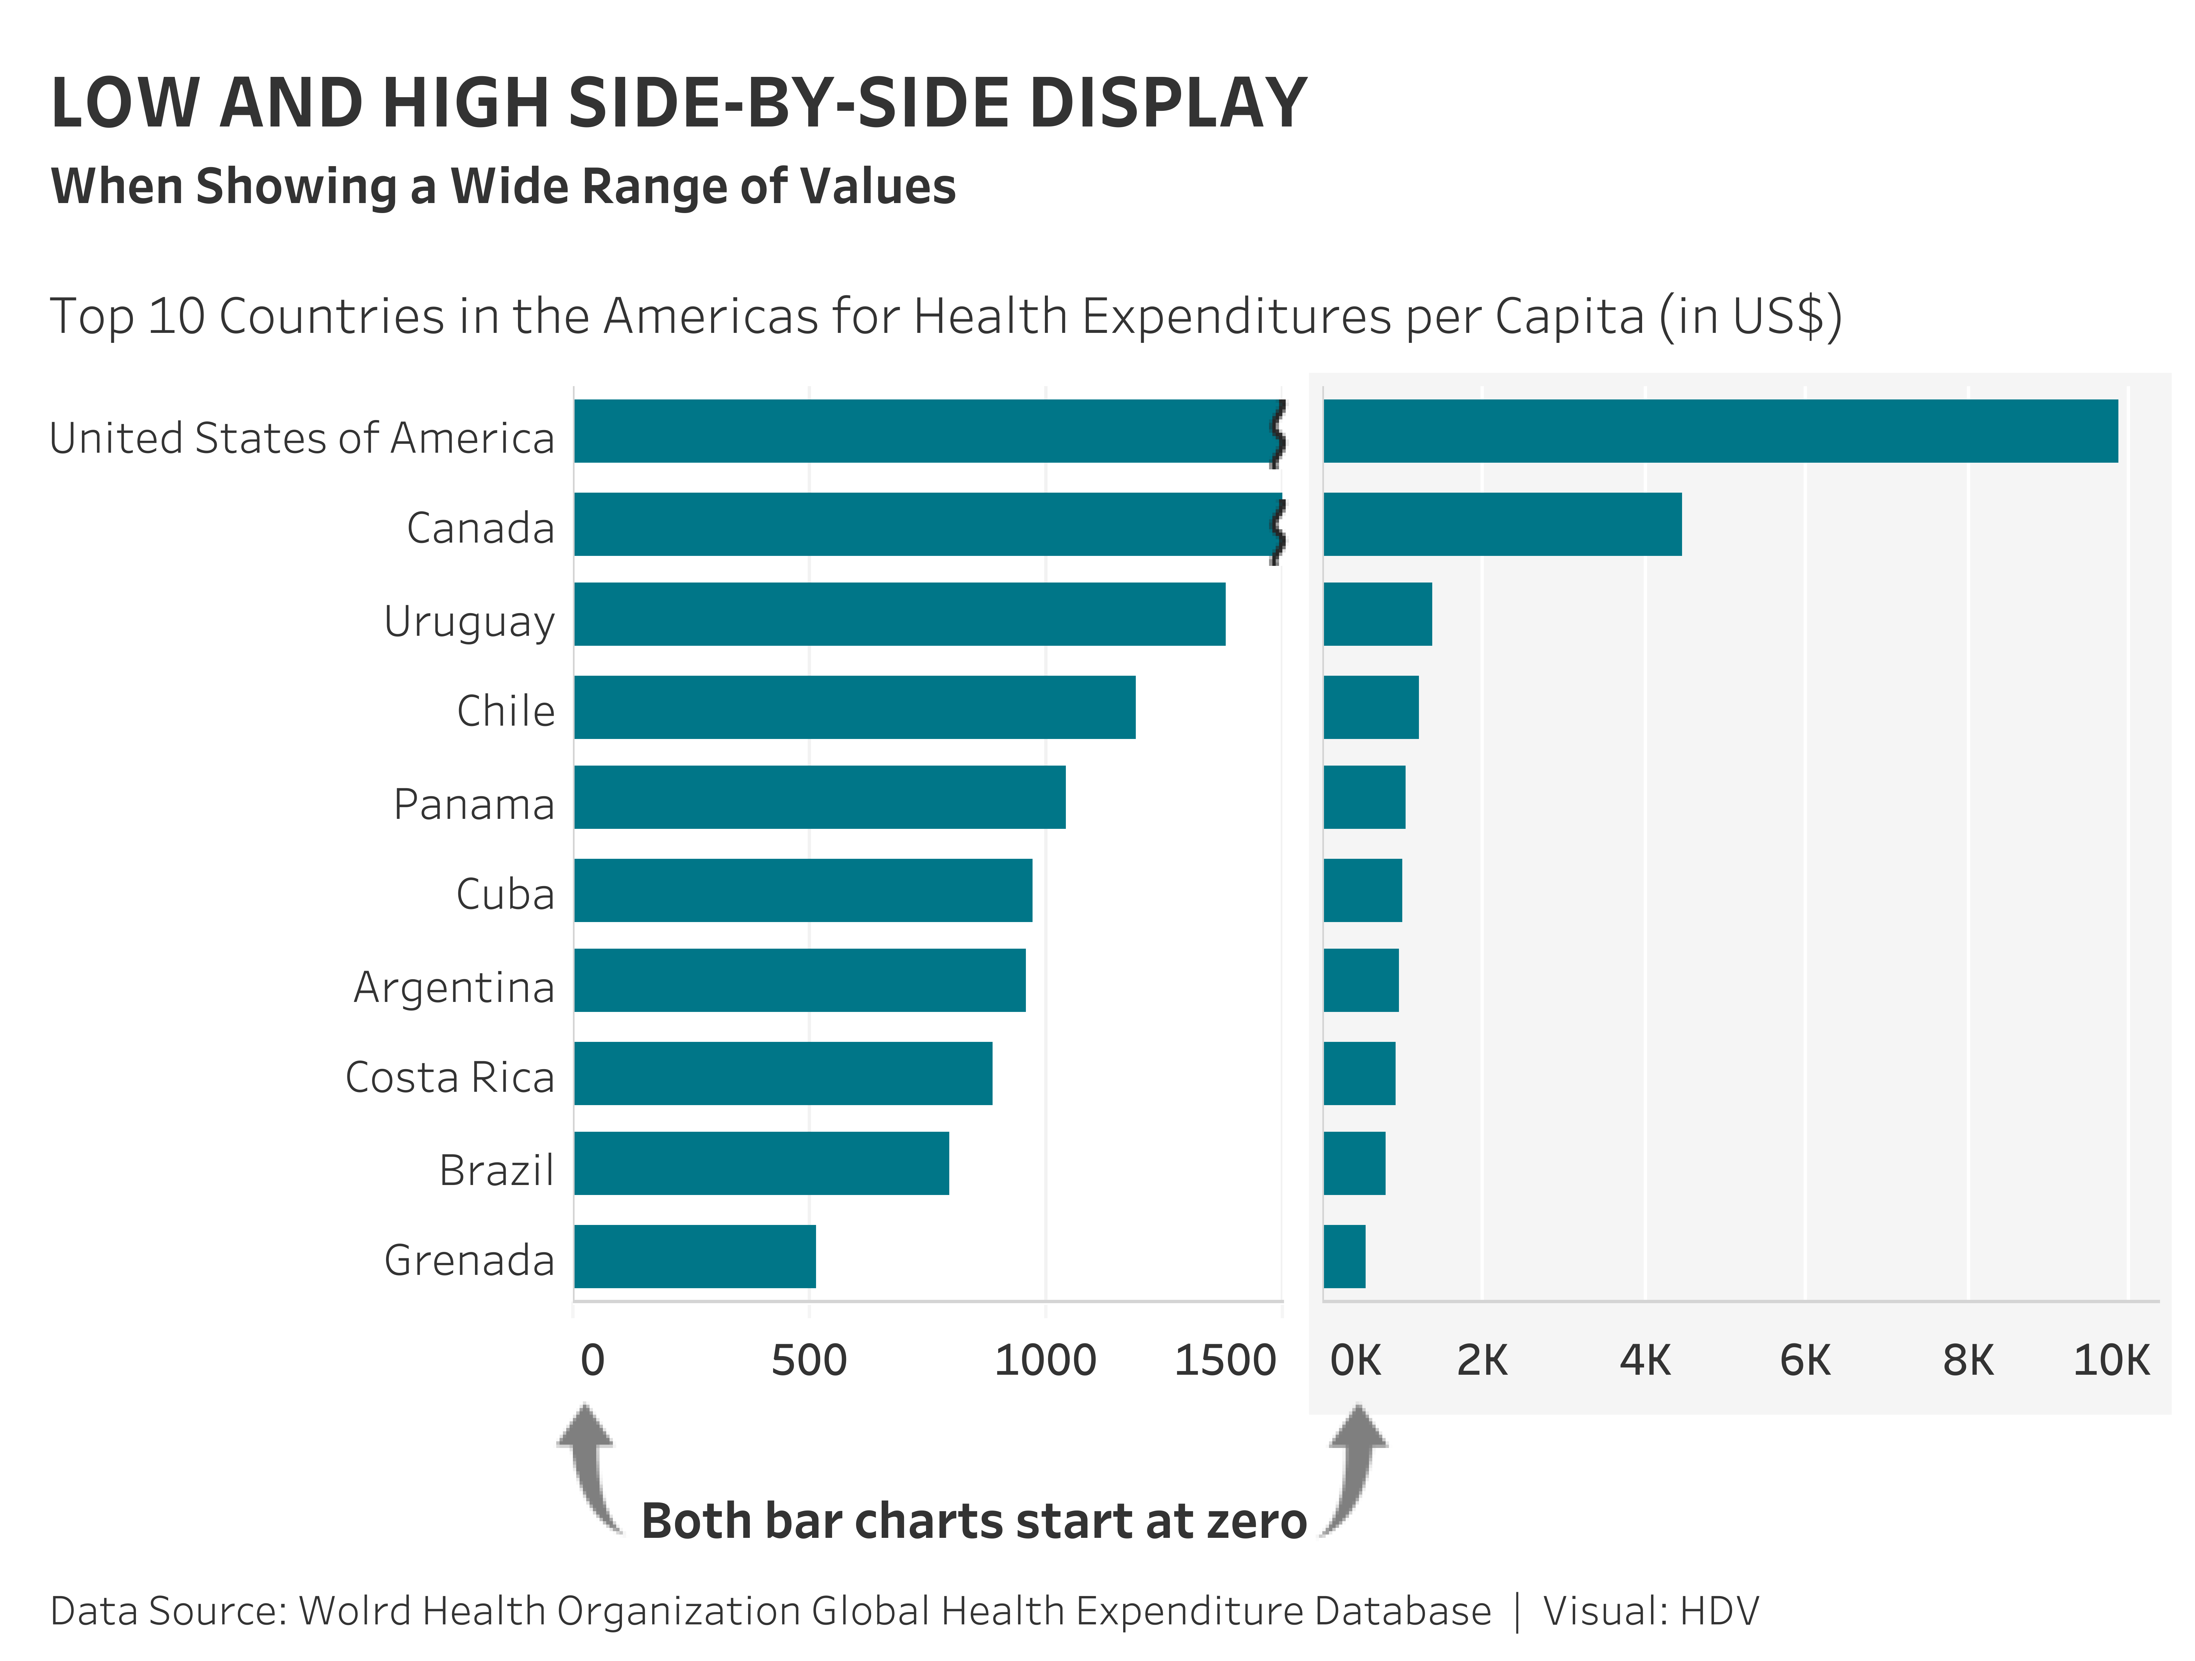
Wide ranges of data values may be displayed using two bar charts placed side by side to show the low and high values.
Low and High Side-by-Side Display

Slide 70
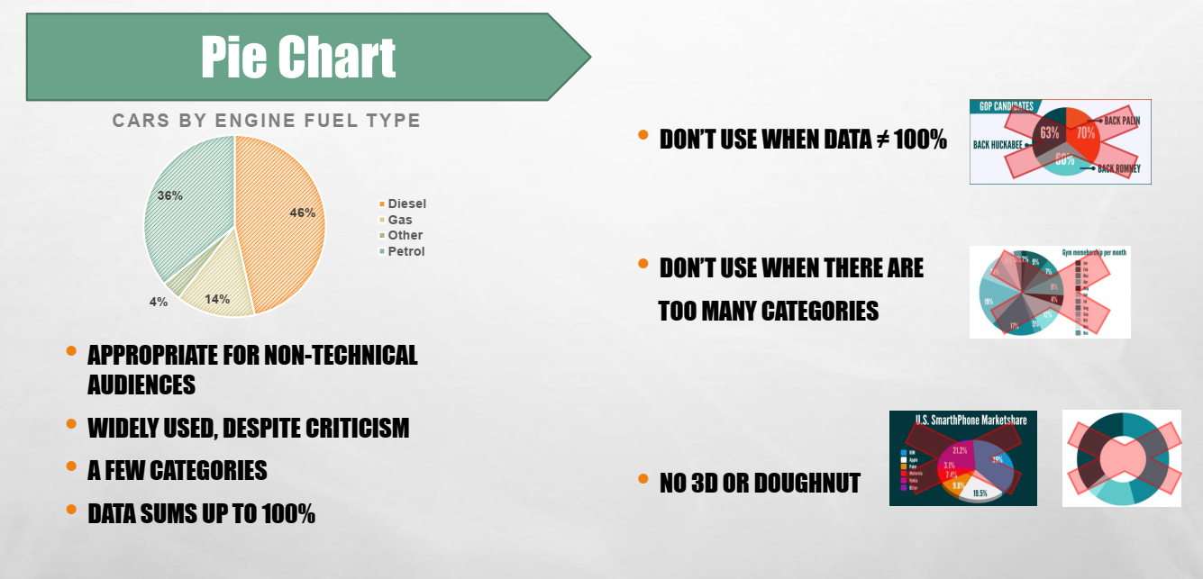

Slide 71
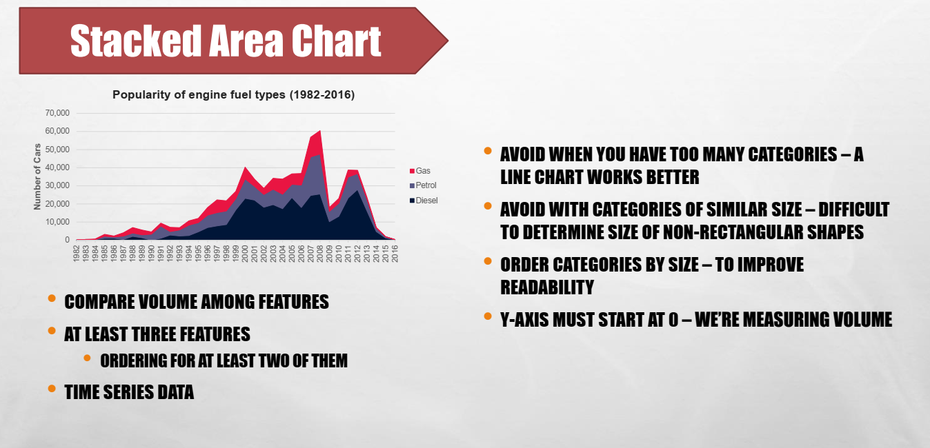

Slide 72
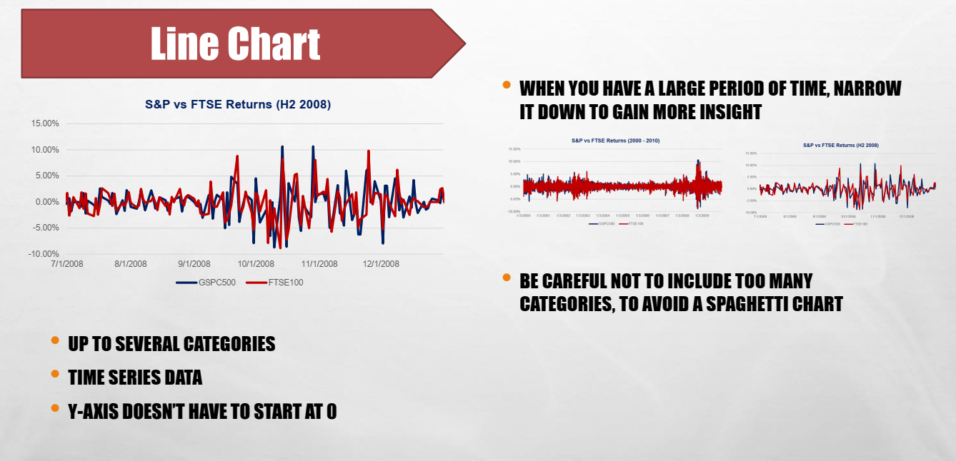

Slide 73
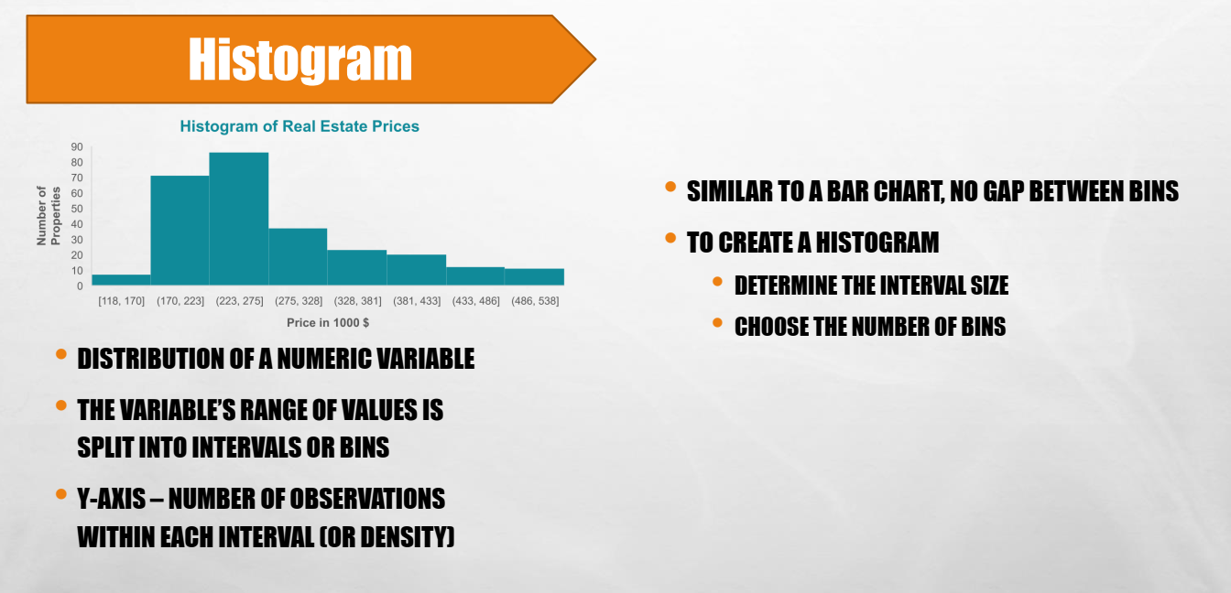

Slide 74
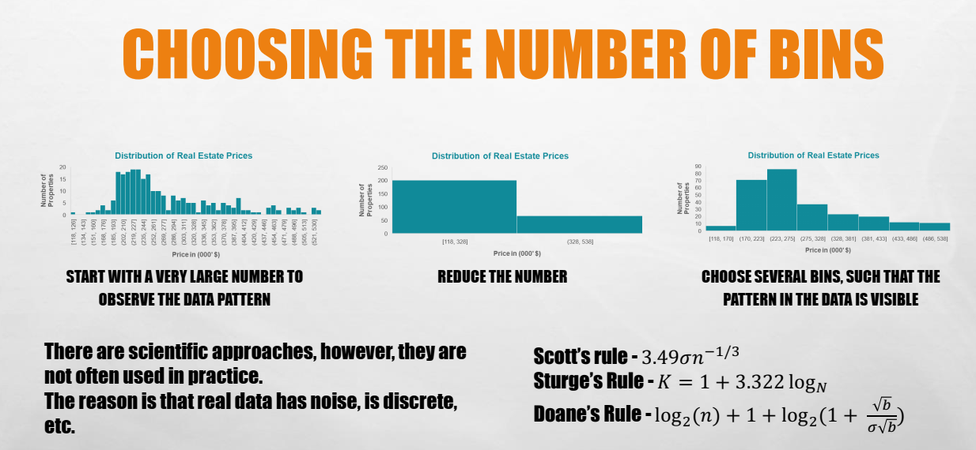

Slide 75
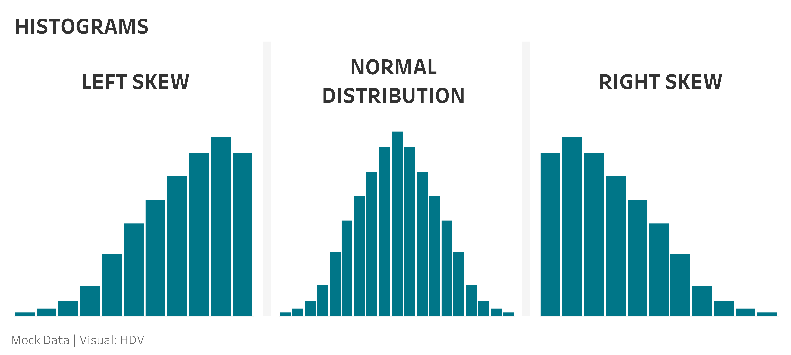
Histograms

Slide 76
Bin Size and Labels
Beware of the “My Bin or Yours” Trap
and Different Sized Bins
Don’t overlap bin values
Draw attention to bins of different sizes

Slide 77
Unlike bars, line scales need not start at zero.
Line Basics

Slide 78
Limit lines on a single display, consider small multiples

Slide 79
Missing Data and Actual vs. Forecast Data
If a value is missing, it must be shown as a gap and not as zero, which is a true value.
If actual vs. forecast data is being displayed, the line must display the data using different types of lines.
Leverage preattentive attributes to signal to the viewer “something is different, look here.”

Slide 80
Slope Graphs and Bump Charts
Slope graphs show change from one point in time to another and change in rank.
Bump charts show how the rankings of different values have changed at multiple points in time.

Slide 81
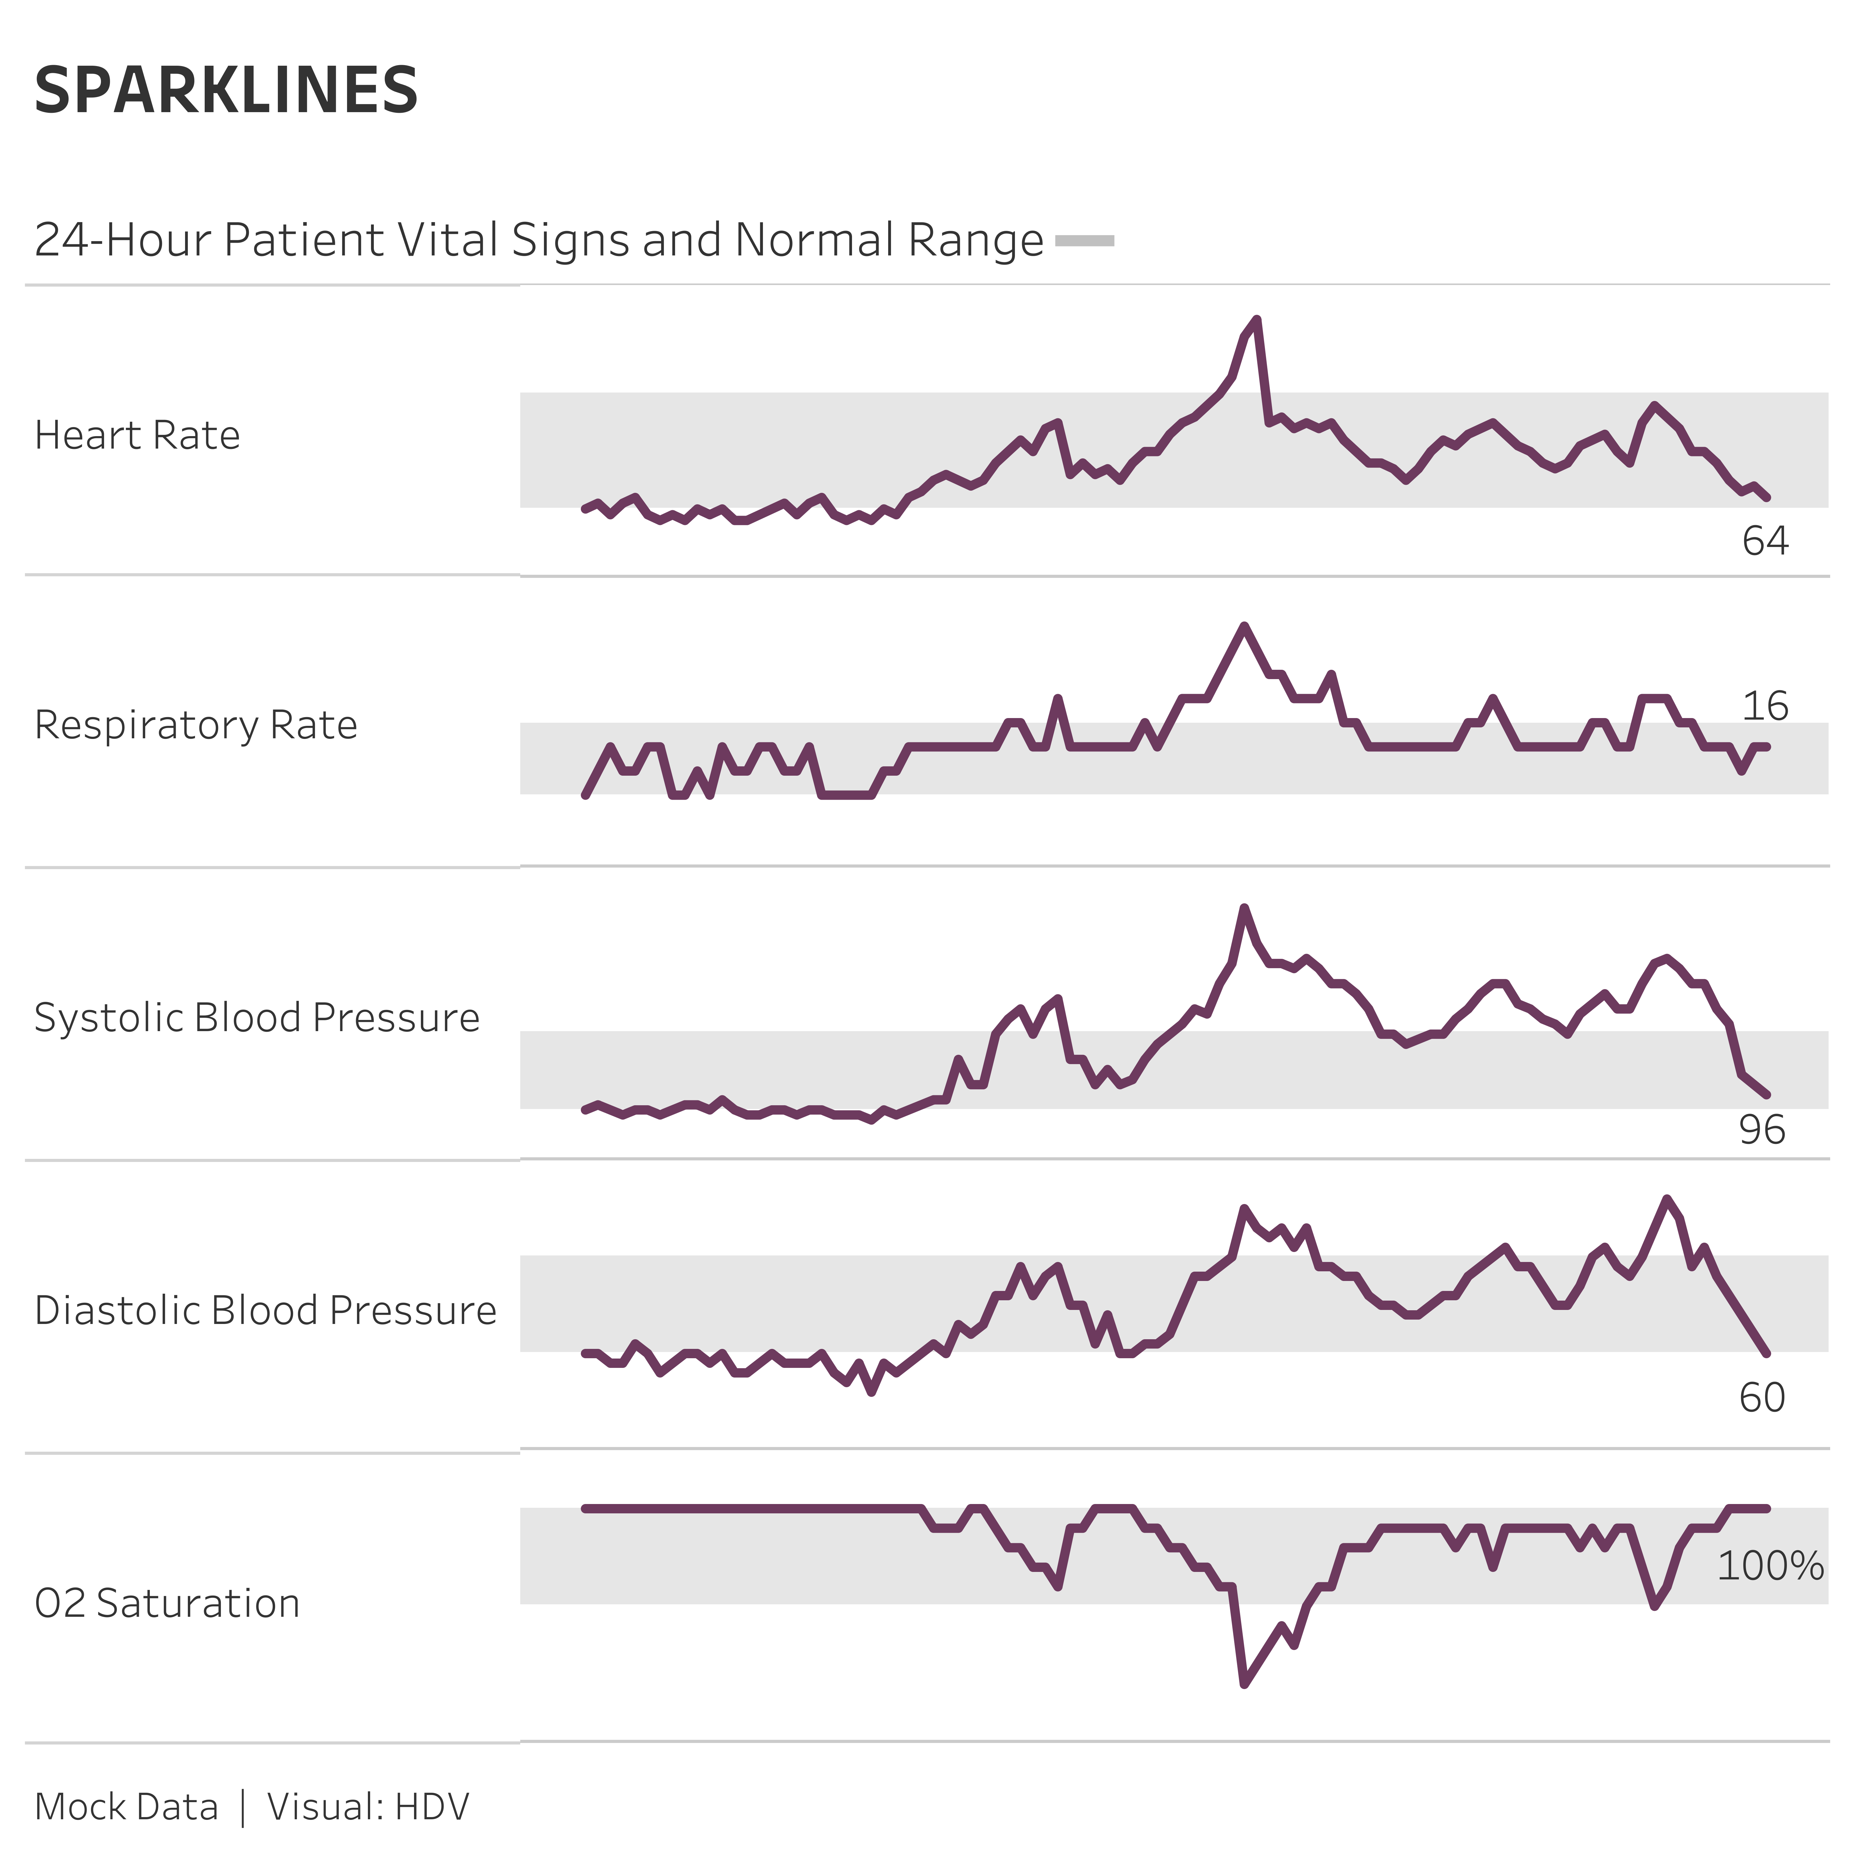
Change over Time – Sparklines
Created by Edward Tufte:
“These little data lines, because of their active quality over time, are named sparklines – small, high-resolution graphics usually embedded in a full context of words, numbers, images. Sparklines are datawords: data-intense, design-simple, word-sized graphics.”

Slide 82
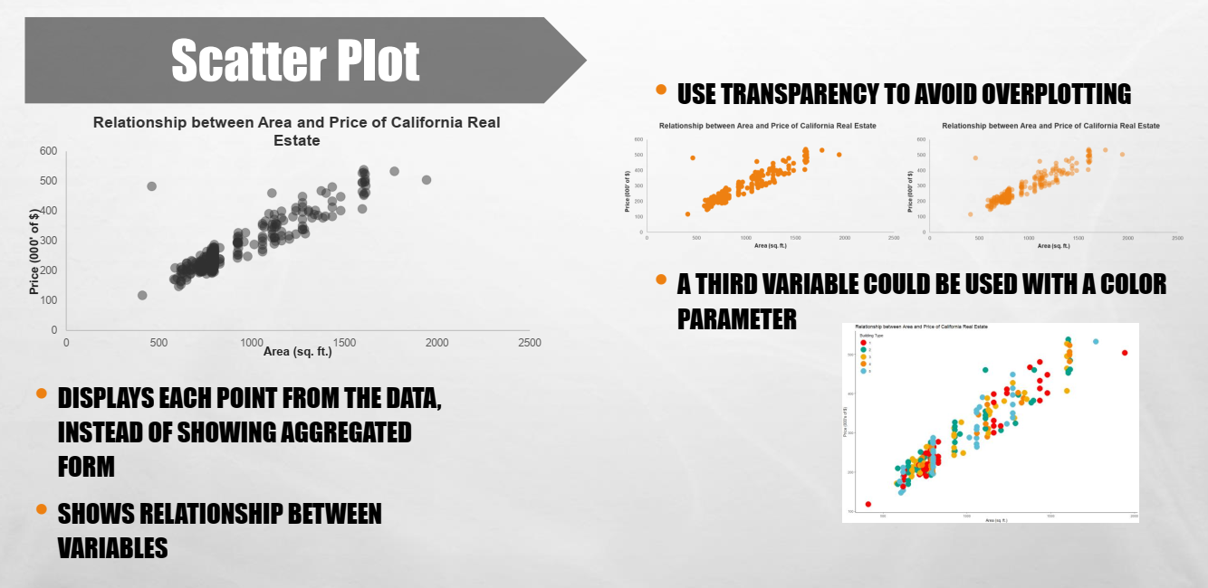

Slide 83
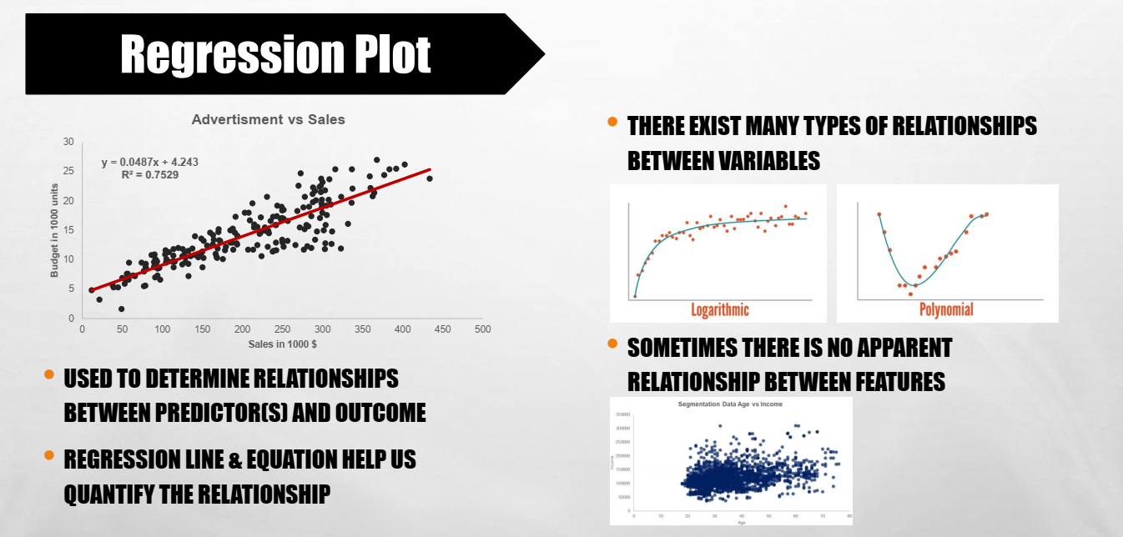

Slide 84
Citations
HTTPS://SEABORN.PYDATA.ORG/TUTORIAL/REGRESSION.HTML
^{HTTP://WWW.COOKBOOK-R.COM/}
HTTP://WWW.STAT.COLUMBIA.EDU/~TZHENG/FILES/RCOLOR.PDF
HTTPS://PYTHON-GRAPH-GALLERY.COM/100-CALLING-A-COLOR-WITH-SEABORN/
^{HTTPS://WWW.DATA-TO-VIZ.COM/}
^{HTTPS://COOLORS.CO/}
From Rome Reborn: The Vatican Library & Renaissance Culture, Library of Congress website. Accessed on 2/18/2012. http://www.loc.gov/exhibits/vatican/math.html
Few, Stephen (2007), Data Visualization: Past, Present, and Future, p.3
Wikipedia entry René Descartes, used under the Creative Commons-Share Alike 3.0 Unported license. Accessed on 2/18/2012. http://en.wikipedia.org/wiki/Rene_descartes
Wikipedia entry Cartesian Coordinate System, used under the Creative Commons-Share Alike 3.0 Unported license. Accessed on 2/18/2012 http://en.wikipedia.org/wiki/Cartesian_coordinate_system
Wikipedia entry William Playfair, used under the Creative Commons-Share Alike 3.0 Unported license. Accessed on 2/18/2012 http://en.wikipedia.org/wiki/William_Playfair
Tufte, Edward R. (2001), The Visual Display of Quantitative Information, Second Edition, p. 9
Friendly, Michael (2001), Gallery of Data Visualization, Electronic document, http://www.datavis.ca/gallery/, Accessed: 02/19/2012 22:20:39
Tufte, Edward R. (2001), The Visual Display of Quantitative Information, Second Edition, p. 40
Bertin, Jacques (1983), Semiology of Graphics, English translation by William J. Berg, pp. 42, 65
Wikipedia entry Exploratory Data Analysis, https://en.wikipedia.org/wiki/Exploratory_data_analysis
Wikipedia entry Edward Tufte, used under the Creative Commons-Share Alike 3.0 Unported license. Accessed on 2/19/2012. http://en.wikipedia.org/wiki/Edward_Tufte

