Slide 1


DATA-DRIVEN ENERGY & CLIMATE NTELLIGENCE FOR
PAKISTAN

Slide 2
WHO WE ARE?
Renewables First (RF) is a think tank for energy and environment. Our work addresses critical energy and natural resource issues with the aim to make energy and climate transitions just and inclusive.
Toiled in a plethora of challenges, decarbonization and energy transition remains a low priority for the World’s fifth largest population in Pakistan. RF is leading energy transition coalitions, incubating organizations & networks and cooperating with existing local think tanks and civil society organizations to drive the energy transition, through collaboration and complementarity across all geographic levels.
As Pakistan’s only dedicated energy transition think- and do- tank, Renewables First’s uniqueness lies in our approach towards driving the energy transition. By emphasizing inclusivity and immediate action, we are positioned to drive change that is both sustainable and equitable. By leveraging partnerships and data-driven research, we identify, promote, advocate and communicate evidence-based, viable solutions that are tailored to the needs of the country.
Explore more about us:
https://renewablesfirst.org/

Slide 3
THE DATA CHALLENGE IN PAKISTAN’S ENERGY & CLIMATE LANDSCAPE
Without an integrated data system, progress toward national energy transition and climate goals cannot be effectively monitored or achieved.
Energy data remains fragmented and siloed, dispersed across multiple agencies with limited coordination.
Lack of integrated, transparent data systems makes it difficult to monitor progress toward national energy and climate objectives.
Inconsistent reporting frameworks hinder comparative analysis and long-term planning.
Decision-making often relies on incomplete or delayed information, slowing the clean energy transition.
Without a unified evidence base, Pakistan may struggle to achieve its energy and power sector goals and broader climate commitments under the Paris Agreement.

Slide 4
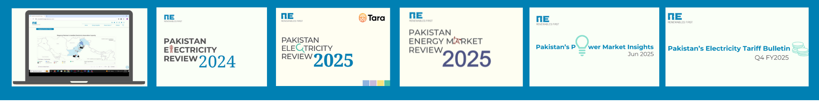
BUILDING A UNIFIED ENERGY DATA ECOSYSTEM
Pakistan’s energy transition depends on creating a centralized, transparent data ecosystem that bridges institutional silos and supports informed decision-making.
Pakistan’s energy transition demands timely, transparent, and interoperable data to guide investment and policy.
A centralized platform can bridge institutional silos and provide a shared evidence base for all stakeholders.
Data integration and visualization enable faster, insight-driven decisions aligned with national priorities.
To bridge this gap, RF launched a suite of analytical products that deliver regular reviews of Pakistan’s power and energy sector, track monthly data to capture evolving trends, and make all datasets publicly accessible through the Pakistan Energy and Climate Insights (PECI) dashboard.

Slide 5


TRANSFORMING ENERGY DATA INTO DECISIONS
Pakistan’s energy data was long scattered across reports and files, limiting analysis and decision-making. RF’s Pakistan’s first Energy & Climate Insights (PECI) dashboard unifies 20 years of fragmented data into one platform, using automated analytics and interactive visuals to power informed, data-driven decisions across the energy sector.
Tools used:
Python,
Tableau prep
Tableau
Web applications
https://peci.renewablesfirst.org/

Slide 6
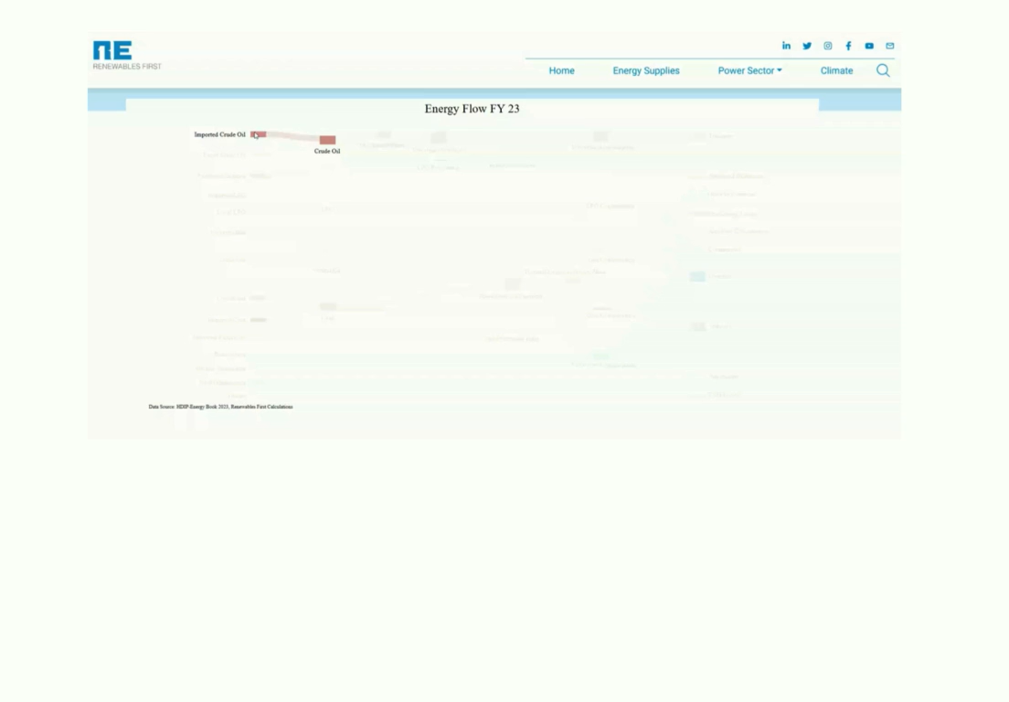


PAKISTAN ELECTRICITY REVIEW : A DATA-DRIVEN LOOK AT THE POWER SECTOR
The Pakistan Electricity Review (PER) offers a data-driven exploration of Pakistan’s power sector. Using innovative storytelling and interactive visuals like a Sankey diagram, it unpacks key trends in electricity generation, renewable energy growth, and infrastructure progress.
Find the study here
Find the study here

Slide 7
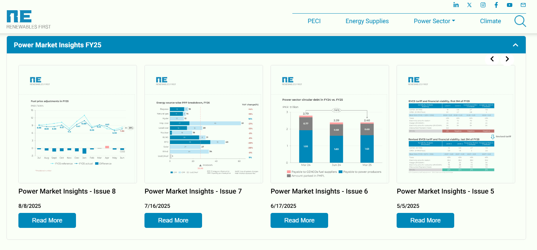
POWER MARKET INSIGHTS: CONNECTING DATA ACROSS PAKISTAN’S ENERGY INSTITUTIONS
Integrated data pipeline: PECI aggregates power sector data from NEPRA, NTDC, CPPA-G, K-Electric, and other government sources.
Real-time tracking: Monitors trends in generation mix, fuel costs, tariffs, and circular debt through regular power market insights.
Data-backed decisions: Enables policymakers and analysts to interpret ongoing sector developments with evidence-based insights.
Click here for insights

Slide 8
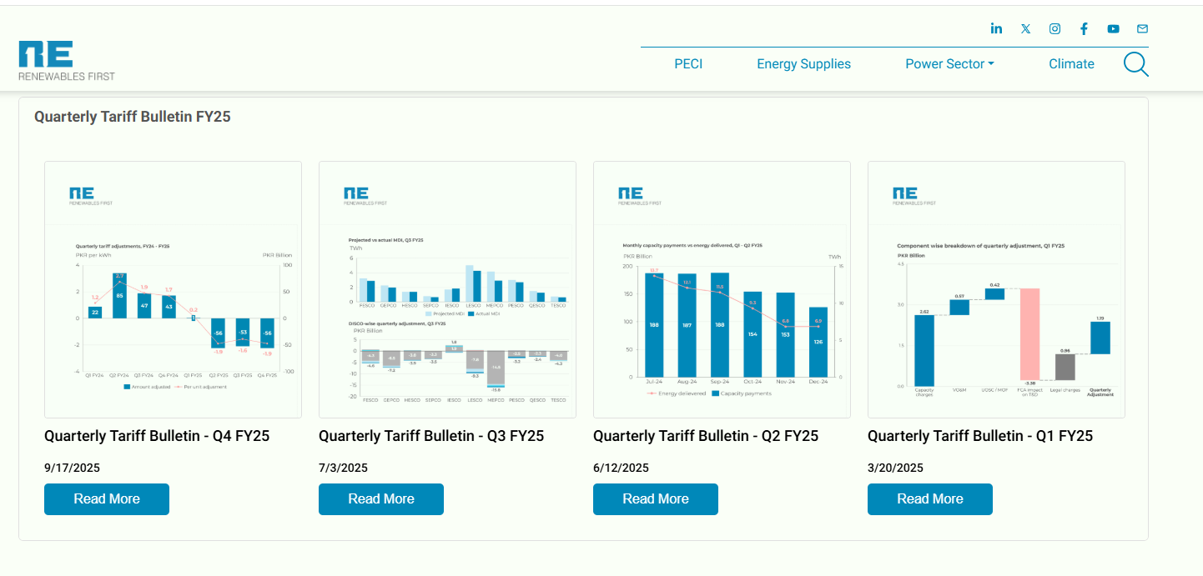
TARIFF BULLETINS: TRACKING ELECTRICITY PRICE DYNAMICS
Through regular data-backed electricity tariff bulletins we track changes in generation costs, fuel adjustments, and consumer tariffs.
Enables users to compare historical and current tariff trends.
Supports data-driven analysis of electricity pricing, fuel cost variations, and their impact on consumers and on the power sector.
Click here for bulletins

Slide 9

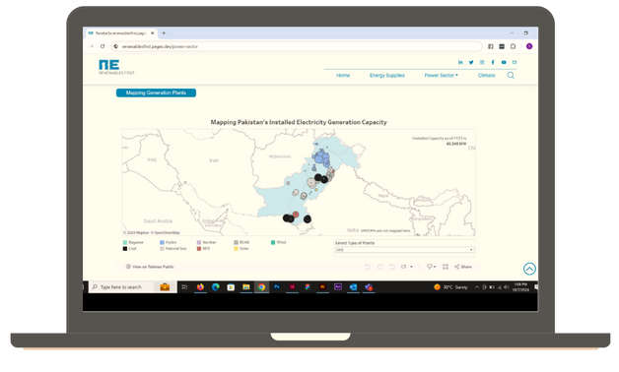


For more power sector-related insights, visit:
Pakistan Energy and Climate Insights Dashboard
www.peci.renewablesfirst.org
PECI, an initiative of Renewables First, is an innovative platform that consolidates fragmented energy data from various agencies, supporting informed decision-making across Pakistan's energy sector. By centralizing critical energy and climate data, PECI improves accessibility and clarifies environmental impacts and emissions for stakeholders. RF's collaboration with Herald Analytics led to the development of the PECI Dashboard, which drives insights and offers robust analytics for energy data.
Pakistan Electricity Review 2025
https://uploads.renewablesfirst.org/Pakistan_Electricity_Review_2025_80753f62aa.pdf
The Pakistan Electricity Review 2025 report aims to improve technical accessibility and awareness of critical aspects of power generation, transmission, and consumption. It presents a comprehensive analysis of key trends and challenges that shaped Pakistan’s power sector during the fiscal year 2024 (FY24). The report utilizes publicly available data for the power sector, with NEPRA’s state of industry report (SIR) serving as a primary data source.

Slide 10

Renewables First (RF) is a think tank for energy and environment. Our work addresses critical energy and natural resource issues with the aim to make energy and climate transitions fair and inclusive.
10 - 11, 3rd Floor, Executive Complex,
G-8 Markaz, Islamabad
+92 51 - 8773676
info@renewablesfirst.org

