Slide 1





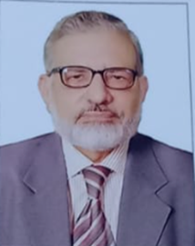
"اعداد کی زبان، ترقی کا نشان"
D1S2W1: Mr. Muhammad Younis
EX-PRINCIPAL TRAINING WING, PBS

Slide 2
Topic & Key Points
Topic : “Salient Features of Official Statistics”
Key Points:
Official Statistics.
National Statistical System(NSS).
Key Players of the National Statistical System of Pakistan.
Contribution of Various Organs of (NSS) for development of Statistics in Pakistan.

Slide 3
Chair Person:
Dr. Babar Wasim, Consultant, ADB.

