Slide 1

DataBridge: Making data a co-decision-maker
EasyData
make data a co-decision maker
Statistics and Data Services Department

Slide 2


DataBridge: Making data a co-decision-maker
Roadmap
Central Bank: Objectives and Functions
Importance of data
EasyData
Data Coverage
Features
Recent Enhancements
Walkthrough
Q/A Session

Slide 3



DataBridge: Making data a co-decision-maker
State Bank of Pakistan: Objectives
Price Stability
Financial Stability
Support to govt. policies for economic growth

Slide 4






DataBridge: Making data a co-decision-maker
State Bank of Pakistan: Functions
Monetary Policy Conduct
Banking Regulations
Lender of the last resort
Currency Management
Banking Supervision
Banker to the Government

Slide 5


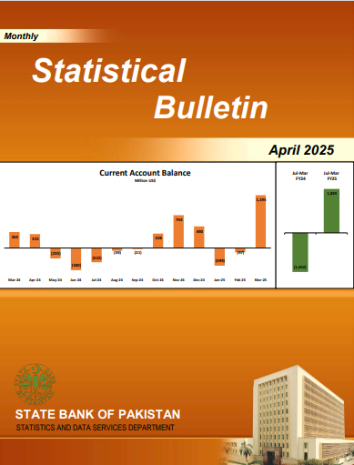



DataBridge: Making data a co-decision-maker
State Bank of Pakistan: Functions (contd.)
Financial Inclusion
Payment Systems
Reserve Management
FX Management
Collection and Production
of Statistics - Section 4 C (f)
of SBP Act, 1956.

Slide 6


DataBridge: Making data a co-decision-maker
Why do we compile data?
For assessment of the state of economy, policy formulation/decision making, policy evaluation, impact assessment.
Sharing data for informed decision making by the households, markets, academia, government, and international stakeholders

Slide 7
DataBridge: Making data a co-decision-maker
Data Compilation Standards
SBP follows IMF Manuals/ Guidelines on BoP/MFS/EDS and World Bank’s Guide on Workers’ Remittances for compilation of data on money, banking, finance, international trade, foreign investment, balance of payments and country’s debt and liabilities.

Slide 8

DataBridge: Making data a co-decision-maker
Traditional Data Dissemination
Traditionally, data was disseminated through print publications. In recent past we also started sharing data through SBP website in PDF as well as Excel.
The main pages are:
  Economic Data
  Publications

Slide 9
DataBridge: Making data a co-decision-maker
Limitations of Traditional Data Dissemination
Past publications are available in main libraries only.
Data on website is available in different formats (such as pdf, Excel, Word etc.)
Lack of a centralized data repository
Non-interactive user interface on EcoData page
No dashboard available
No machine to machine communication possible

Slide 10
DataBridge: Making data a co-decision-maker
Moving the Next!
EasyData is the solution to address above issues and to fulfil needs of today and tomorrow.

Slide 11



DataBridge: Making data a co-decision-maker
https://easydata.sbp.org.pk

Slide 12


DataBridge: Making data a co-decision-maker
What is EasyData?
EasyData is an online data repository offered by the State Bank of Pakistan
EasyData has a user-friendly, intuitive and interactive interface to make “data access easier”

Slide 13








DataBridge: Making data a co-decision-maker
DataBridge
Data Sources
EasyData gives access to a wide range of historical and current data compiled by the State Bank of Pakistan and other official sources
Notes:
National Fertilizer Development Company : Dataset Name - Sales/offtake of Fertilizers
National Institute of Population Studies: Dataset Name - Distribution of Population by Age and Sex
IFS by IMF

Slide 14


DataBridge: Making data a co-decision-maker
The Goal
To make EasyData the most rich repository on timely and credible economic and financial data of Pakistan
EasyData unlocks the problem of data accessibility for its users, in a format that is understood by humans as well as machines

Slide 15
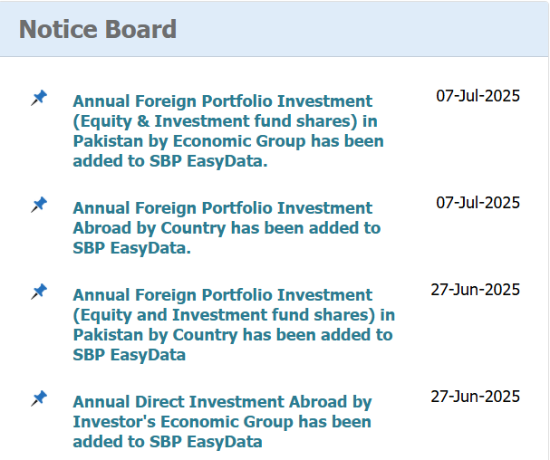
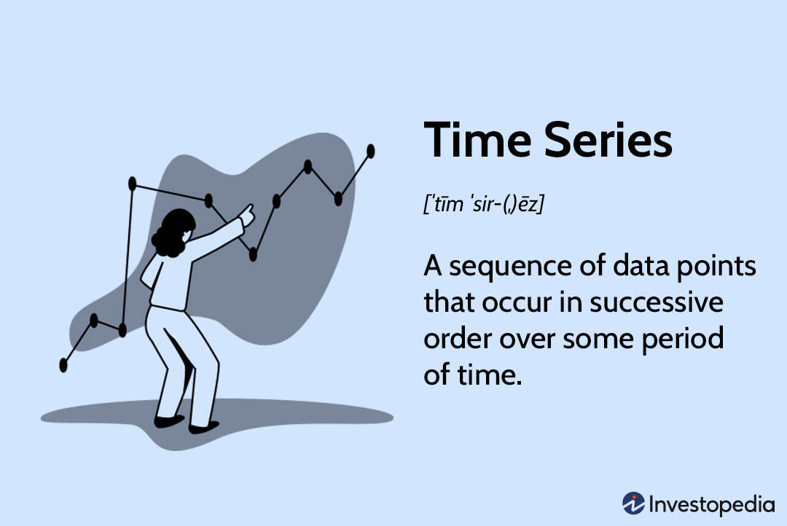
DataBridge: Making data a co-decision-maker
Time-series database
More and more datasets are being added gradually. You may check them on Home Page of EasyData.
EasyData offers a user friendly interface over a time-series database

Slide 16

DataBridge: Making data a co-decision-maker
Data Coverage
Most of the data compiled by SBP is included.
220+ datasets comprising of 23,000+ variables
The data is divided into various subjects:
  External Sector
  Monetary and Financial Sector
  Pakistan’s Debt Profile
  Interest Rate
  Real Sector
  Public Finance
  Social Sector Developments

Slide 17
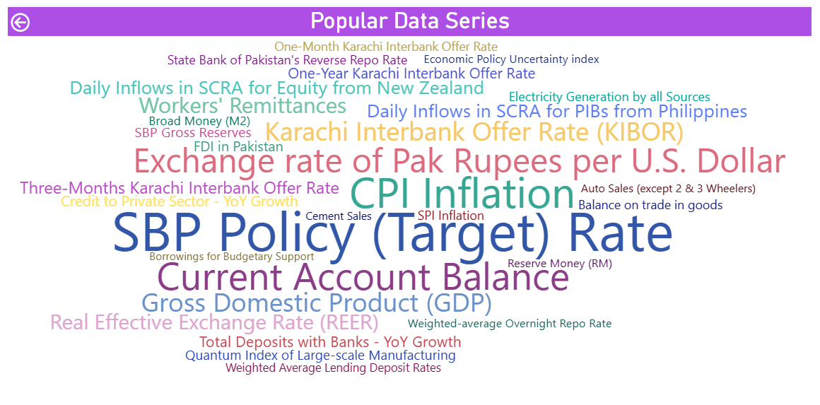
DataBridge: Making data a co-decision-maker
Most Searched Series

Slide 18
DataBridge: Making data a co-decision-maker
Features
  User friendly Search
  Datasets
  Data downloads at series and datasets levels
  Conversion of long format (more suitable for machine to machine reading) excel file to wide format (as is on SBP Economic Data Page)
  Updates on newly released data
  Snapshot on Key Indicators and My Indicators
  Chart views
  Personalized Data Basket
  API integration
  Interactive Charts and Topical Dashboards
  Email Subscription
  Past Archives and Related Datasets
  Useful help with:
    Frequently Asked Questions;
    Step-by-step How-To guide; and
    Developer Guide on how to use APIs

Slide 19
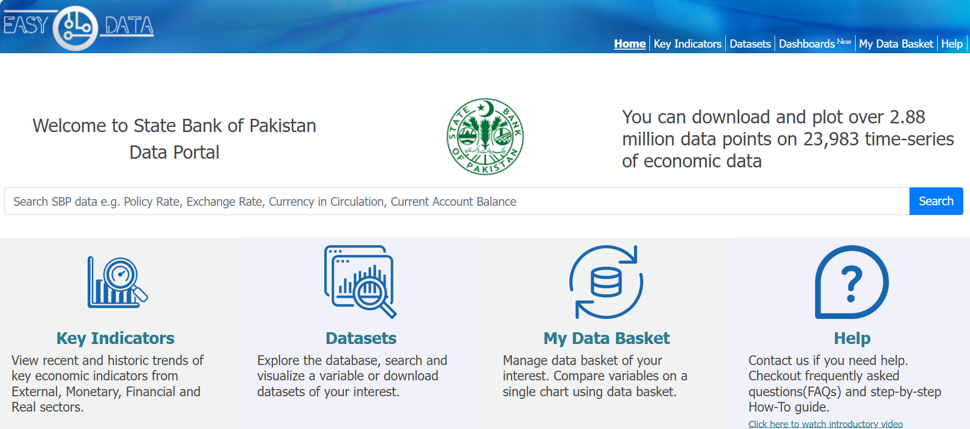
DataBridge: Making data a co-decision-maker
EasyData Walkthrough

Slide 20
DataBridge: Making data a co-decision-maker
Features: User friendly Search Bar

Slide 21
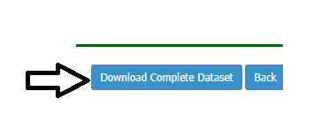

DataBridge: Making data a co-decision-maker
Features : Download Complete Data
Users can download a complete dataset in csv (long) format which can be converted into a wide format
Current and historical series of any variable can also be downloaded

Slide 22
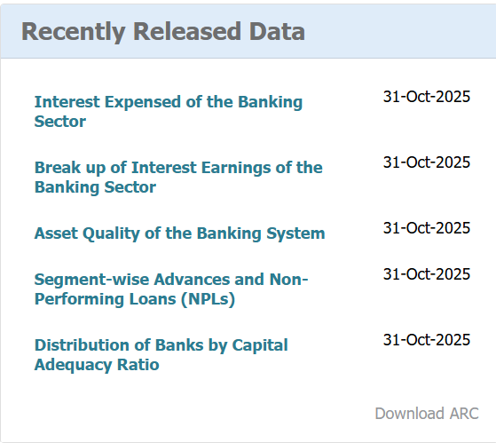
DataBridge: Making data a co-decision-maker
Features: Recently Released Data and Notice Board
Advance Release Calendar of SBP data.
The data that has been recently updated is also displayed on Home page.
Newly added datasets and other notifications are being displayed on Home page.

Slide 23
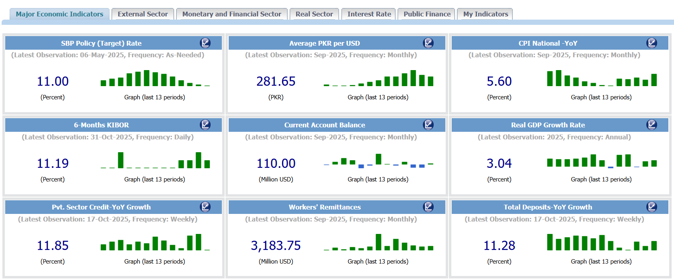
DataBridge: Making data a co-decision-maker
Features: Major Economic Indicators
Users can view important economic indicators at a glance and can also develop personalized dashboards consisting of set of indicators of his/her choice.

Slide 24
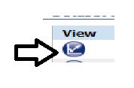
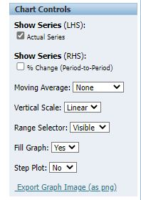

DataBridge: Making data a co-decision-maker
Features: Chart views
View charts for any series
Download a complete series
Date range selection
Useful chart controls

Slide 25
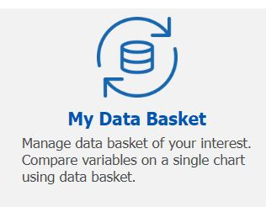
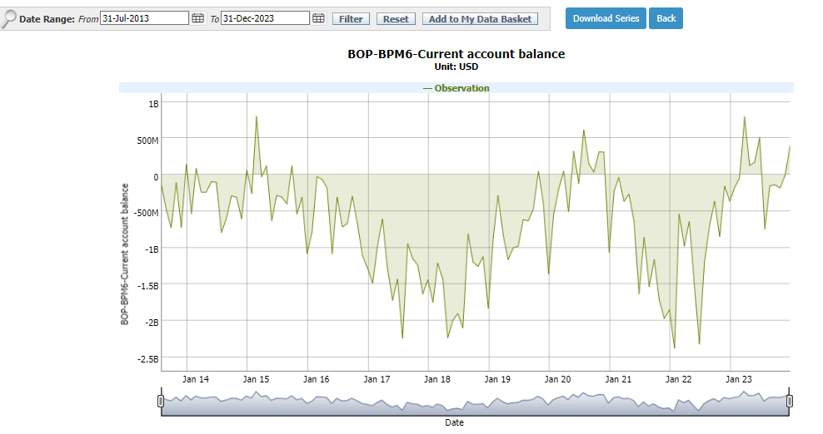
DataBridge: Making data a co-decision-maker
Features: My Data Basket
Customizable Data Basket for later retrieval
Interactive charts
Zoom-in/out
Area under the chart
Step/curve plot

Slide 26
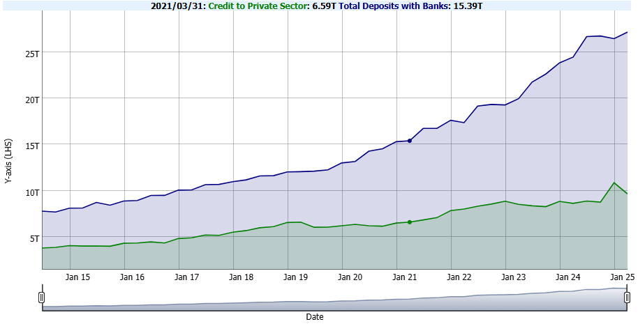
DataBridge: Making data a co-decision-maker
Features: My Data Basket
Comparison of two or more variables

Slide 27

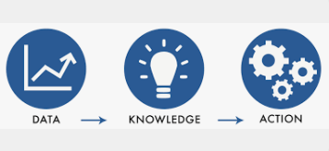
DataBridge: Making data a co-decision-maker
Features: APIs (Machine to Machine Integration)
APIs
Provides data in machine readable formats (csv and JSON)
Data can be directly exported to a software of your choice such R, Python, PowerBI, MS Excel etc.

Slide 28

DataBridge: Making data a co-decision-maker
Features: Interactive Dashboards

Slide 29




DataBridge: Making data a co-decision-maker
a data bridge…
Email subscription based notifications on new data releases
Recent Enhancements
Notice Board
Customizable dashboards for every user
Most viewed series and datasets

Slide 30




DataBridge: Making data a co-decision-maker
Other useful tips
FAQs
How To?
Contact Us
Disclaimer

Slide 31
DataBridge: Making data a co-decision-maker
We are happy
to address your
statistics related
queries on
SBP EasyData

Slide 32
DataBridge: Making data a co-decision-maker
Thank You

