Slide 1
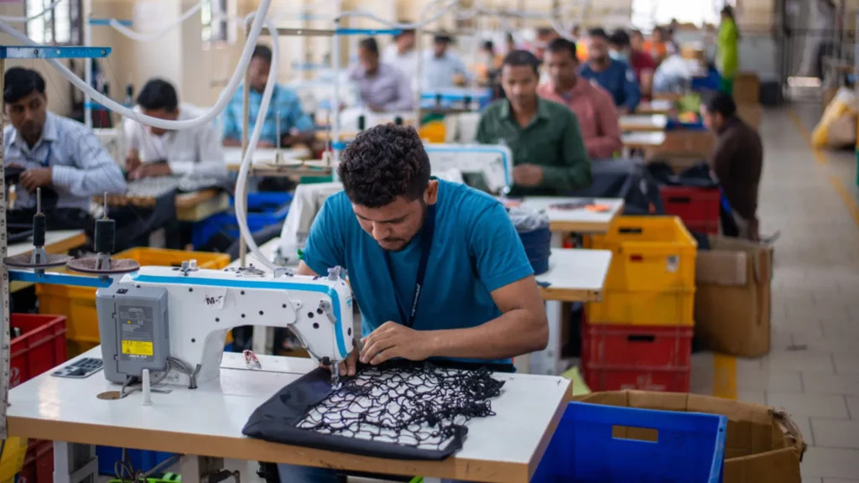

Challenges to Export Growth in the Textile Sector
PBS Data Fest
11th November 2025

Slide 2
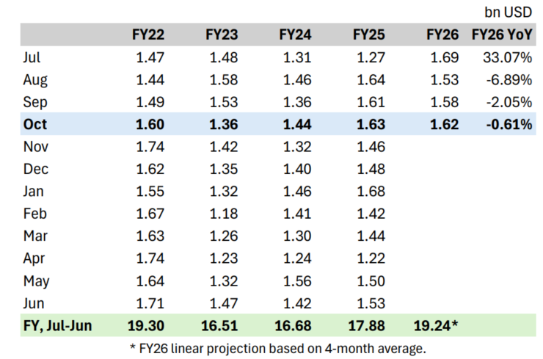
Context and Outlook
Textile and Apparel Exports
Pakistan’s textile industry, accounting for 60% of total exports, has faced severe volatility since FY22.
Exports peaked at $19.3 bn in FY22, fell to $16.5 bn in FY23; despite recovery in FY24-FY25, the overall trajectory is stagnant.
Installed capacity already supports $25 bn exports.
Realizing the government’s $30 bn target requires removing deep policy bottlenecks in taxation, energy, and finance, while encouraging investment in higher-value segments.

Slide 3
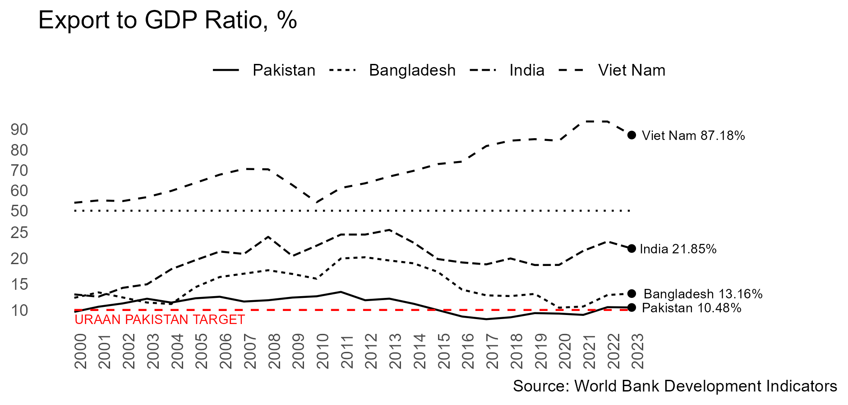

Slide 4
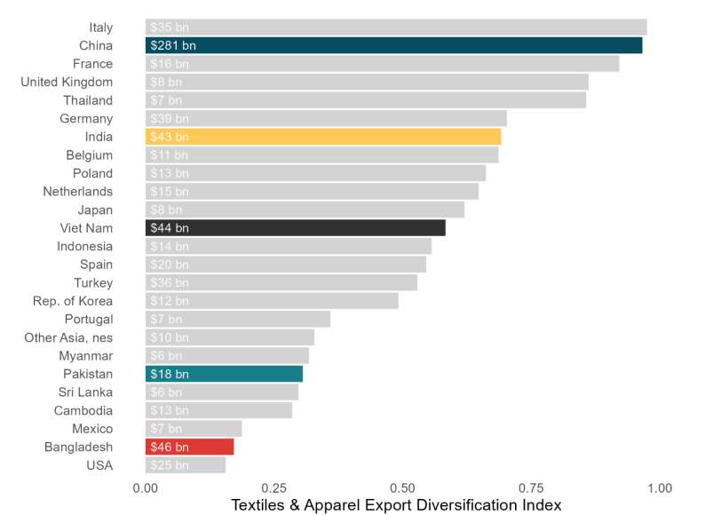
Low Export Diversification
Among the top 25 exporters of textiles and apparel, Pakistan has one of the least diversified export baskets.
Of 24,903 HS tariff lines related to textile and apparel, the top 87 tariff lines exported account for 50% of Pakistan’s exports compared to 838 for China, 237 for India and 99 for Vietnam.

Slide 5
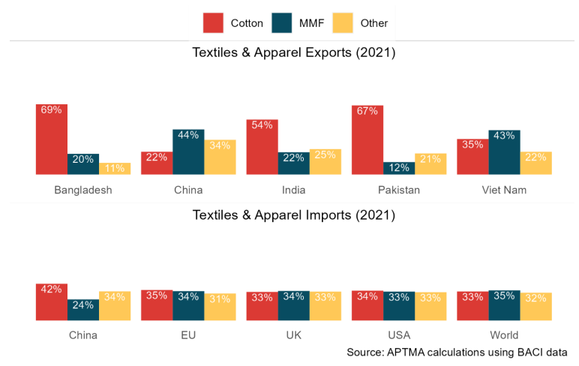
Export Structure: Stuck in Cotton
Over two-thirds of Pakistan’s exports are cotton-based, while the world market is now increasingly dominated by man-made fibers (MMF).
Dependence on cotton limits diversification, exposes exporters to climate and price shocks, and restricts entry into fast-growing synthetic apparel segments.

Slide 6
Value-added Exports Without Value Addition?
Despite export growth in value added segments, domestic value addition in exports is declining as upstream segments are unable to compete with imported inputs (cotton, yarn and fabric) due to energy and tax bottlenecks.

Slide 7
Dual-Track Growth Strategy
Pakistan must pursue a dual approach:
Restore competitiveness by correcting fundamental distortions such as prohibitive and distorted energy prices, and excessive taxation.
Enable diversification and investment through facilitation schemes like APTMA’s 1,000 Garment Plants Program and incentives for export diversification and growth.
Effort on both fronts is essential to unlock the sector’s true potential.

Slide 8
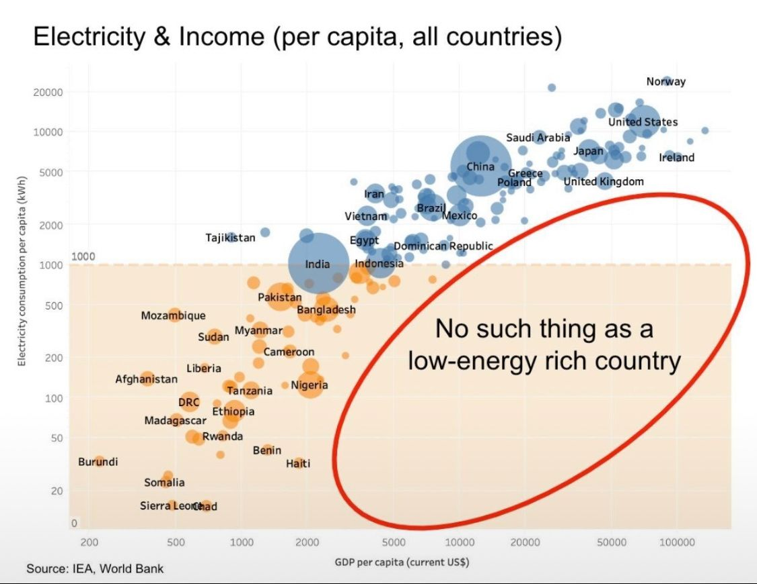
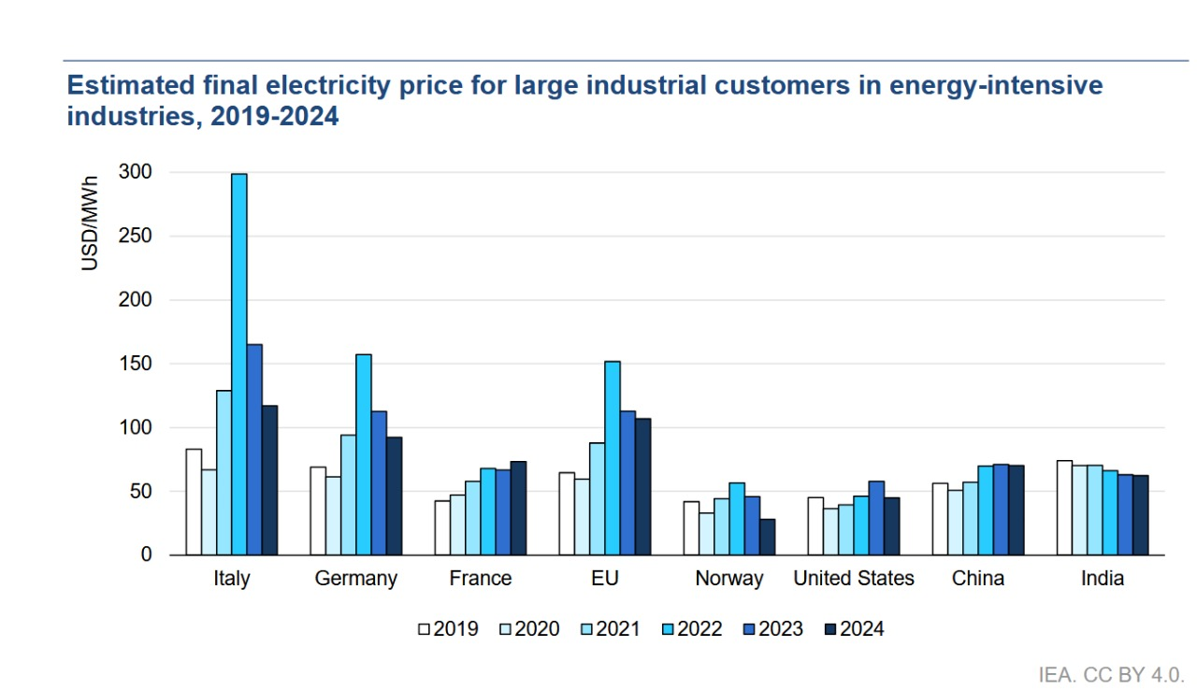
Energy: Pakistan’s Core Bottleneck
Pakistan, ~12.5 cents/kWh
Industrial electricity prices are one of the highest in the world.

Slide 9
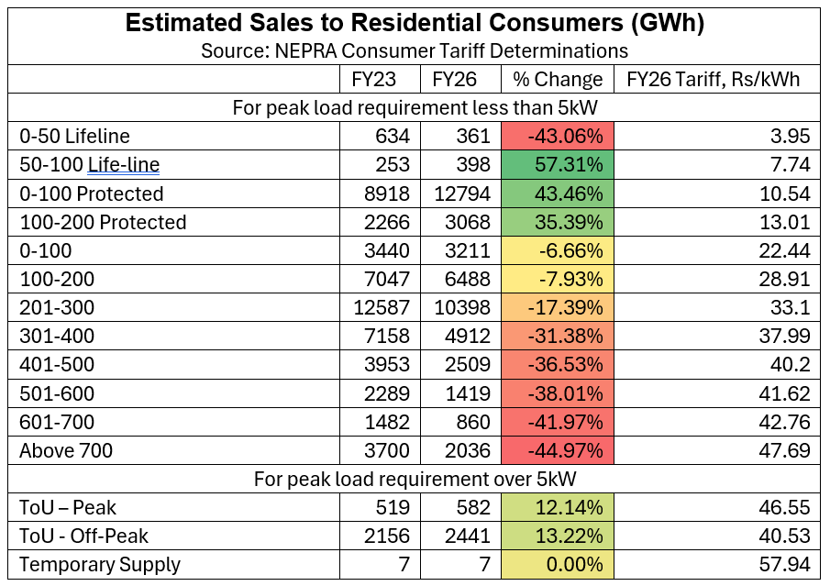
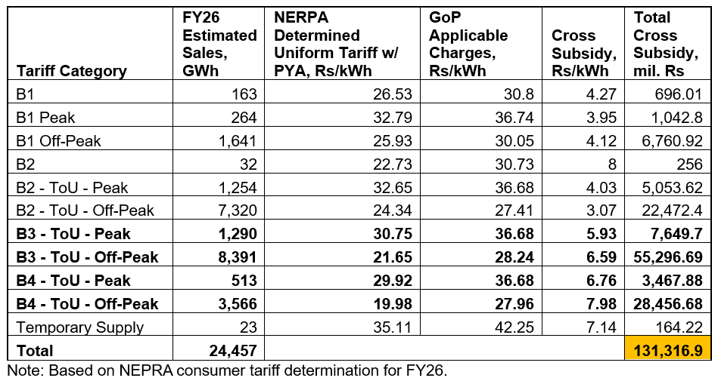
Cross Subsidies in Power Tariffs
A Rs. 131 bn cross-subsidy inflates tariffs by Rs. 6.5/kWh, inhibiting industrial competitiveness and demand for grid electricity.
Meanwhile, the quantum of cross subsidized consumption on the grid has grown unchecked.

Slide 10
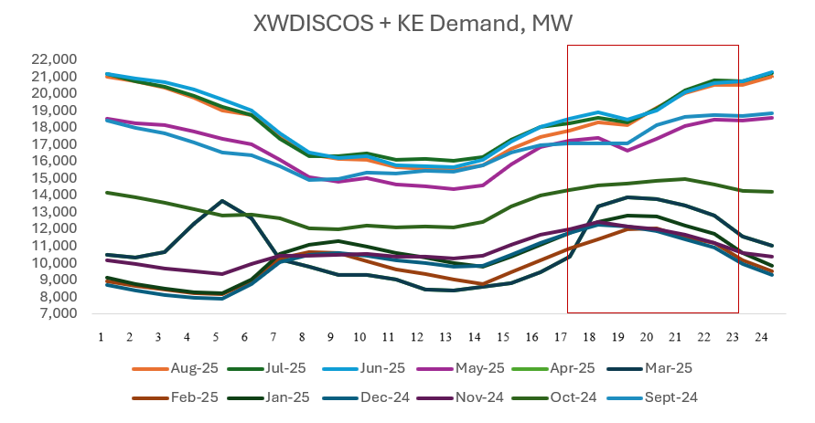
Peak Hours in a Power Surplus System
The current Time-of-Use (ToU) tariff regime for industrial consumers is outdated and counterproductive.
System data clearly demonstrates that the actual peak demand now occurs well outside the officially designated peak hours.
This renders the existing ToU tariff regime both economically and operationally irrational.

Slide 11
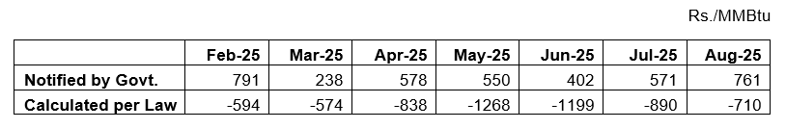
Levy on Gas for Captive Power Plants
The Government of Pakistan initially committed the outright elimination of gas supply to captive power plants under the IMF Agreement.
Subsequently, a punitive levy was introduced such that the final price of gas would take the cost of captive generation 10-20% above the grid electricity tariff.
The levy calculation is contrary to law, done to artificially inflate the it; calculated correctly the levy comes out negative.
  The peak rate of the B3 power tariff, which is applicable for only 4 out of 24 hours a day, has been taken while the off-peak rate, applicable for 20 out of 24 hours a day, is disregarded.
  Captive O&M cost is based on an 8-year-old tariff determination. Indexing it to CPI inflation and PKR depreciation increases it from Rs. 1.65/kWh to Rs. 4.31/kWh.
  The debt servicing surcharge is not a component of the NEPRA notified power tariff that is to be used as per law.

Slide 12
Impact of the Levy on Captive Power Plants
Eroded competitiveness of export-oriented units relying on high-efficiency combined heat and power (CHP) captive to meet their power and hot water/steam requirements.
  Must invest in gas boilers, with gas supplied at Rs. 2300/MMBtu, reducing overall production efficiency and increasing costs.
  Grid supply is also unstable, unreliable and unsuitable for sophisticated large-scale manufacturing; a single outage can lead to millions in production losses.
Resultantly, gas consumption for captive use has declined by up to 90% YoY, creating 200-300 mmcfd of surplus RLNG.
RLNG diversion to households at a recovery of ~$4/MMBtu, significantly below the delivered cost of ~$12 per MMBtu, results in a subsidy of ~$8 per MMBtu and is a major contributor to the gas sector circular debt, now exceeding Rs. 3 trillion.
Rs. 109 billion shortfall in gas sector cross subsidy against only Rs. 35 billion gains in power sector (also wiped out by demand shifting to on/off-grid solar).
The RLNG surplus has triggered curtailment of ~270 MMCFD of indigenous gas production, resulting in projected losses of ~$378 million to E&P companies, according to OGDCL.

Slide 13
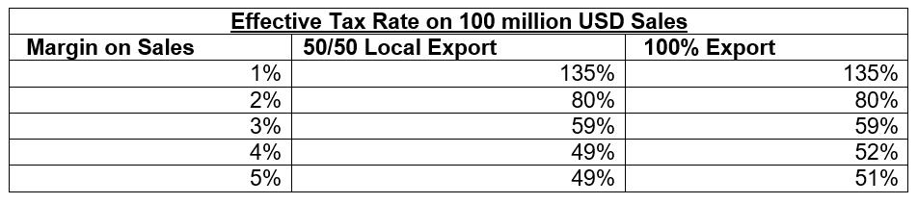
Double Advance Income Tax on Exports
Exporters are subject to double advance taxation under the fixed tax regime (1% of export proceeds, plus 0.25% export development surcharge) and the normal tax regime (1.25% advance tax), adjustable against 29% income tax and up to 10% super tax.
Local businesses only face the 1.25% advance tax under normal tax regime.
This discriminates against exporters and eliminates the incentive to export across the economy by making it less profitable than selling domestically.
Exporters face advance tax rate of up to 135% of profits, creating a severe liquidity strain in terms of working and reinvestment capital as excess amounts become permanently stuck in refunds.

Slide 14
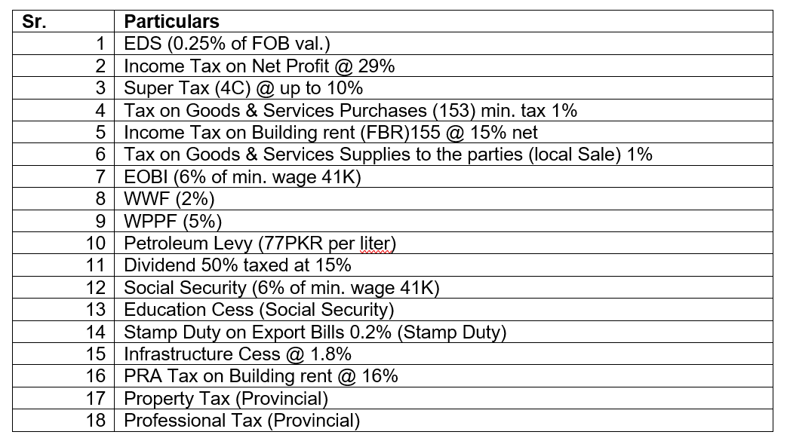
Cumulative Tax Burden
More than 18 federal and provincial levies consume 7–11% of turnover on profit margins of 6–15%.
Most are unrelated to exports, unlike competitor countries that refund such costs.

Slide 15
Other Issues
Interest rates
  With inflation at 3-5%, the prevailing policy rate of 11% is hindering investment and depressing business confidence.
Perpetually delayed sales tax and other refunds
  Over Rs. 330 billion pending on account of sales tax, deferred sales tax, duty drawback, income tax, DLTL/DDT/ TUF, mark-up subsidy, RCET differential and other refunds.
Mandatory traceability across the textile value chain
  The EU will begin requiring Digital Product Passports from 2027.
Revival of cotton production in Pakistan
  From around 15 million bales in 2014-15, Pakistan’s local cotton production has declined to 5-7 million bales per annum.
  Pakistani cotton has high trash and moisture content, making it unsuitable for exports.

Slide 16
Industrial, Export Processing and Commercial Zones
Current production capacity is capped at $25 billion and heavily concentrated in cotton-based textiles. Increasing capacity requires fresh investment and a conducive business environment
Industrial and Export Processing Zones
  1,000 new garment plants in plug-and-play industrial zones can add $5 billion in annual exports with over 500,000 new jobs.
Free Commercial Zones
  Designated areas offering tax exemption, simplified customs and bonded warehousing, and relaxed regulations to facilitate trade, cut logistics costs, attract local and foreign investment, and facilitate export growth.

Slide 17
Industrial, Export Processing and Commercial Zones
Working-Capital Financing:
  Access to affordable working capital is a key missing link in export competitiveness.
  Revamp the export financing scheme to ensure predictable and transferable credit across banks, expanded limits, and alignment with actual export cycles.
MMF Facilitation Package:
  Abolish duties on man-made fibers and introduce a targeted MMF Export Facilitation Package with rebates, concessional financing, and tax incentives can drive diversification into man-made fibers.
DLTL Rebate for Product and Market Diversification
  Reward exports of new products and to markets.
Have to say GOODBYE to the IMF first!

Slide 18
Thank you.

