Slide 1


1st MEETING OF THE COMMITTEE FOR RECOMMENDATIONS & ADOPTION OF BEST PRACTICES FOR UPCOMING CENSUS
14.01.2021

Slide 2

NOTIFICATION
  Competent Authority has been pleased to constitute the Committee for recommendations & adoption of best practices for upcoming population census:
Sl | Name & Designation
1. | Mr. Muhammad Jehanzeb Khan, Deputy Chairman Planning Commission | Chairman
2. | Mr. Muhammad Ahmed Zubair, Chief Economist | Member
3. | Mr. Muhammad Sarwar Gondal, Member (Support Services /RM) | Member
4. | Dr. G. M. Arif, Independent Researcher | Member
5. | Dr. Muhammad Nizamuddin, Independent Researcher | Member
6. | Representative of NADRA | Member

Slide 3
TERMS OF REFERENCE OF THE COMMITTEE
  To review the census process, data collection and field operation methodologies used for Census-2017 & recommend the modern methodologies being adopted for censuses in region & globe for conduct of upcoming census
  To compare the regional / globally adopted census questionnaires and proposals for improvement
  To review mode of Data Collection (Manual / Electronic) for provision of timely & credible results & recommendation for adoption of innovative tools & technologies for geo referred enumeration up to the household level for upcoming census

Slide 4
TERMS OF REFERENCE OF THE COMMITTEE
  To review the best practices of field operations including monitoring / supervision & data processing to minimize the omissions / errors and complete coverage
  To devise strategy for confidence building measures of all stakeholders for smooth completion of census operations and for increasing reliability & credibility of census results

Slide 5
AGENDA OF THE MEETING
Time | Description
03:00 – 03:05 PM | Recitation from The Holy Quran
03:05 – 03:20 PM | Introductory remarks and background of Committee | Mr. Jehanzeb Khan, DCPC
03:20 – 03:50 PM | Discussion on Term of Reference of the Committee
03:50 – 04:30 PM | Devising the way forward to proceed further
Any other item with the permission of the Chair

Slide 6
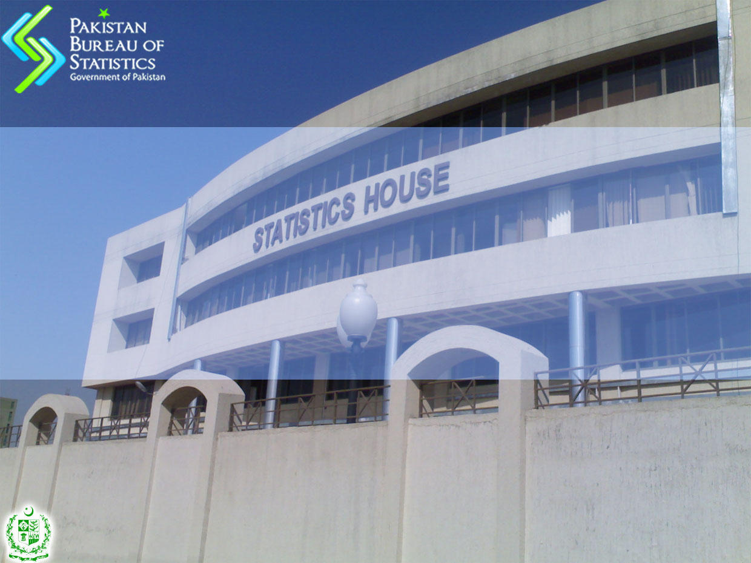
THANK YOU

